Slide 1
Cryptocurrencies:
A Brief Look
&
Sentiment Analysis
Alexander Fuller
Robert MacDonald
Matthew Nagel
Notes:
ROBERT

Slide 2
Presentation Overview
Project Scope / Introduction
Companies / Business Understanding
Data Understanding
Data Preparation / Process
Results
Final thoughts
Notes:
ROBERT

Slide 3
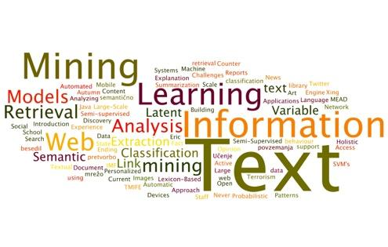
Introduction
Project Scope
Cryptocurrency vs. Companies
Sentiment analysis (News & Twitter)
Data Understanding
News Findings
Finals thoughts and useful extrapolation
Notes:
https://www.meaningcloud.com/wp-content/uploads/2015/09/Text-Analytics.jpg fdsaFALEXcurrency market giving us a reasonable assumption to conduct a Bubble anal

Slide 4
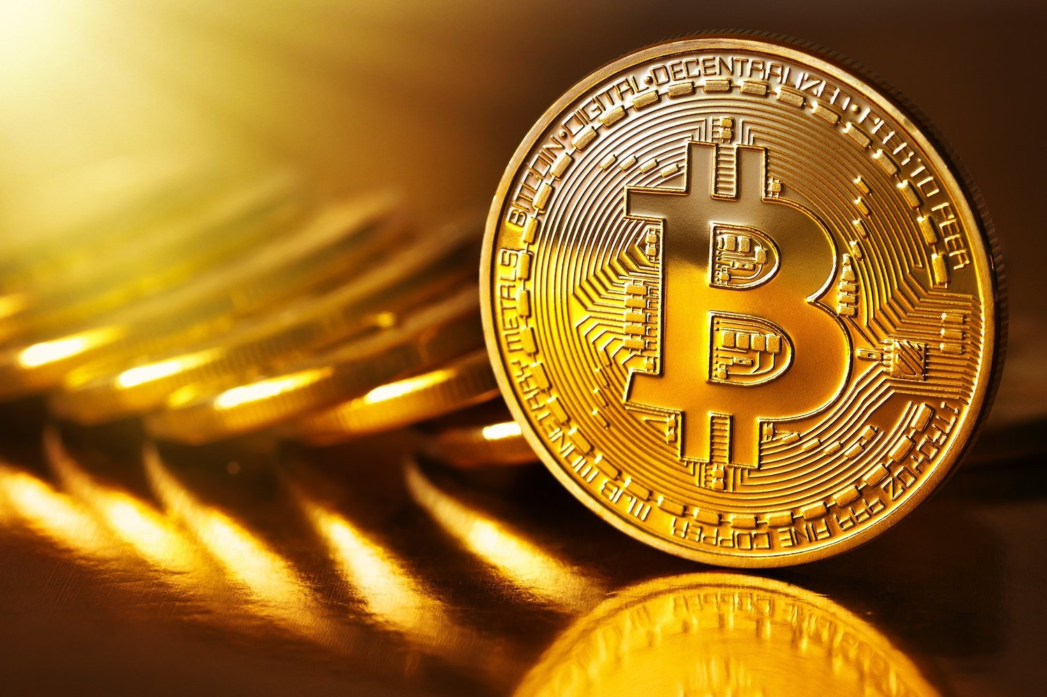
Business Understanding
Companies
Notes:
https://ethereum.org/images/wallpaper-homestead.jpg
https://vialogue.files.wordpress.com/2010/09/netflix-logo.png
https://media.coindesk.com/uploads/2017/03/bitcoin.jpg
www.financeqa.com/images/pnc-bank-online-banking-review.jpg
https://hamilton-bank.com/wp-content/themes/hamilton-bank/images/logo-mt-bank-ret.png
http://newsroom.unl.edu/announce/files/file73618.png
ALEX

Slide 5
Bitcoin
Created back in 2008, it has gone through phases of criticism and growth and recently breaking the ten thousand dollar mark as a traded stock. It started to gain momentum back in 2014 but recently the world has taken notice of the electronic currency.
The hype surrounding Bitcoin has many starting to believe it may be a bubble, so how does the hype around this cryptocurrency compare to the hype around other, more household companies?
Notes:
https://media.coindesk.com/uploads/2017/03/bitcoin.jpg
ROBERT

Slide 6
Business Understanding
Bitcoin
Bitcoin is a cryptocurrency, a digital asset designed to work as a medium of exchange that uses cryptography (practice and study of techniques for secure communication in the presence of third parties called adversaries) to control its creation and management.
Notes:
https://media.coindesk.com/uploads/2017/03/bitcoin.jpg
MATT

Slide 7
Data Understanding
Twitter
GOAL: produce sentiment “scores” based on the text found in a company’s Tweet
Weight these scores by retweet quantity
Start with Tweet collection on the 6 companies to have their own train and test sets
Training
Apply Aylien to train set in order to have Tweets labelled “positive”, “negative”, or “neutral”
Use labelled Tweets to train a classification model for each company
Testing
Apply the model to the test set
Compare sentiment patterns of each company, particularly against that of Bitcoin, to see what differences appear
Notes:
ROBERT

Slide 8
Data Understanding
Articles
GOAL: produce sentiment “scores” based on the text found in articles from two different websites.
Start with the 12 different article collections on the 6 companies
Lexicon Approach
Taking these articles and running them through a sentiment analysis process that determines sentiment scores based on a positive and negative lexicon.
Aylien
Running the same articles through Aylien’s analyze sentiment operator and picking out specifically the polarity. Lastly cross referencing it with the Lexicon approach above.
Notes:
MATT

Slide 9
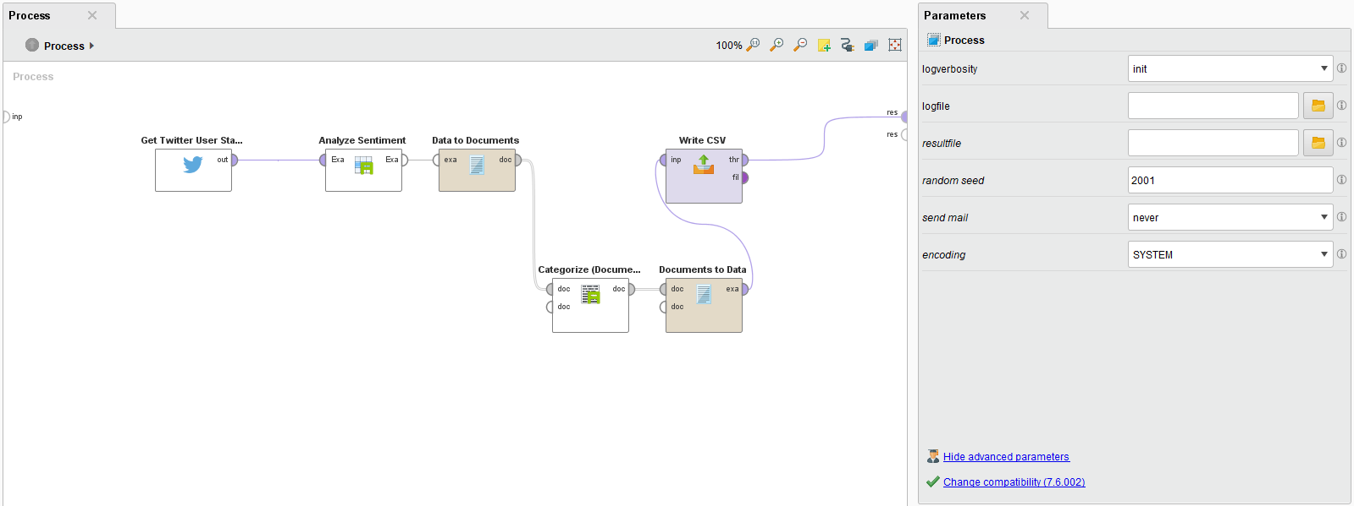
Data Preparation
Twitter
Gather 10,200 training data points
Use Aylien to add sentiment classification with meta confidence score
Eliminate anything below a 90% confidence level
Hand sorted the remaining data for strong points
Build cross validated machine learning model
Notes:
ALEX

Slide 10
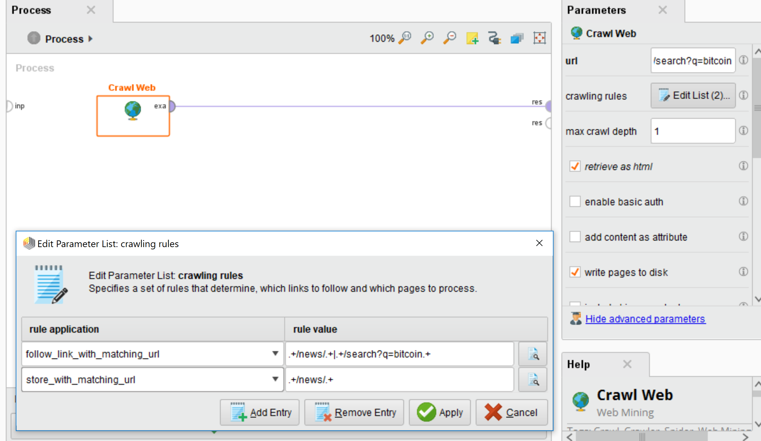
Data Preparation
News
Finding the News Sources (trial and error)
Once found searching each news site based on company
Once each correct seed page was found run web crawling
Run on both News sites for each company saving it to a different file.
Notes:
MATT

Slide 11
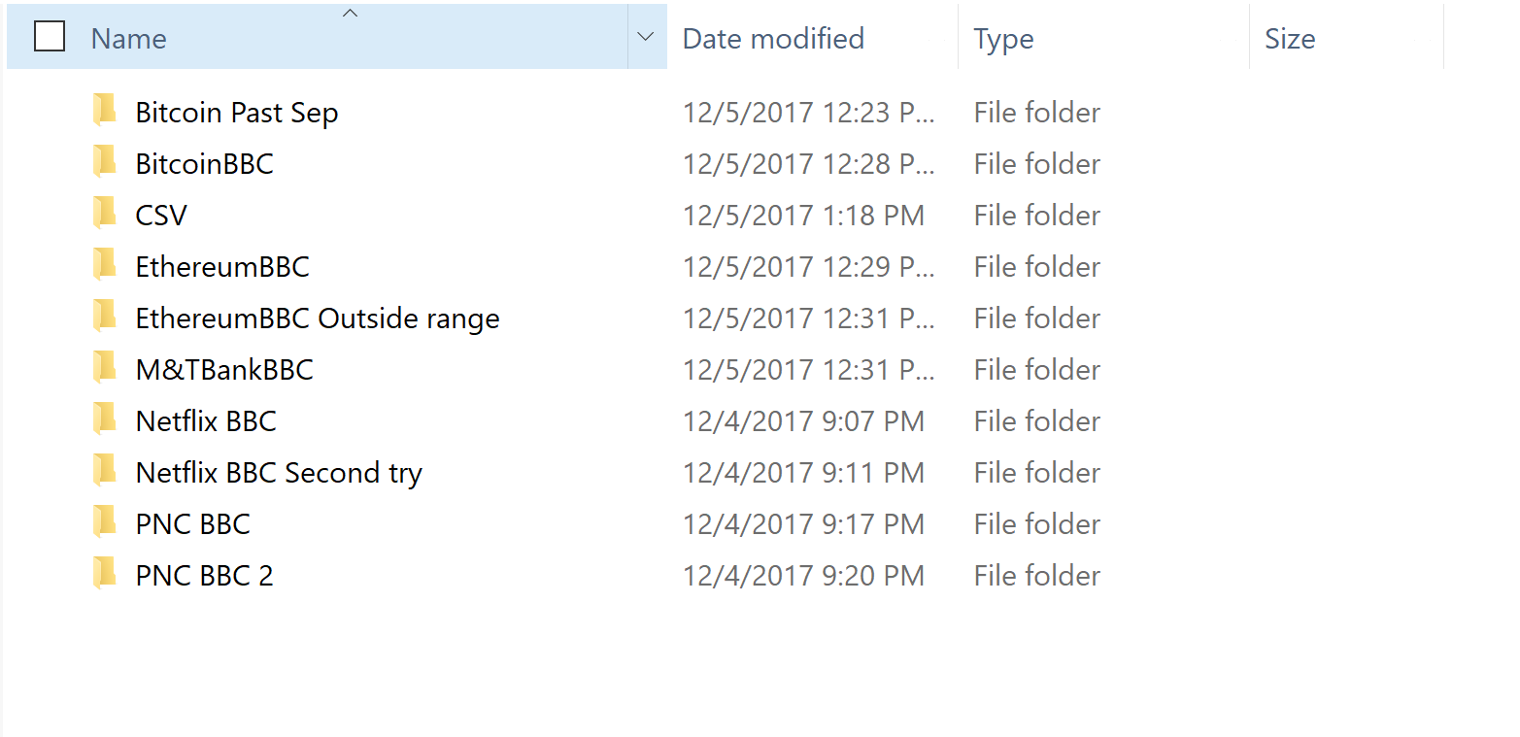
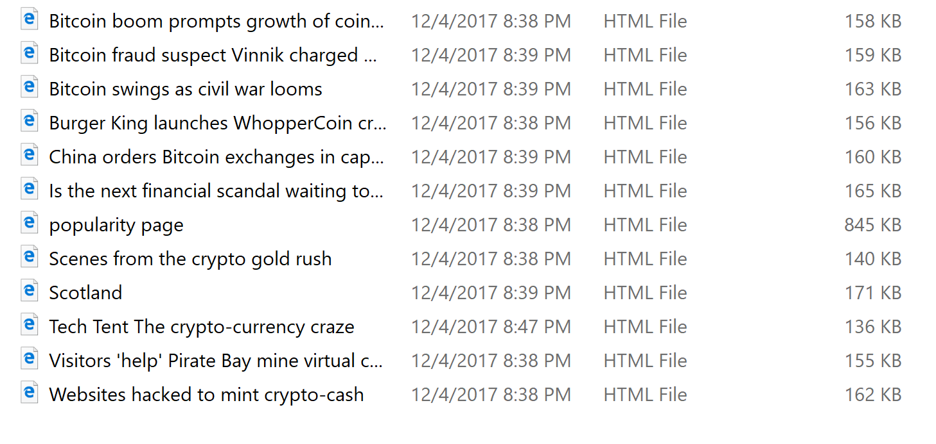
Data Preparation
News
Looking at the first few web pages and quickly reading them to make sure they are relevant pages.
Perform correct file management to have all the collected pages in one location labeled correctly.
Notes:
MATT

Slide 12
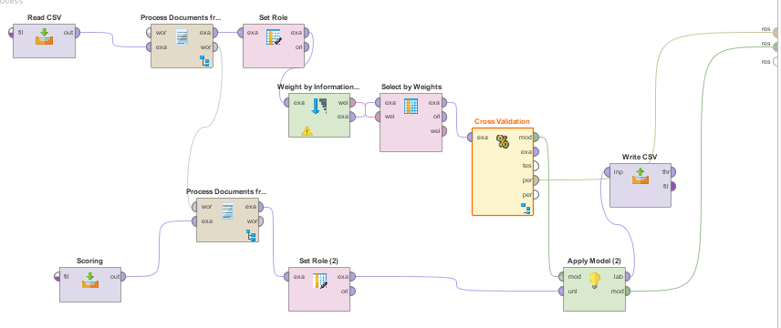
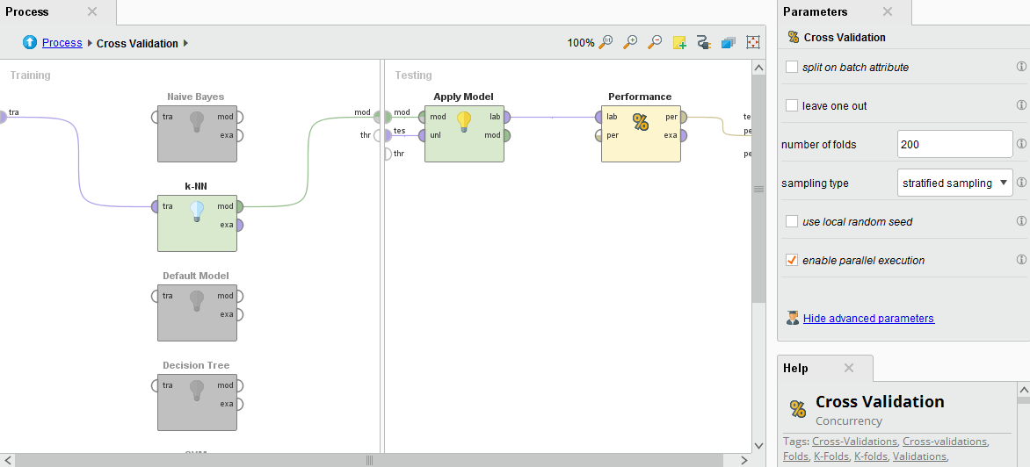
Process
Twitter
Each company had the same general process layout, just with different attributes along the way to optimize training accuracy
TRAINING
TESTING
CV OPERATOR
Final output was a tidy CSV containing that company’s TD matrix, plus each Tweet and its specific confidence score, retweet count, and class (positive, negative, or neutral) prediction
Notes:
ROBERT

Slide 13
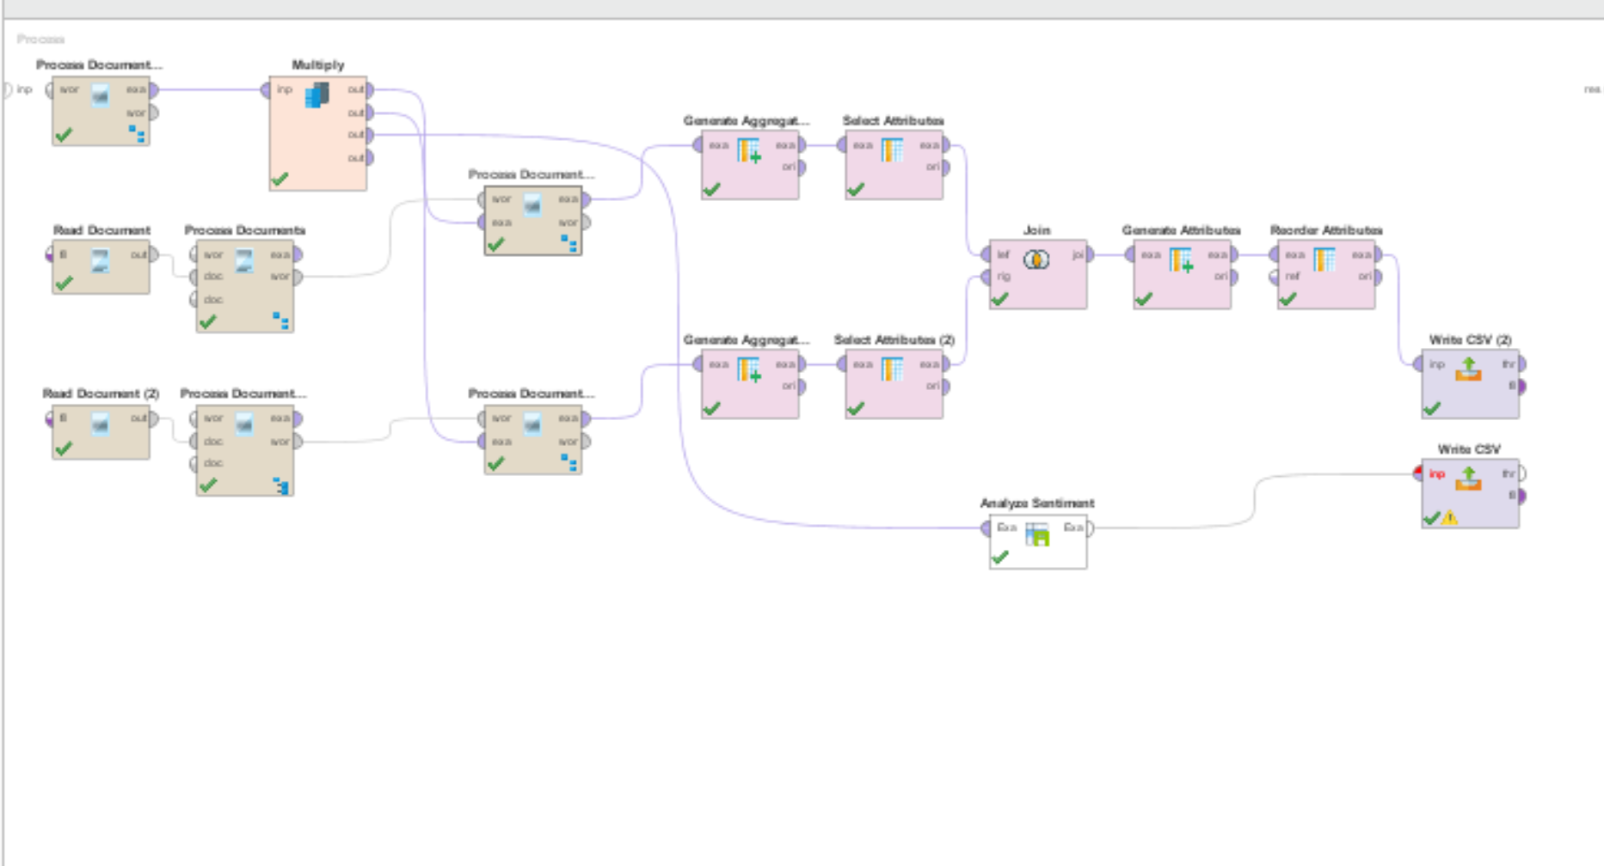
Sentiment Analysis Process
News
Each company over the two different new sources had its own process that all wrote one csv with the appended information outputted from the process.
Notes:
MATT

Slide 14
Results
The Sentiments found by Aylien and the Lexicon based approach discussed in class for the majority of the articles on business related topics were pretty closely related.
But as the scores narrowed in on zero it become less and less stable of a prediction.
For some of the cases the prediction ended up being incorrect.
Notes:
Matt

Slide 15
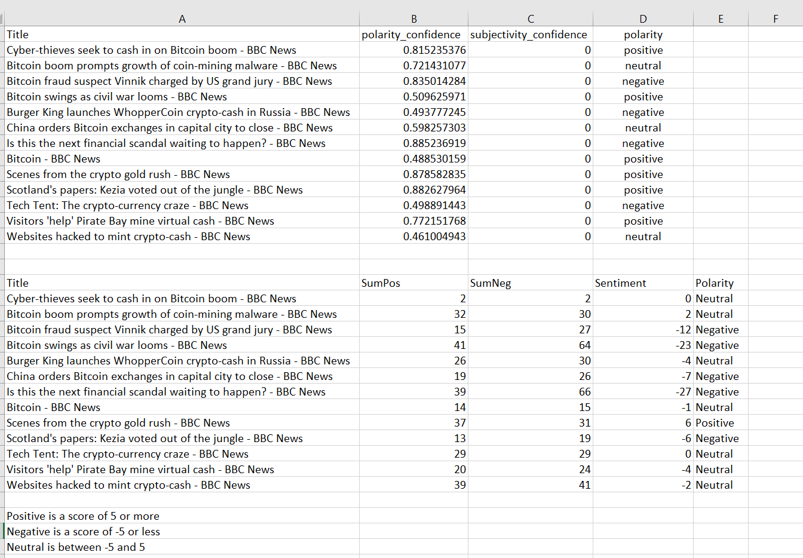
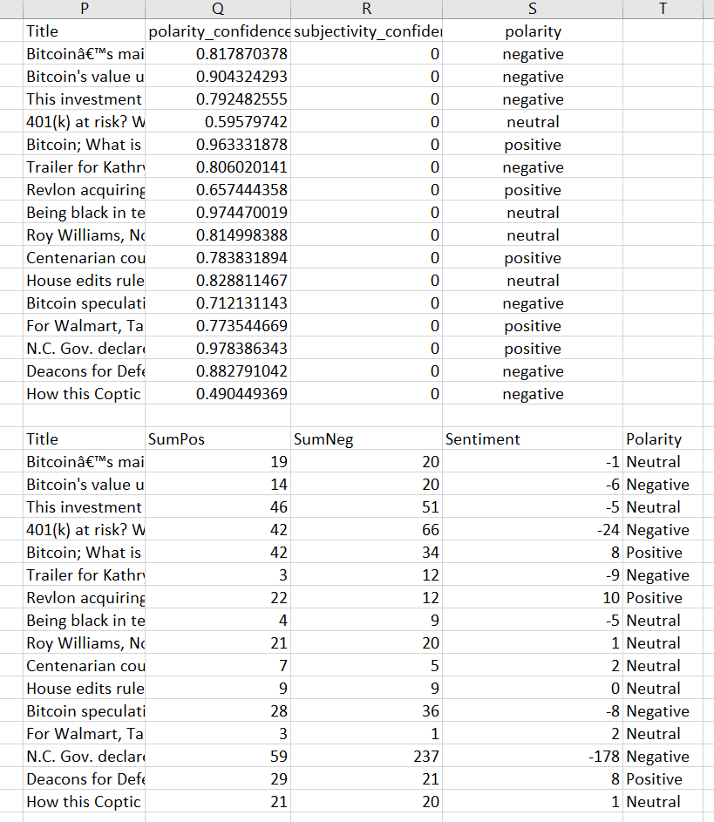
Results
Bitcoin BBC
Bitcoin USA Today
Notes:
Matt

Slide 16
Results
No significant relationship between S&P 500 and Twitter
Relationships between health care and IT
Significant relationship w/ Twitter and Bitcoin
t-score = 4.5, coefficient = 4.02
No ethereum relationship, due to timeline
Notes:
ALEX

Slide 17
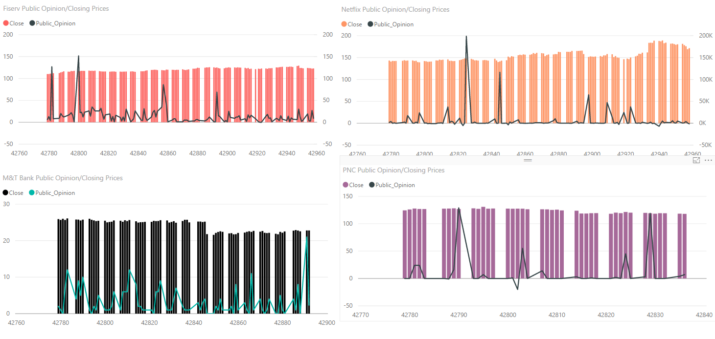
General Companies

Slide 18
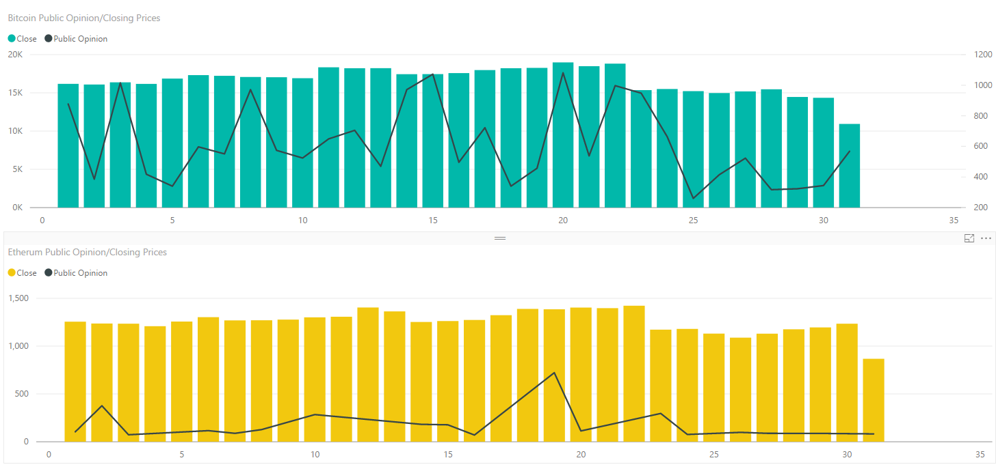
Crypto Companies

Slide 19
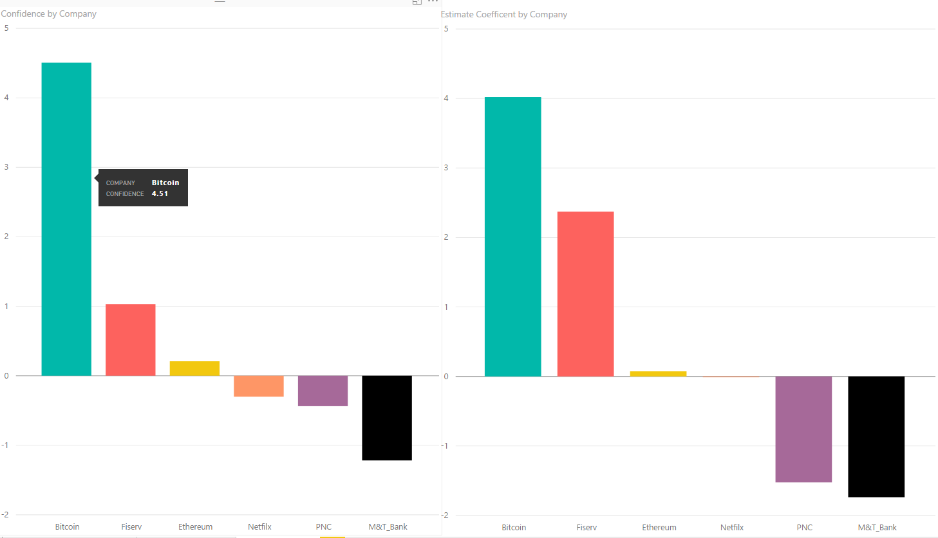
Coefficients and Support

Slide 20
Final Assertions
This should be continued until a market crash happens, analyze the sentiment to determine if there is a determining factor to mark the crash.
Analyze the sentiment of current and the crash to determine what attributes affect it most.
Use this to protect future investors.
Notes:
ALEX

