Slide 1
Earthquakes
Staff Assembly Earthquake Preparedness Training
USC Office of Fire Safety Emergency Planning

Slide 2
Earthquakes
Overall Earthquake Risk:
75 million Americans in 39 states face significant risk
Residents of California face the highest risk followed by Washington State
90% probability of a major earthquake in southern California in the next 20 years
Almost every area of the region will experience strong ground shaking at some point.

Slide 3
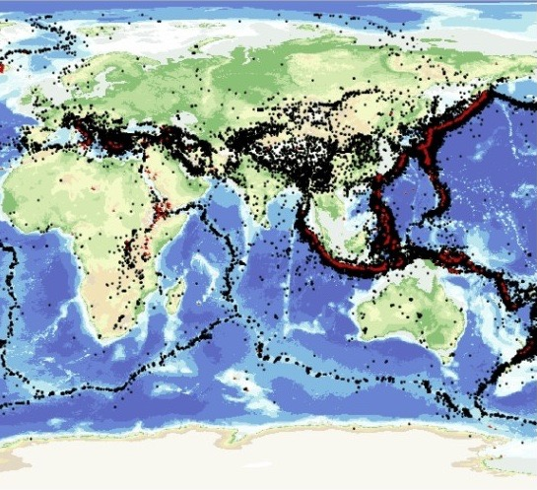
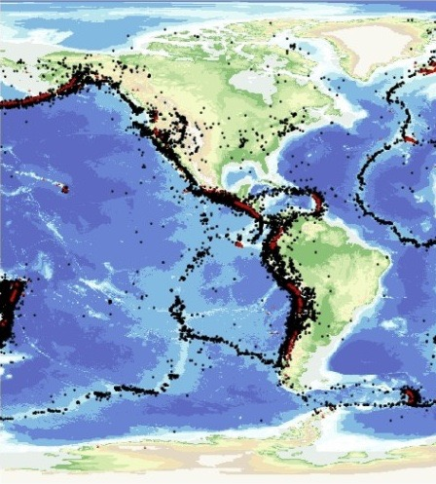
Earthquakes
Earthquakes happen all over the world, but especially along edges of the Earth’s tectonic plates (such as the West Coast of North America).

Slide 4
Earthquakes
Southern California has over 300 active faults

Slide 5
Earthquakes

Slide 6
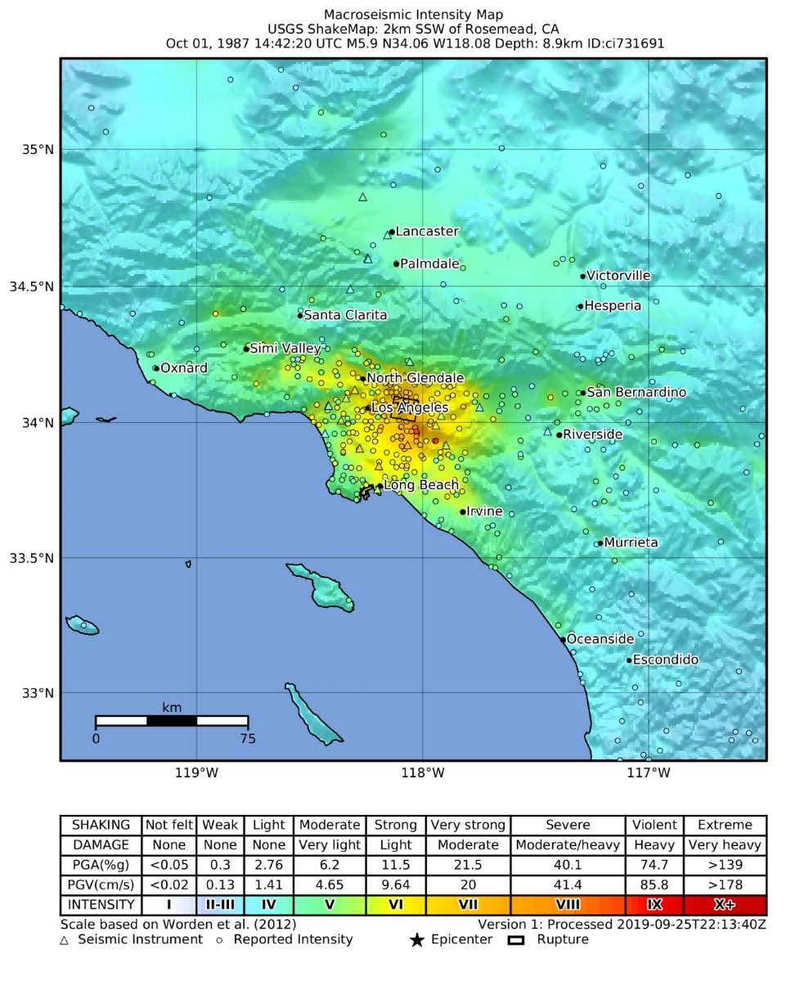
Earthquakes
1987 Whittier Narrows Earthquake Facts:
1987; 7:42 am
Magnitude 5.9
Strong shaking near epicenter
20 Seconds
8 deaths
Damage was estimated at 100 million

Slide 7
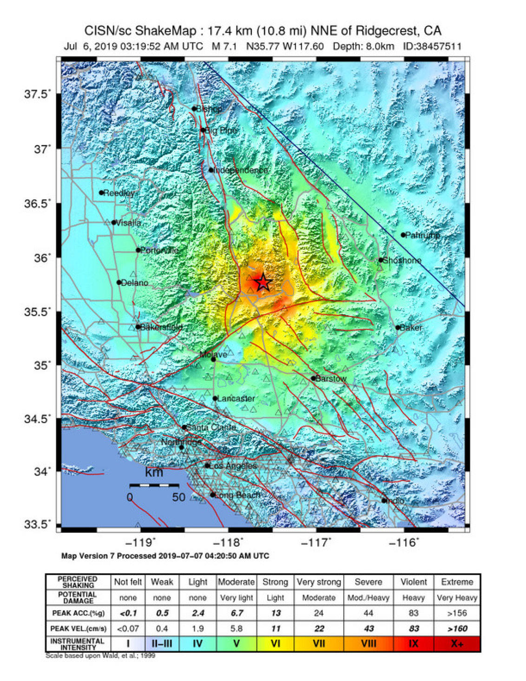
Earthquakes
1994 Northridge Earthquake Facts:
Jan. 17, 1994
Magnitude 6.7
Strong shaking near epicenter
7 Seconds
Over 40,000 Injured
57 deaths

Slide 8
Earthquakes
2019 Ridgecrest Earthquake Facts:
July 5, 2019
Magnitude 7.1 with 6.4 and 5.4
Strong shaking near epicenter
7 Seconds
25 Injured
1 death

Slide 9
Earthquakes
Magnitude | Intensity
1.0 - 3.0 | I – Not felt.
3.0 - 3.9 | II – III: Felt indoors & on upper floors, but most do not recognize it as an earthquake.
4.0 - 4.9 | IV – V: Felt by nearly everyone, may awaken at night, “stuff “disturbed, walls may make cracking noise.
5.0 - 5.9 | VI – VII: Felt by all, many frightened. Slight damage in well built buildings, considerable damage in poorly built/designed buildings. Some chimneys may break.
6.0 - 6.9 | VII – IX: Damage considerable, plumb issues, shifting off foundation, heavy furniture overturned.
7.0 and higher | VIII or higher: Well built wooden structures destroyed, masonry structures, & bridges destroyed, rails bent.

Slide 10
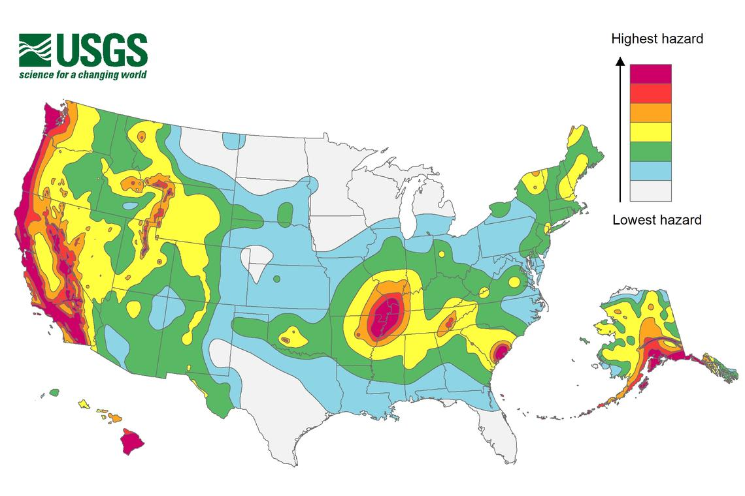
Earthquakes
The U.S. Geological Survey estimates that shaking intensity and frequency is highest in:
California, Oregon,
Washington, Alaska, Hawaii,
the Central U.S., and South
Carolina.

Slide 11
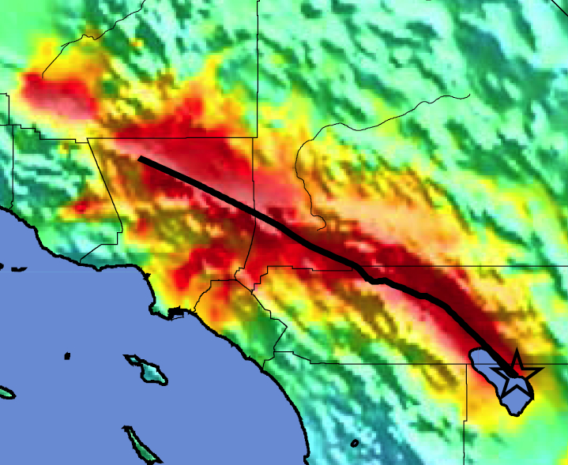
Earthquake - Prediction
7.8 Magnitude San Andreas Fault EQ:
Geographically widespread
Strong ground shaking
Duration 1 – 2 minutes
OVERDUE!!!
Expectations:
300,000 buildings damaged
1,800 fatalities
53,000 injured
255,000 homeless
1,600 FIRES
$200-$300 Billion in damage
Bakersfield
Los Angeles
Riverside
Mag 7.8 ShakeOut Scenario Earthquake Instrumental Intensity

Slide 12
Earthquake Response

Slide 13
Earthquake Response

Slide 14
Earthquake Response
WHAT IF….
You are at home?
You are in bed?
You are at work?
You are at Costco?
You are in a grocery store?
You are driving?

Slide 15
Earthquake Response
What NOT to do:
Panic
RUN
Take shelter in a doorway

Slide 16
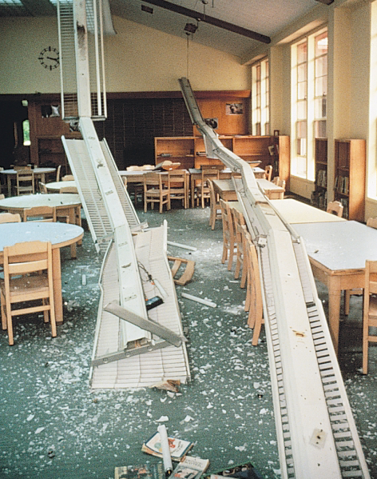
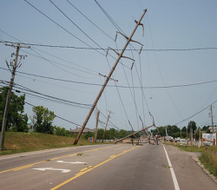
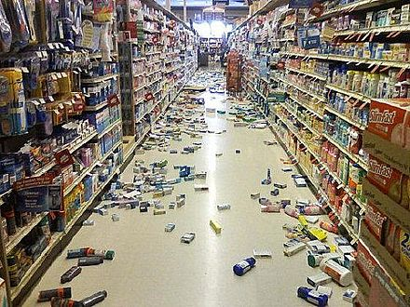
Earthquake Response
Hazards to be aware of:
The main hazard is falling objects
Smell of smoke or fire
Down power lines

Slide 17
Earthquake Preparedness
You can’t control how an earthquake will SHAKE you….
BUT
You can control how an earthquake will HARM you!!!

Slide 18
Preparing for a Disaster((2 of 2)
Have the skills to evaluate the situation quickly and take effective action to protect yourself
Have a family disaster plan and practice the plan with drills
Assemble supplies in multiple locations
Reduce the impact of hazards through mitigation practices
Get involved by participating in training and volunteer programs

Slide 19
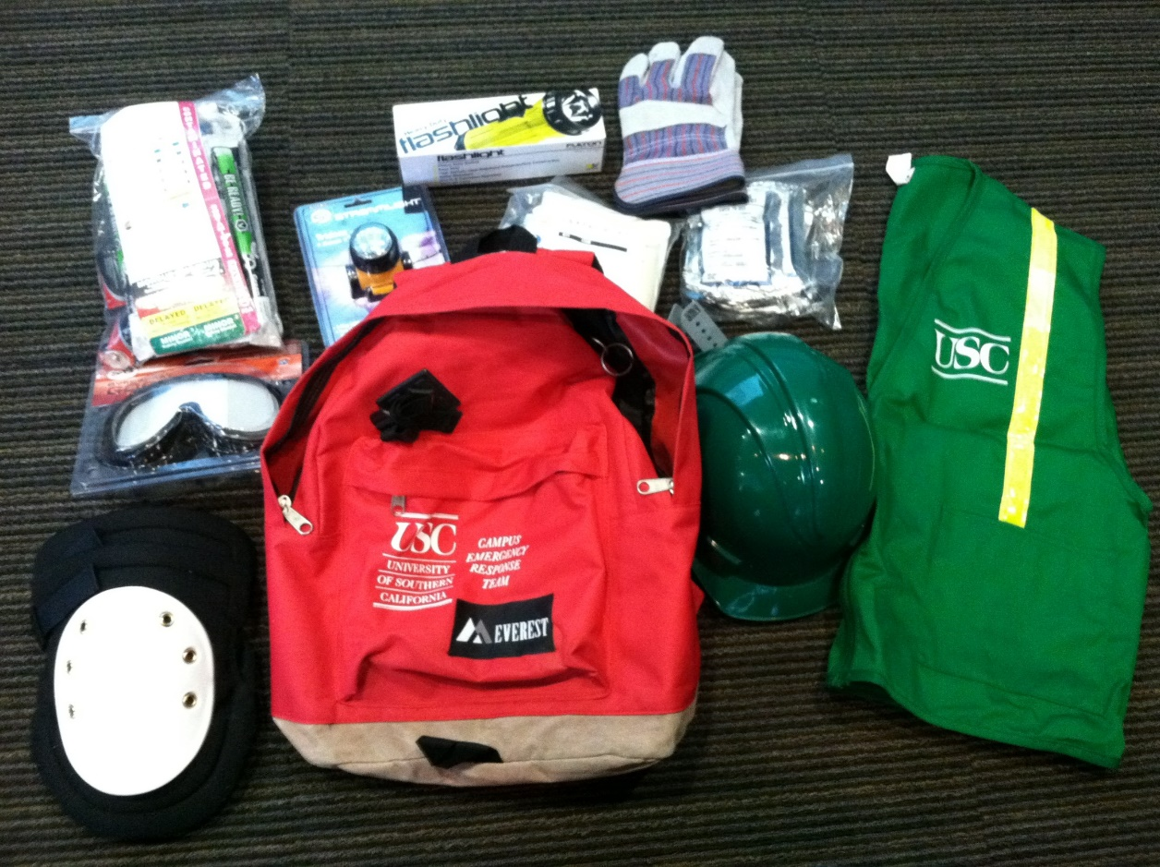
Personal Protective Equipment
Helmet/Head lamp
Goggles
N95 Mask
Gloves (work and non-latex)
Flash light
Knee pads
First Aid Supplies
Triage tags
Sturdy shoes or work boots

Slide 20
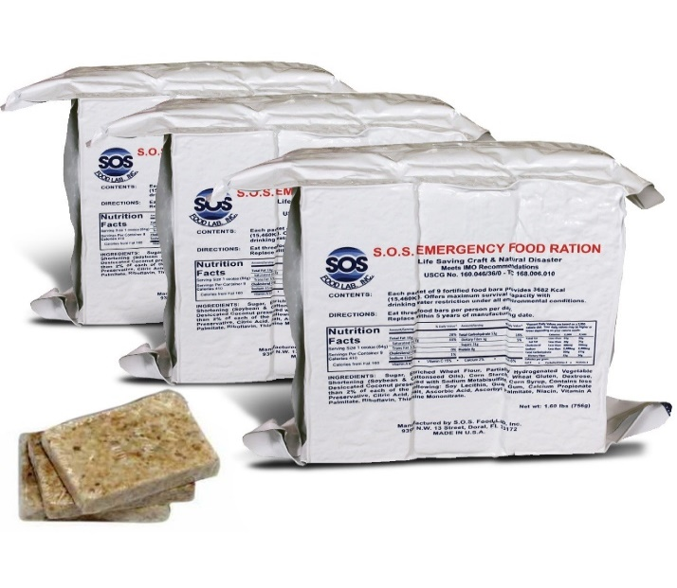
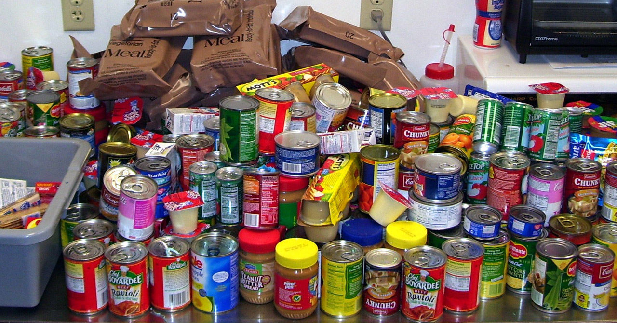
Earthquake Supplies
Food
Foods that you normally eat
Canned food – can opener
Low sodium
Comfort Food

Slide 21
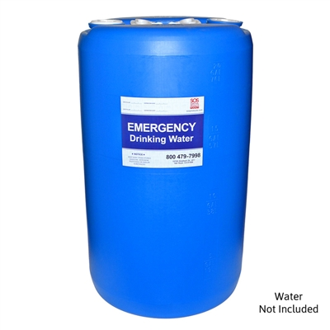
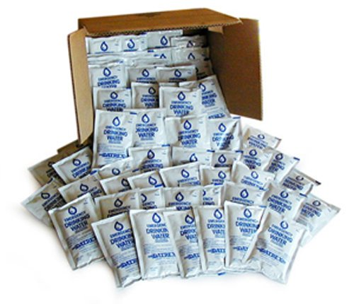
Earthquake Supplies
Water
FEMA recommends 1 gallon a day per/person for drinking & 1 gallon a day for sanitation
Rotate water supplies every 6 months
Be ready to purify water
mixture of 8 drops of bleach to a gallon of generally clear water for best a

Slide 22
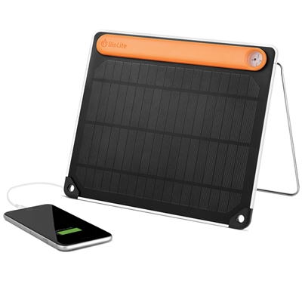
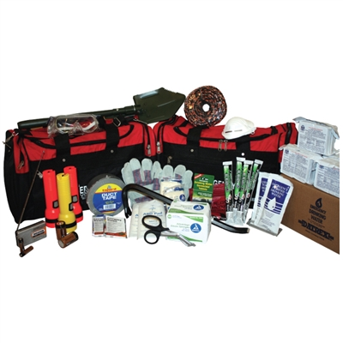
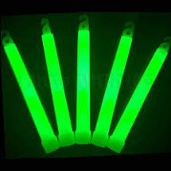
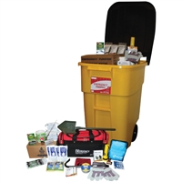
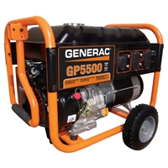
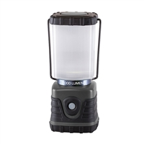
Earthquake Supplies
Supplies for your home kit
Flashlight/batteries; glow sticks
Transistor radio
Work gloves
Eye protection
Tools – pry bar
Gas shut off wrench
First aid supplies
Generator – solar charger
BBQ

Slide 23
Earthquake Supplies
Essential Medicines:
Minimum 2 week supply
Never take the last one
Prescription glasses
Critical Papers:
Insurance, bank, medical records
Cash – low denominations

Slide 24
Family Disaster Plan
Where will you meet family members?
Who is your out-of-state “check-in” contact?
Will you have an extended stay? Shelter in place? Evacuate?
How will you escape your home? Workplace? School? Place of worship?
What route (and several alternates) will you use to evacuate your neighborhood?
Do you have transportation?
Did you practice your plan?

Slide 25
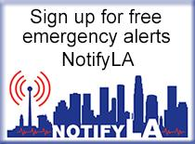
Earthquake Preparedness
Connect – Have a communication plan
Maintain a paper contact list – with out of state contacts
Join your cities or counties emergency alert system
Make sure you receive USC TrojansAlert

Slide 26
Earthquake Preparedness

Slide 27
Mitigation
Mitigation is the reduction of loss of life and property by lessening the impact of disasters and includes any activity that prevents an emergency or reduces effects of hazards
Have adequate homeowners coverage
Add flood insurance if in a flood hazard area
Earthquake Insurance?

Slide 28
Structural Mitigation Measures
Bolt houses to foundations
Strap propane tanks and chimneys
Strap mobile homes to their slabs
Raise utilities

Slide 29
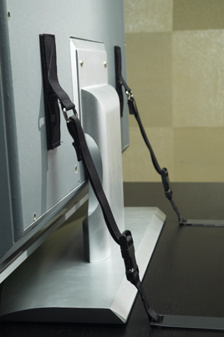
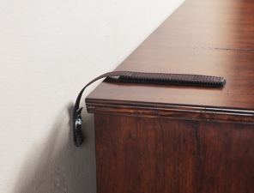
Non-Structural Hazard Mitigation
Anchor heavy furniture
Secure appliances and office equipment
Childproof cabinet doors
Museum Wax or earthquake putty for small items
Locate and label gas, electricity, and water shutoffs
Secure water heaters and have flexible gas lines installed

Slide 30
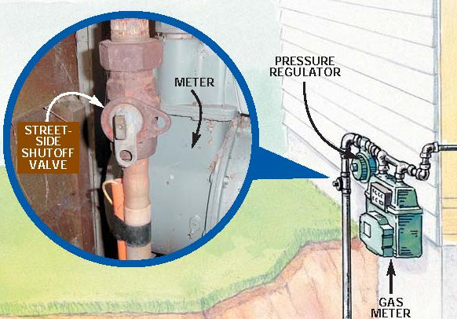
Utility Shut Offs

Slide 31
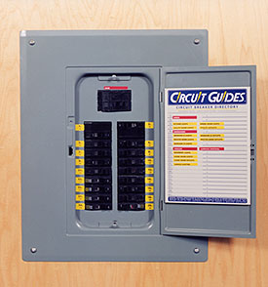
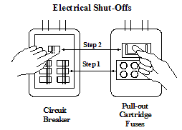
Utility Shut Offs

Slide 32
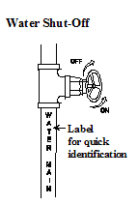
Utility Shut Offs

Slide 33
Disaster Response

Slide 34
Disaster Response
Angela DiBenedetto, CEM, EMT, MHA
adiben@usc.edu
213 281 0990

