Slide 1










Towards validation of urban GHG emissions using a very high resolution atmospheric inversion in the Indianapolis Flux Experiment
GC51G-02
Kenneth J. Davis¹, Thomas Lauvaux¹, Laura E. McGowan¹, Maria Cambaliza², Michael Hardesty³, Laura T. Iraci⁴, Kevin R. Gurney⁵, Patrick W. Hillyard⁴, Anna Karion³, Natasha L. Miles¹, James R. Podolske⁴, Igor Razlivanov⁵, Scott J. Richardson¹, Daniel P. Sarmiento¹, Paul B. Shepson², Yang Song⁵, Colm Sweeney², Jocelyn Turnbull⁶, James Whetstone⁷
¹The Pennsylvania State University, ²Purdue University, ³NOAA ESRL, ⁴NASA Ames, ⁵Arizona State University, ⁶GNS Science, ⁷NIST
AGU Fall Meeting, San Francisco, CA, 7 December, 2012
NACP

Slide 2
INFLUX Objectives
Test “top-down” and “bottom-up” approaches to urban anthropogenic CO₂ and CH₄ emissions quantification.
  Compare whole-city estimates using three different approaches (inventory, tower inversion, aircraft budget).
  Determine GHG emissions at 1 km² resolution and with 10% precision and accuracy across the city using atmospheric inversions.
  Quantify the uncertainty in atmospheric budget and inversion methods at the urban scale

Slide 3
Outline
Inversion system description
Observations!
Forwards modeling
  Simulated influence of boundary conditions
  Influence of sectoral emissions
  (Model-data comparisons) – only qualitative
Atmospheric inversions
  System design experiment
  (Real data inversions)

Slide 4
Inversion system
Not a model! A system for model-data synthesis

Slide 5
Tower-based atmospheric inversion system
Atmospheric transport model:
(WRF-chem, 1-2 km)
Boundary and initial conditions (GHGs/met):
(Carbon Tracker, NOAA aircraft profiles, NCEP meteorology)
Air Parcel
wind
wind
Air Parcel
Sources
Sinks
Air Parcel
Prior flux estimate:
(Hestia and Vulcan,
EDGAR and EPA,
CT posterior and/or VPRM)
Sample
Sample
Network of tower-based GHG sensors:
(~11-12 sites with CO₂, CH₄, CO and ¹⁴CO₂)
Notes:
Skip if Paul shows this.

Slide 6
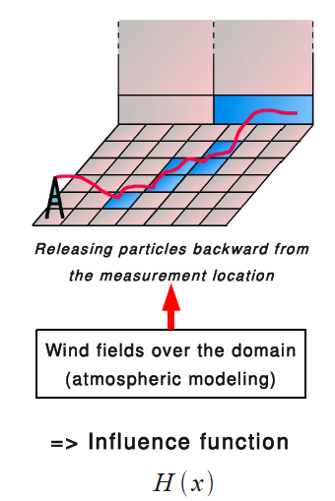
Inversion system, continued
Lagragian Particle Dispersion Model (LPDM, Uliasz).
  Determines “influence function” – the areas that contribute to GHG concentrations at measurement points.
Notes:
Skip if Paul shows this

Slide 7

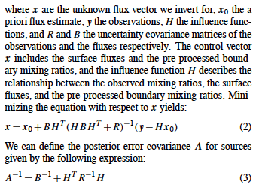

Slide 8
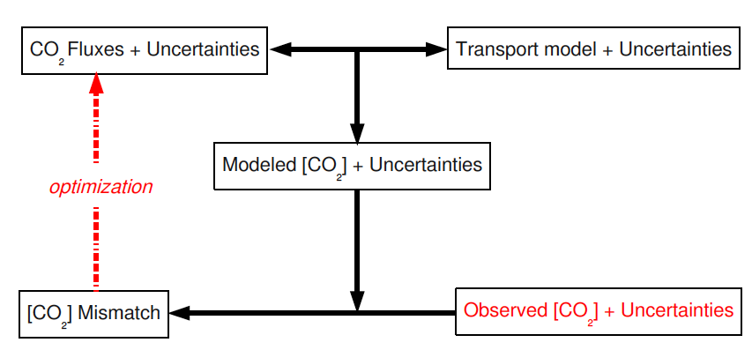
Inversion system
NOAA aircraft, boundary
towers
Lateral boundary CO2
x₀
B
H
Flux tower sites
Purdue aircraft campaign
Estimated together
R
x
Hx₀
WRF vs LPDM
y-Hx₀
y
Instrument error
Uncertainties (flux and observational) estimates from model-data comparisons in the study region.
(following Lauvaux et al., 2012, ACPD)

Slide 9
Modifications for INFLUX
Urban boundary layer and land surface simulated (well?) in WRF-Chem. Evaluate with meteorological observations.
CO/CO₂/¹⁴CO₂ incorporated to disaggregate fossil and biogenic CO₂. (A31H-02: Turnbull)
Strong, relatively well-known point sources quantified prior to regional inversion.
  power plant – CO₂
  landfill, waste water treatment plant – CH₄

Slide 10
Observations
GC53B-1279: Cambaliza
GC53B-1284: Miles

Slide 11
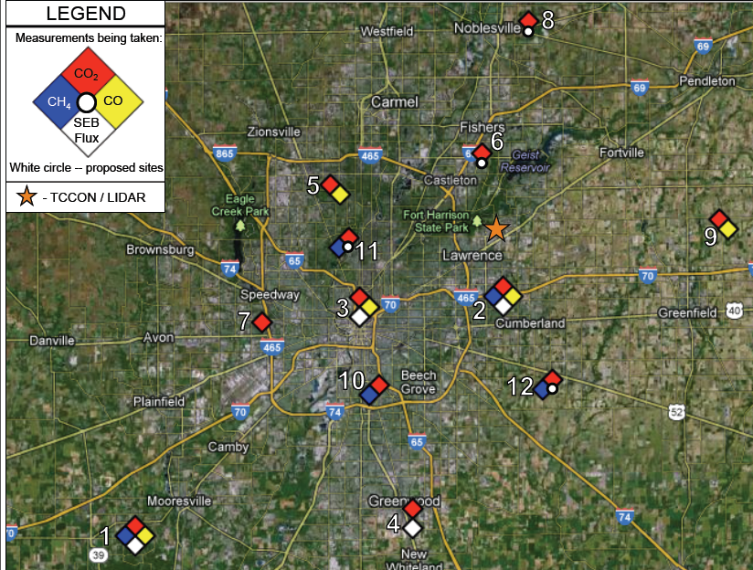
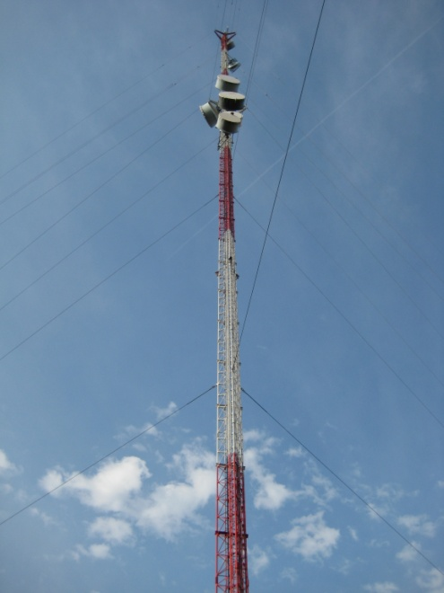
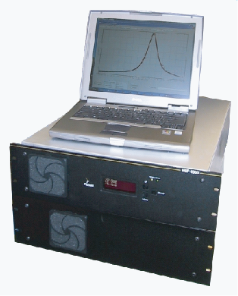
INFLUX ground-based instrumentation
Picarro, CRDS sensors; NOAA automated flask samplers;
Communications towers ~100m AGL
GC53B-1284: Miles

Slide 12
Status of ground-based observational system
9 GHG towers installed and running (1 to be moved, 3 more to be installed ASAP).
1 flux system installed, 3 more in prep.
Doppler lidar scheduled for installation this winter.
TCCON to be removed next week.
Deployment and operation of a network like this is a large effort. Use our data!

Slide 13
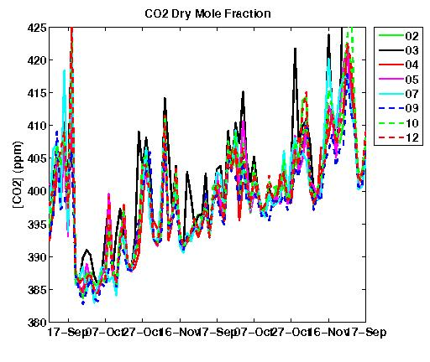
Observed: Comparison of [CO2] at 8 INFLUX sites
September – November 2012.
[CO2] at 3 pm local at 8 sites in the Indianapolis area
Synoptic-scale variability in [CO2] is apparent
15 Sept 15 Oct 15 Nov 2012
* Note: Tower heights range from 40 m AGL to 136 m AGL

Slide 14
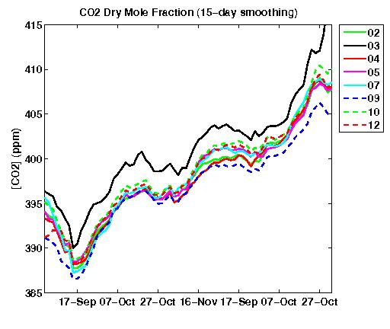
Observed: Comparison of [CO2] at 8 INFLUX sites
September – November 2012
[CO2] at 3 pm local at 8 sites, with 15-day smoothing (removes most of the weather-driven variability)
15 Sept 15 Oct 15 Nov 2012
* Note: Tower heights range from 40 m AGL to 136 m AGL
Notes:
Site 03 is 54 m AGL.

Slide 15
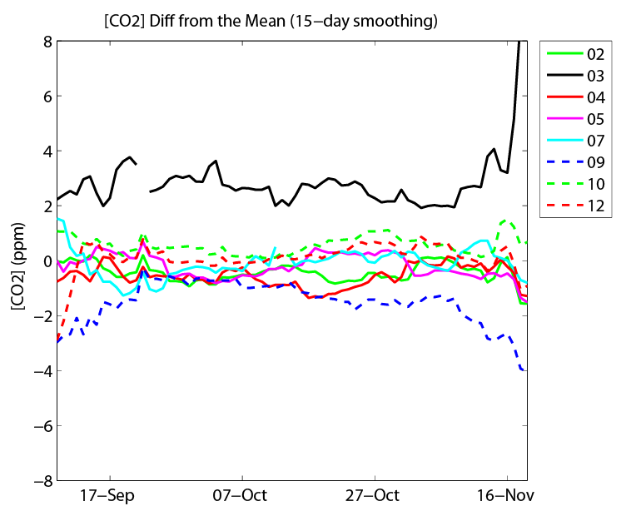
Observed: Comparison of [CO2] at 8 INFLUX sites
September – November 2012
Site 03 (downtown) is consistently higher than the other sites.
Site 09 (background site to the east of the city) measures the lowest average [CO2]
* Note: Tower heights range from 40 m AGL to 136 m AGL
Notes:
Site 03 is 54 m AGL.

Slide 16
INFLUX ground-based instrumentation
Picarro, CRDS sensors; NOAA automated flask samplers;
Communications towers ~100m AGL
GC53B-1284: Miles

Slide 17
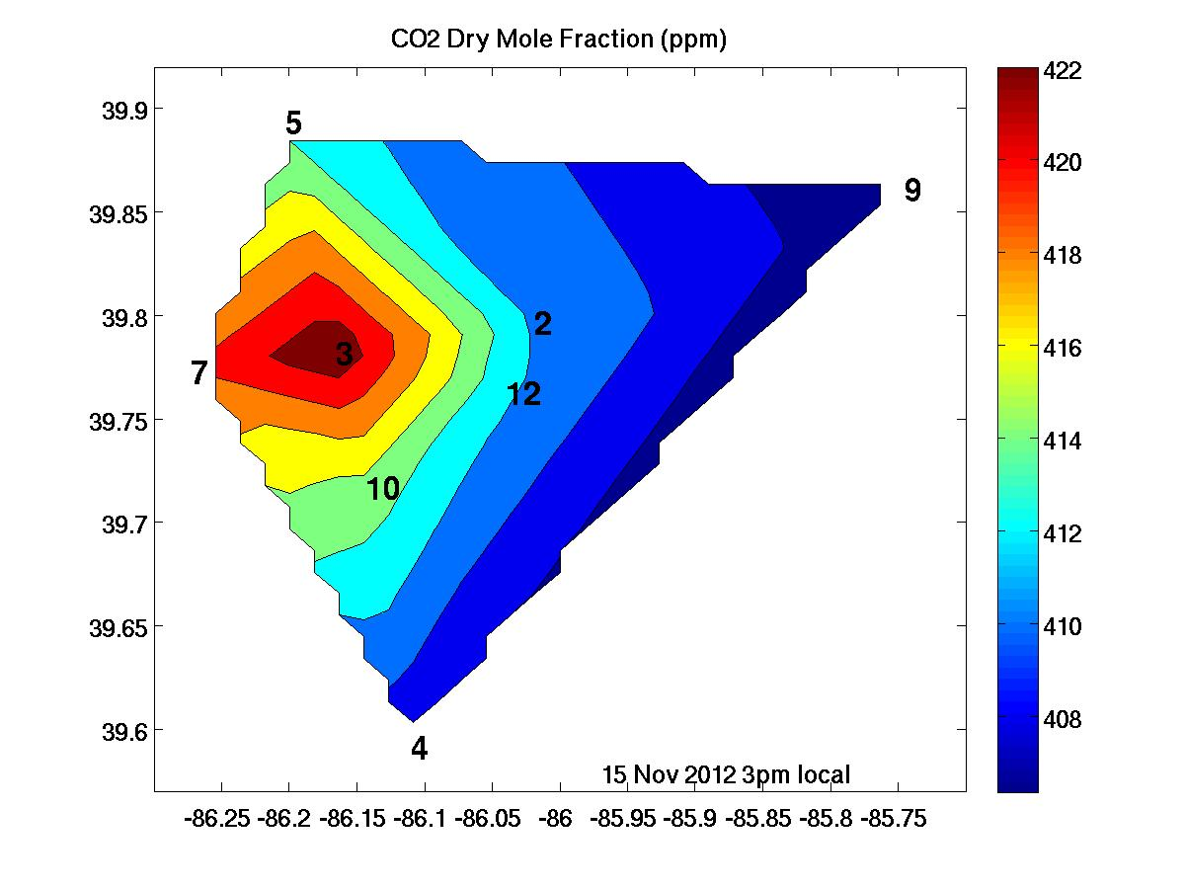
Observed: Dependence of CO2 spatial gradient on
wind speed
15 Nov 2012 at 3 pm local
Winds: calm
Light winds: 15 ppm difference midday

Slide 18
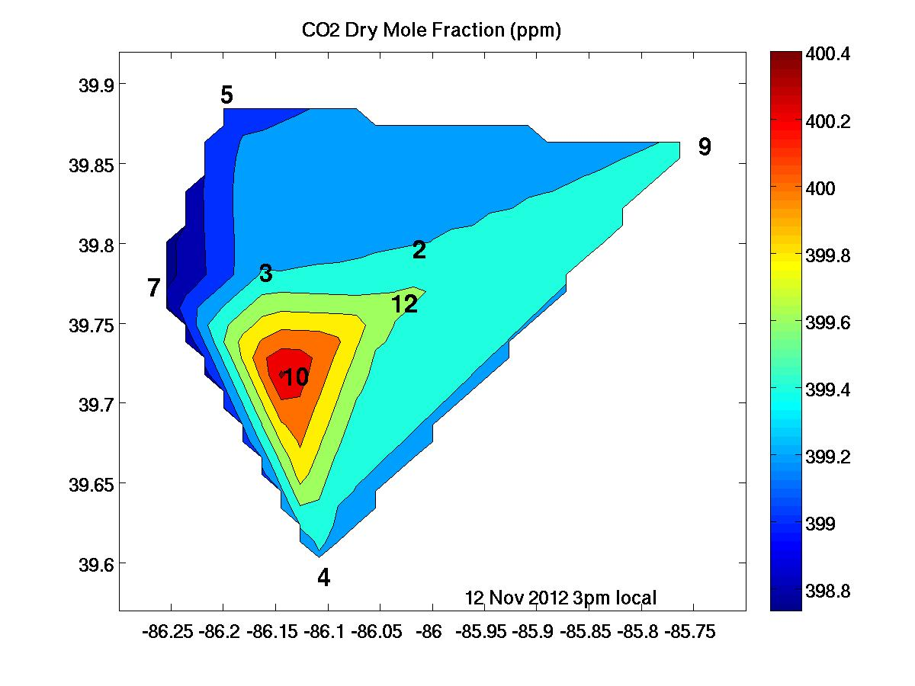
Observed: Dependence of CO2 spatial gradient on
wind speed
12 Nov 2012 at 3 pm local
Winds: 9 m/s from the west
Strong winds: < 2 ppm difference midday

Slide 19
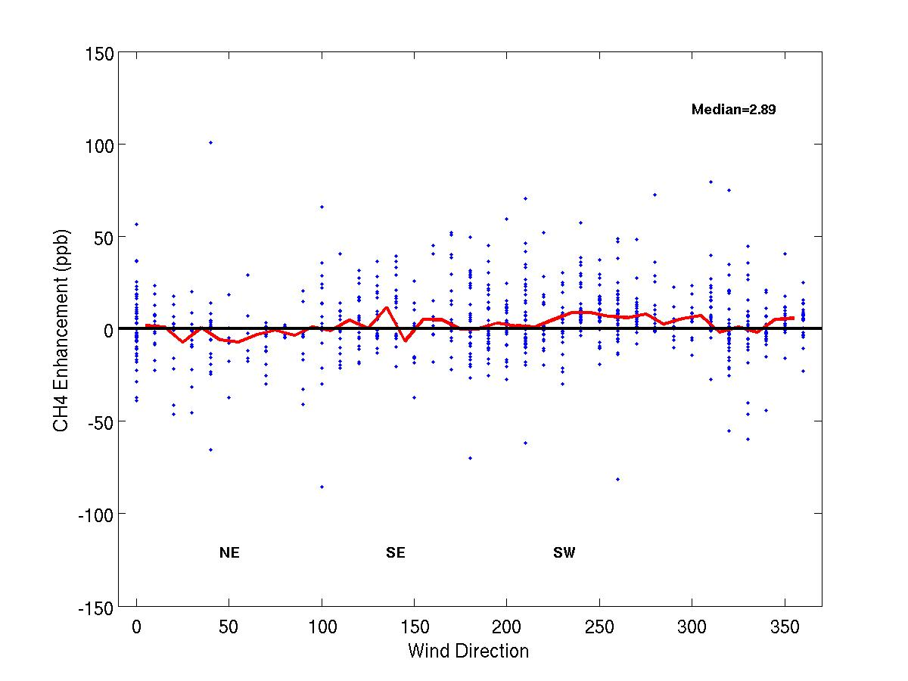
CH4 Enhancement (Site 02 – Site 01) as a Function of Wind Direction
April – November 2011 (Afternoon hours only)
Note the LARGE day to day variability!
Notes:
Only afternoon hours for both plots; no smoothing. The green arrows point to the source for enhancements measured at Site 02, whereas the black arrows point to the source for enhancements measured at Site 01. In addition to the known source to the southeast of Site 02, there is an additional source to the southwest of the city.
19

Slide 20
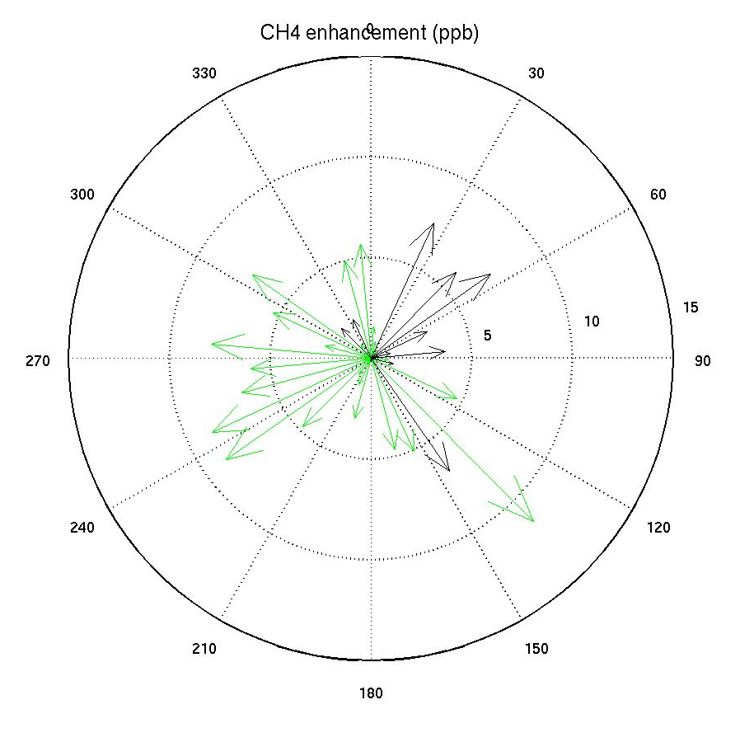
CH4 Enhancement (Site 02 – Site 01) as a Function of Wind Direction
April – November 2011 (Afternoon hours only)
N
Green arrows point to the source for enhancements measured at Site 02, whereas the black arrows point to the source for enhancements measured at Site 01
In addition to the known source to the southeast of Site 02, there is an additional source to the southwest of the city.
CH4 enhancement
10
5
W
E
S
Notes:
Only afternoon hours; no smoothing. The green arrows point to the source for enhancements measured at Site 02, whereas the black arrows point to the source for enhancements measured at Site 01. In addition to the known source to the southeast of Site 02, there is an additional source to the southwest of the city.
20

Slide 21
INFLUX ground-based instrumentation
Picarro, CRDS sensors; NOAA automated flask samplers;
Communications towers ~100m AGL
GC53B-1284: Miles

Slide 22
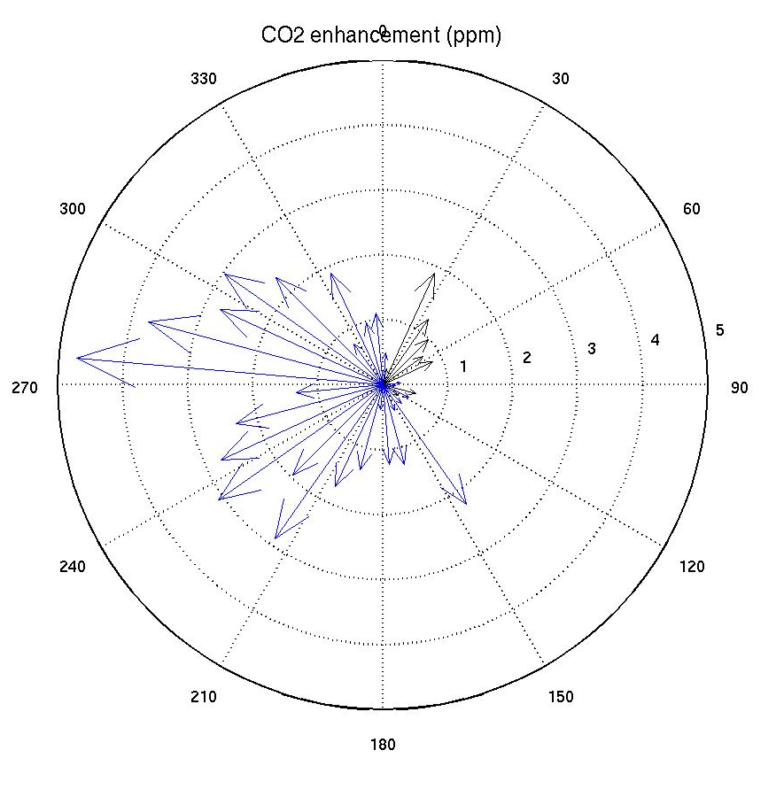
CO2 Enhancement (Site 02 – Site 01) as a Function of Wind Direction

Slide 23
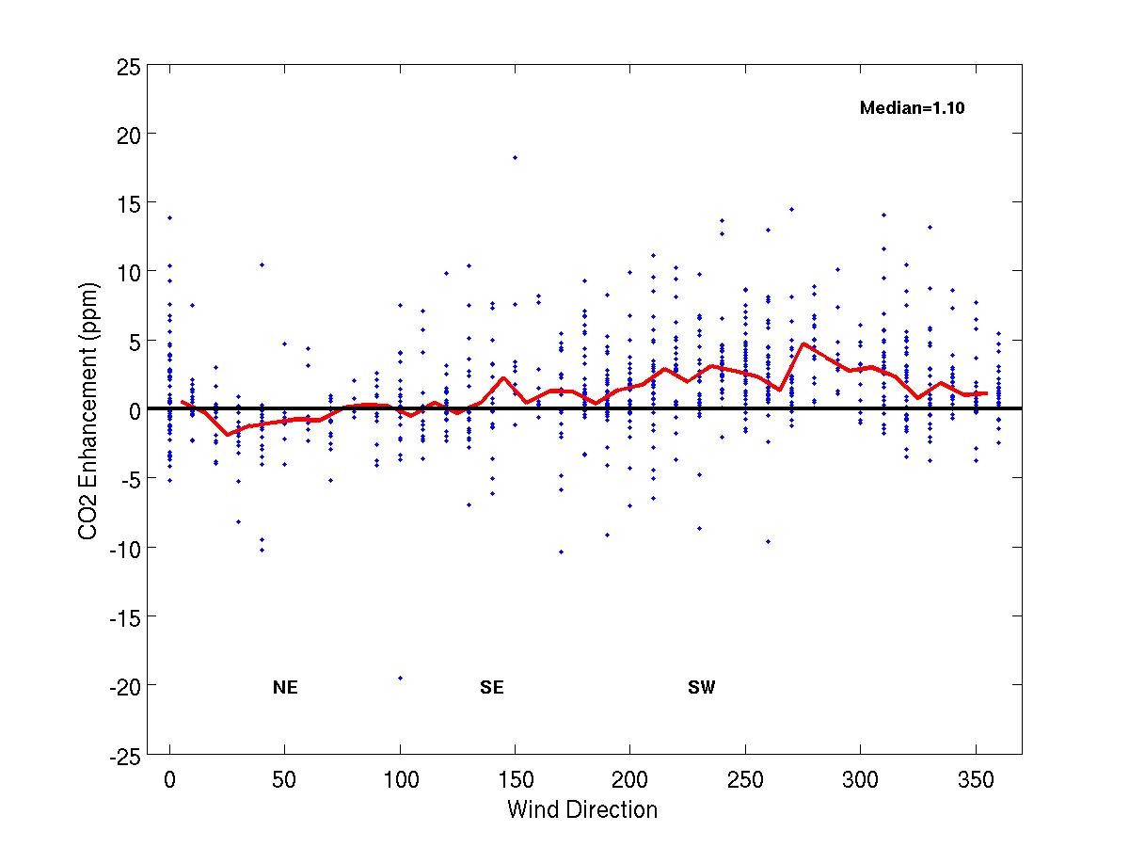
CO2 Enhancement (Site 02 – Site 01) as a Function of Wind Direction
April – November 2011 (Afternoon hours only)
Notes:
Only afternoon hours for both plots; no smoothing
23

Slide 24
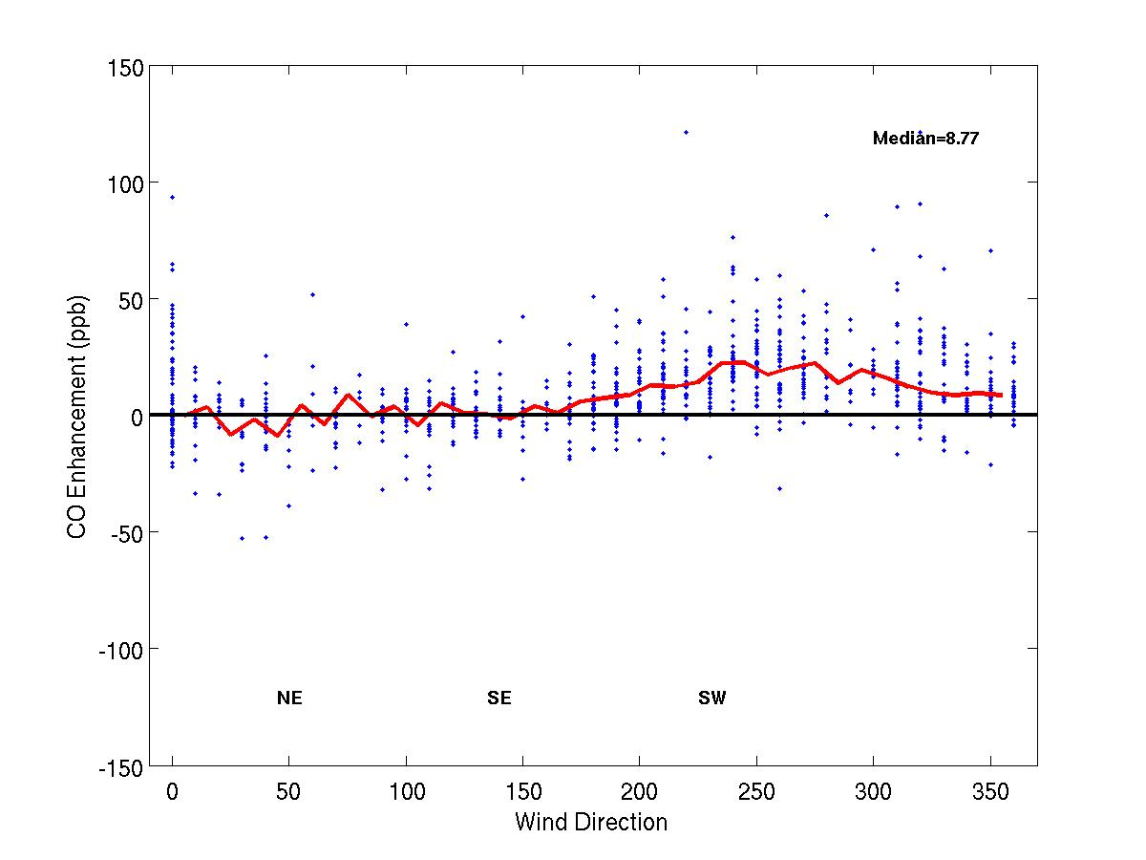
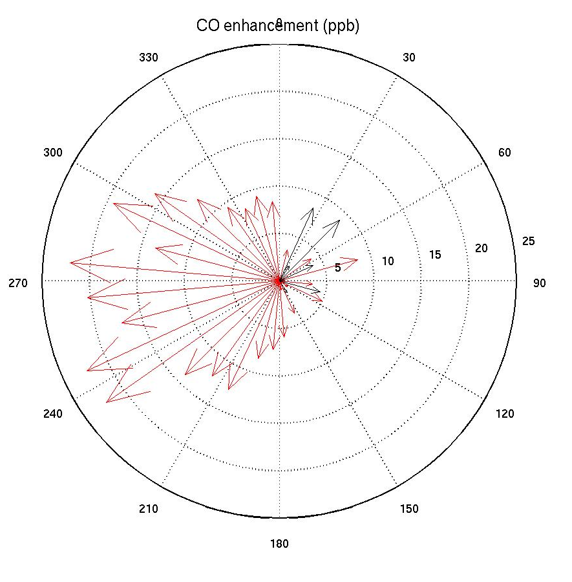
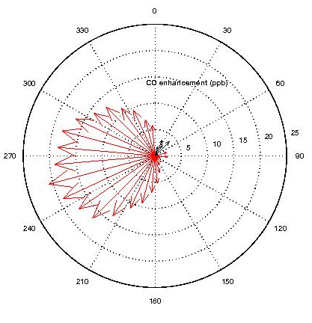
CO
Is the CO enhancement reduced when the wind is from the power plant?
Notes:
Only afternoon hours for both plots; no smoothing
24

Slide 25
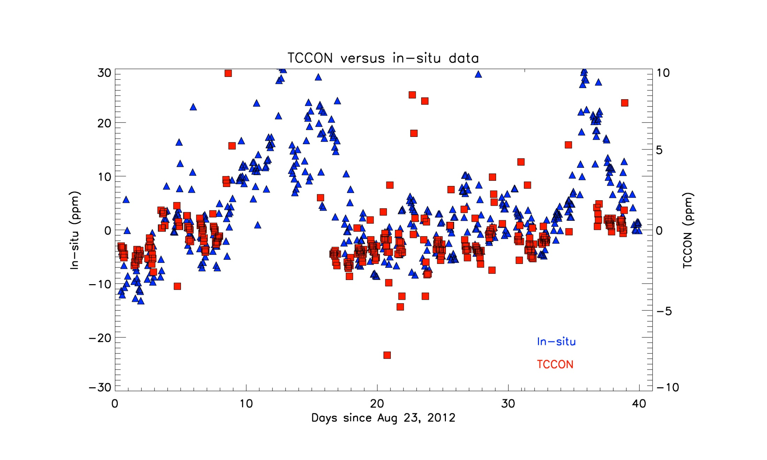
TCCON vs in-situ comparison: CO2

Slide 26
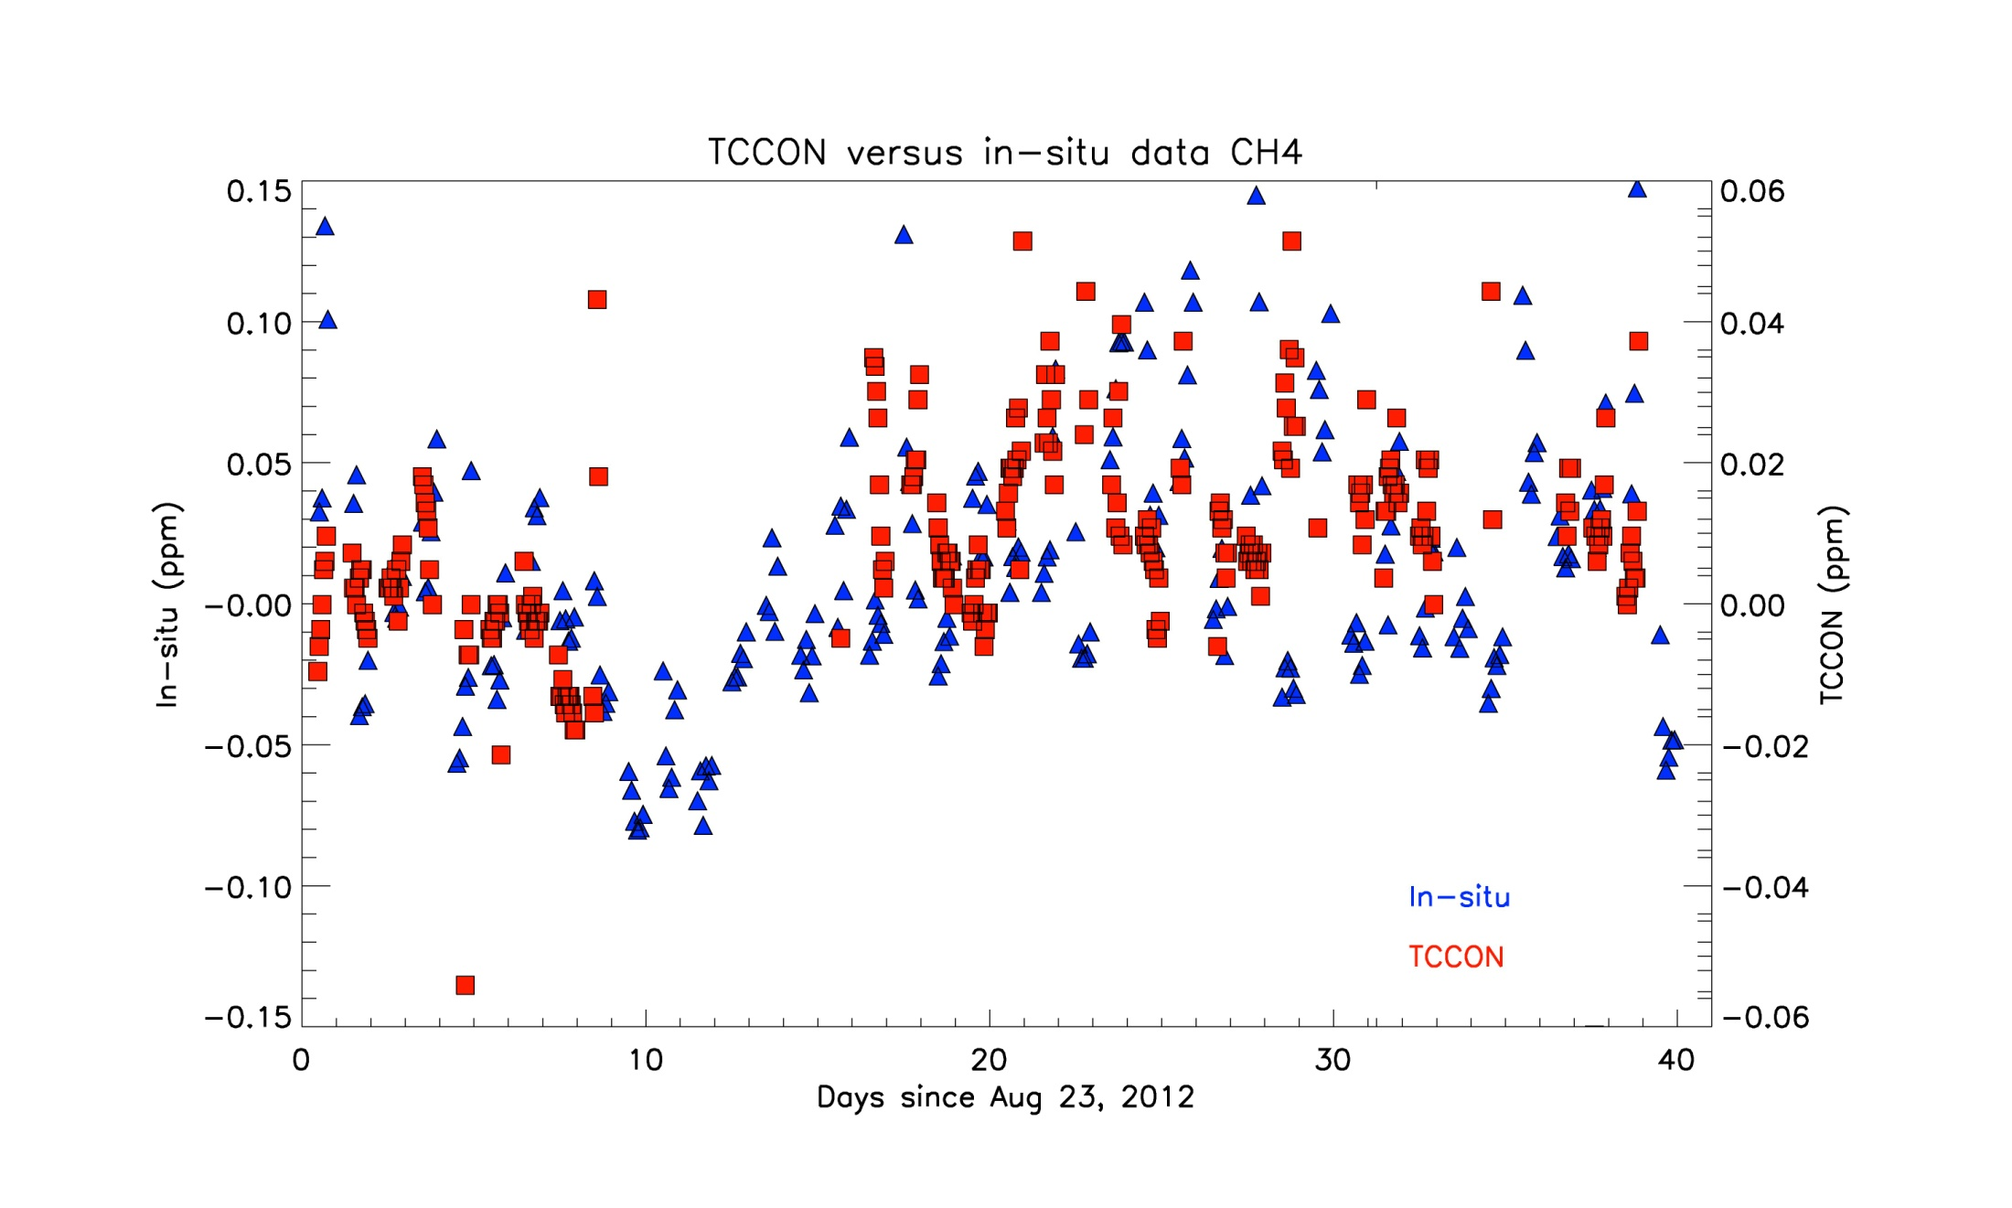
TCCON vs in-situ comparison: CH4
Are the residuals indicative of variability in Free Tropopsheric mole fractions?

Slide 27
Forward model results

Slide 28
Status of modeling system
WRF-Chem running with:
  3 nested domains, inner domain 1km² resolution, 87x87 km² domain
  Meteorological data assimilation
  Hestia anthropogenic fluxes for the inner domain
  Vulcan anthropogenic fluxes for the outer domains
  Carbon Tracker posterior biogenic fluxes
  Carbon Tracker boundary conditions

Slide 29
Status of modeling system
LDPM influence functions computed for Oct 7th – Nov 10th, 2011 and 3 flights in 2011.
“Forward” simulations for Oct 7th – Nov 10th, 2011 and 5 flights in 2011 with:
  Hestia emissions to examine sectoral CO2 influences at various towers (but simple boundary conditions and no biogenic fluxes).
  Vulcan emissions with CT biogenic fluxes and lateral boundary conditions
Inversion system test, neglecting influence of lateral boundary conditions and biogenic fluxes
(Real data inversion) – not yet

Slide 30
Status of modeling system
Model-data comparisons
  Case studies of vertical mixing, plume dispersion – last AGU
  (Comparison of long-term patterns in GHG mixing ratios) - qualitative
  (Long-term evaluation of meteorological performance) - pending
  (Comparisons of flight data to atmospheric simulations) - pending

Slide 31
Vulcan emissions in the atmosphere

Slide 32
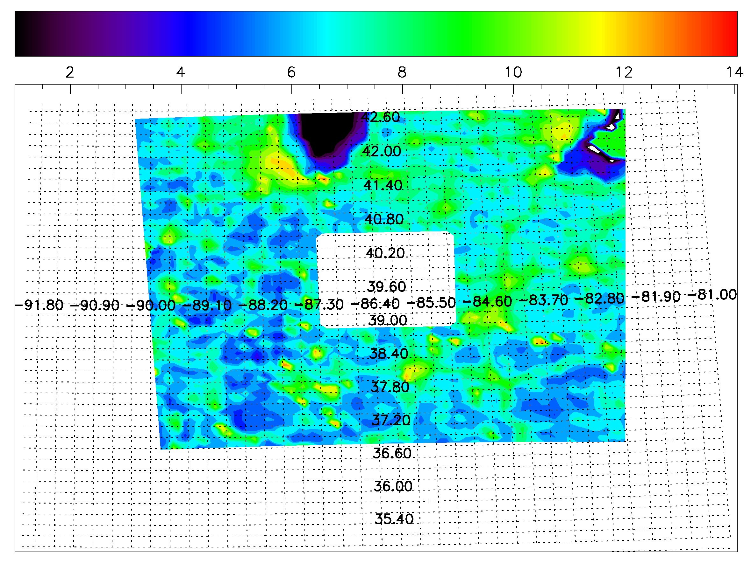
Outer domain Vulcan emissions
Vulcan emissions cropped – Hestia within inner domain

Slide 33
Paul showed you the movie

Slide 34
Can we detect anthropogenic emissions?
Or do biogenic fluxes and lateral boundary conditions dominate?

Slide 35
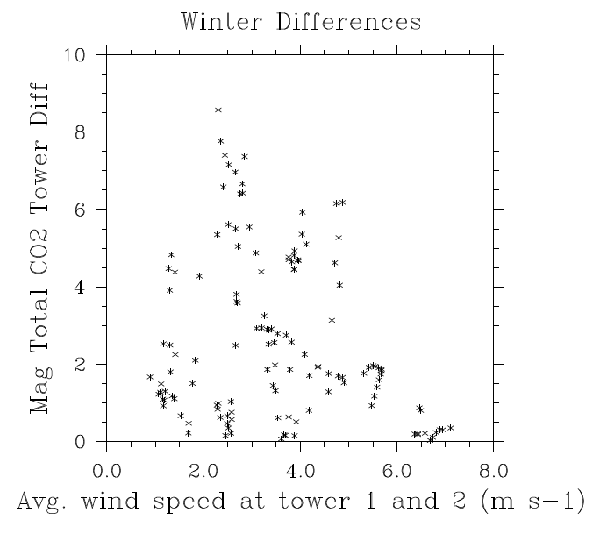
Winter CO2 differences, tower 2 vs. 1
Total CO2 difference
Each point is 20 minutes. 10 day sequence. Midday data.
Includes full suite of boundary conditions and biogenic fluxes.
Note drop with wind speed.
Mole fraction (ppm)

Slide 36
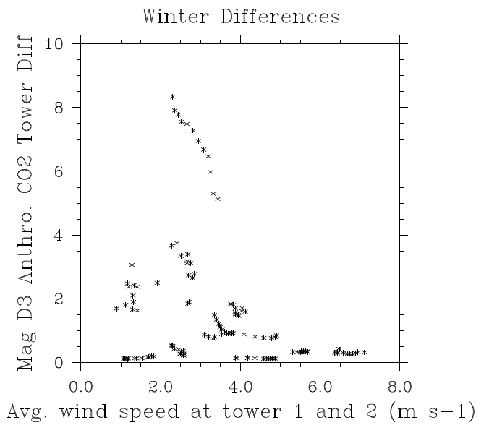
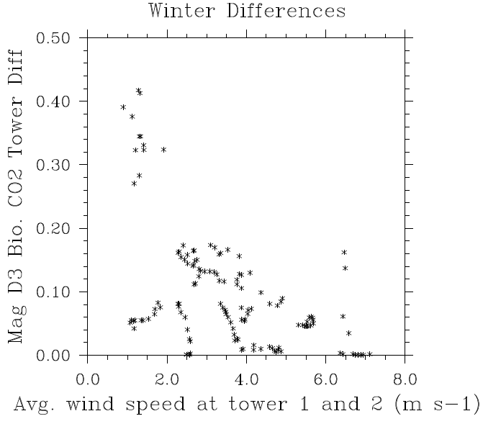
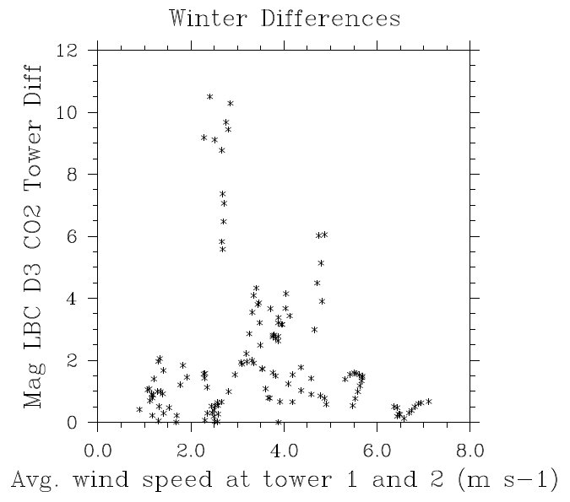
Winter CO2 differences, tower 2 vs. 1: Broken down by source of CO2
Anthropogenic within domain fluxes, 10 ppm scale
Biogenic
within domain fluxes, 0.5 ppm scale
Total boundary condition inflow,
12 ppm scale
Tentative conclusion:
Inflow is of similar magnitude to Indy anthro fluxes.
Similar conclusion for bio fluxes in summer?

Slide 37
Inversion experiment: Network test

Slide 38
Inversion system test
6 tower system tested, hourly daytime data
Prior fluxes with and without strong point sources
Prior errors proportional to fluxes
Prior error correlations 3km, isotropic, correlated with land cover
Noise added with same spatial statistics, 80% of flux magnitude
7 day Bayesian matrix inversion, November
No biogenic fluxes, no boundary conditions

Slide 39
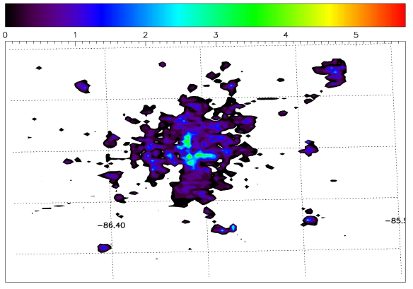
Hestia total emissions without point sources
Flux units: gC m-2 hr-1. Point sources need special treatment

Slide 40
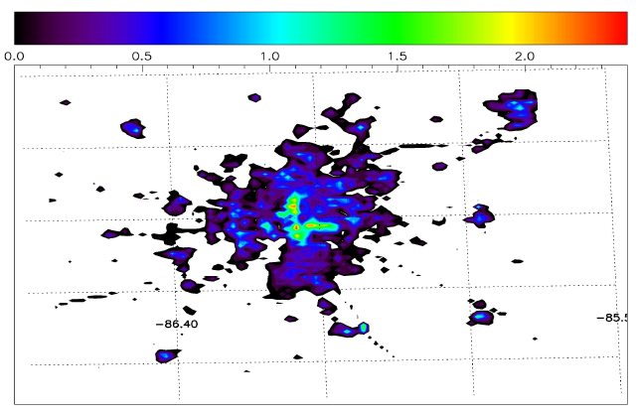
Prior emissions errors
Flux units: gC m-2 hr-1.
Standard deviation = 80% of flux

Slide 41
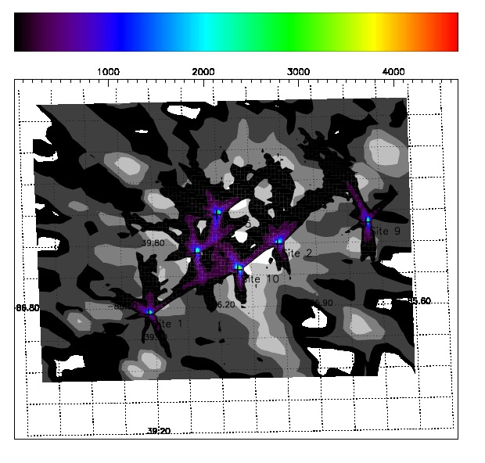
Sample of influence functions for 6 towers
Particle touchdown for July 12, 2011 after a) 12 hours and b) 72 hours. Touchdown is considered within 50m of surface. The background values are EPA 4km CO.

Slide 42
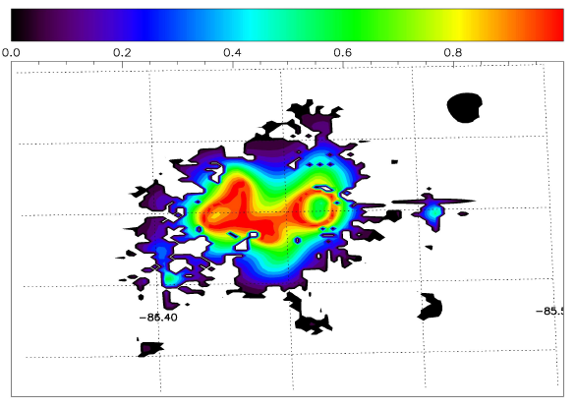
Gain – relative improvement prior vs. posterior
Very good system performance within the tower array.
Very idealized case, but encouraging nonetheless.
Flux units: gC m-2 hr-1.
1 = perfect correction to prior fluxes

Slide 43
Hestia emissions in the atmosphere
Can we isolate fluxes from individual emission sectors?

Slide 44
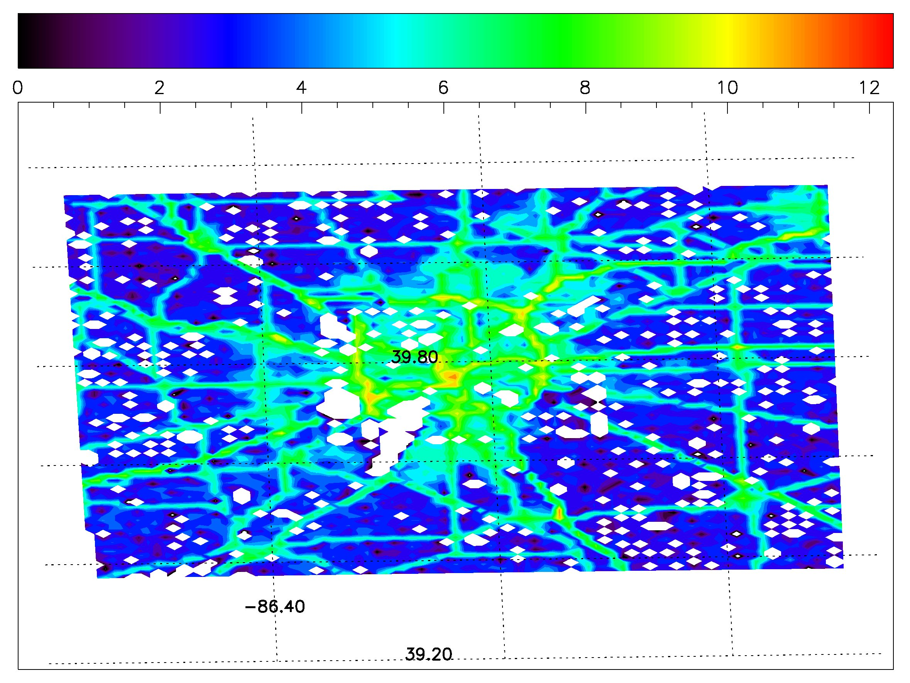
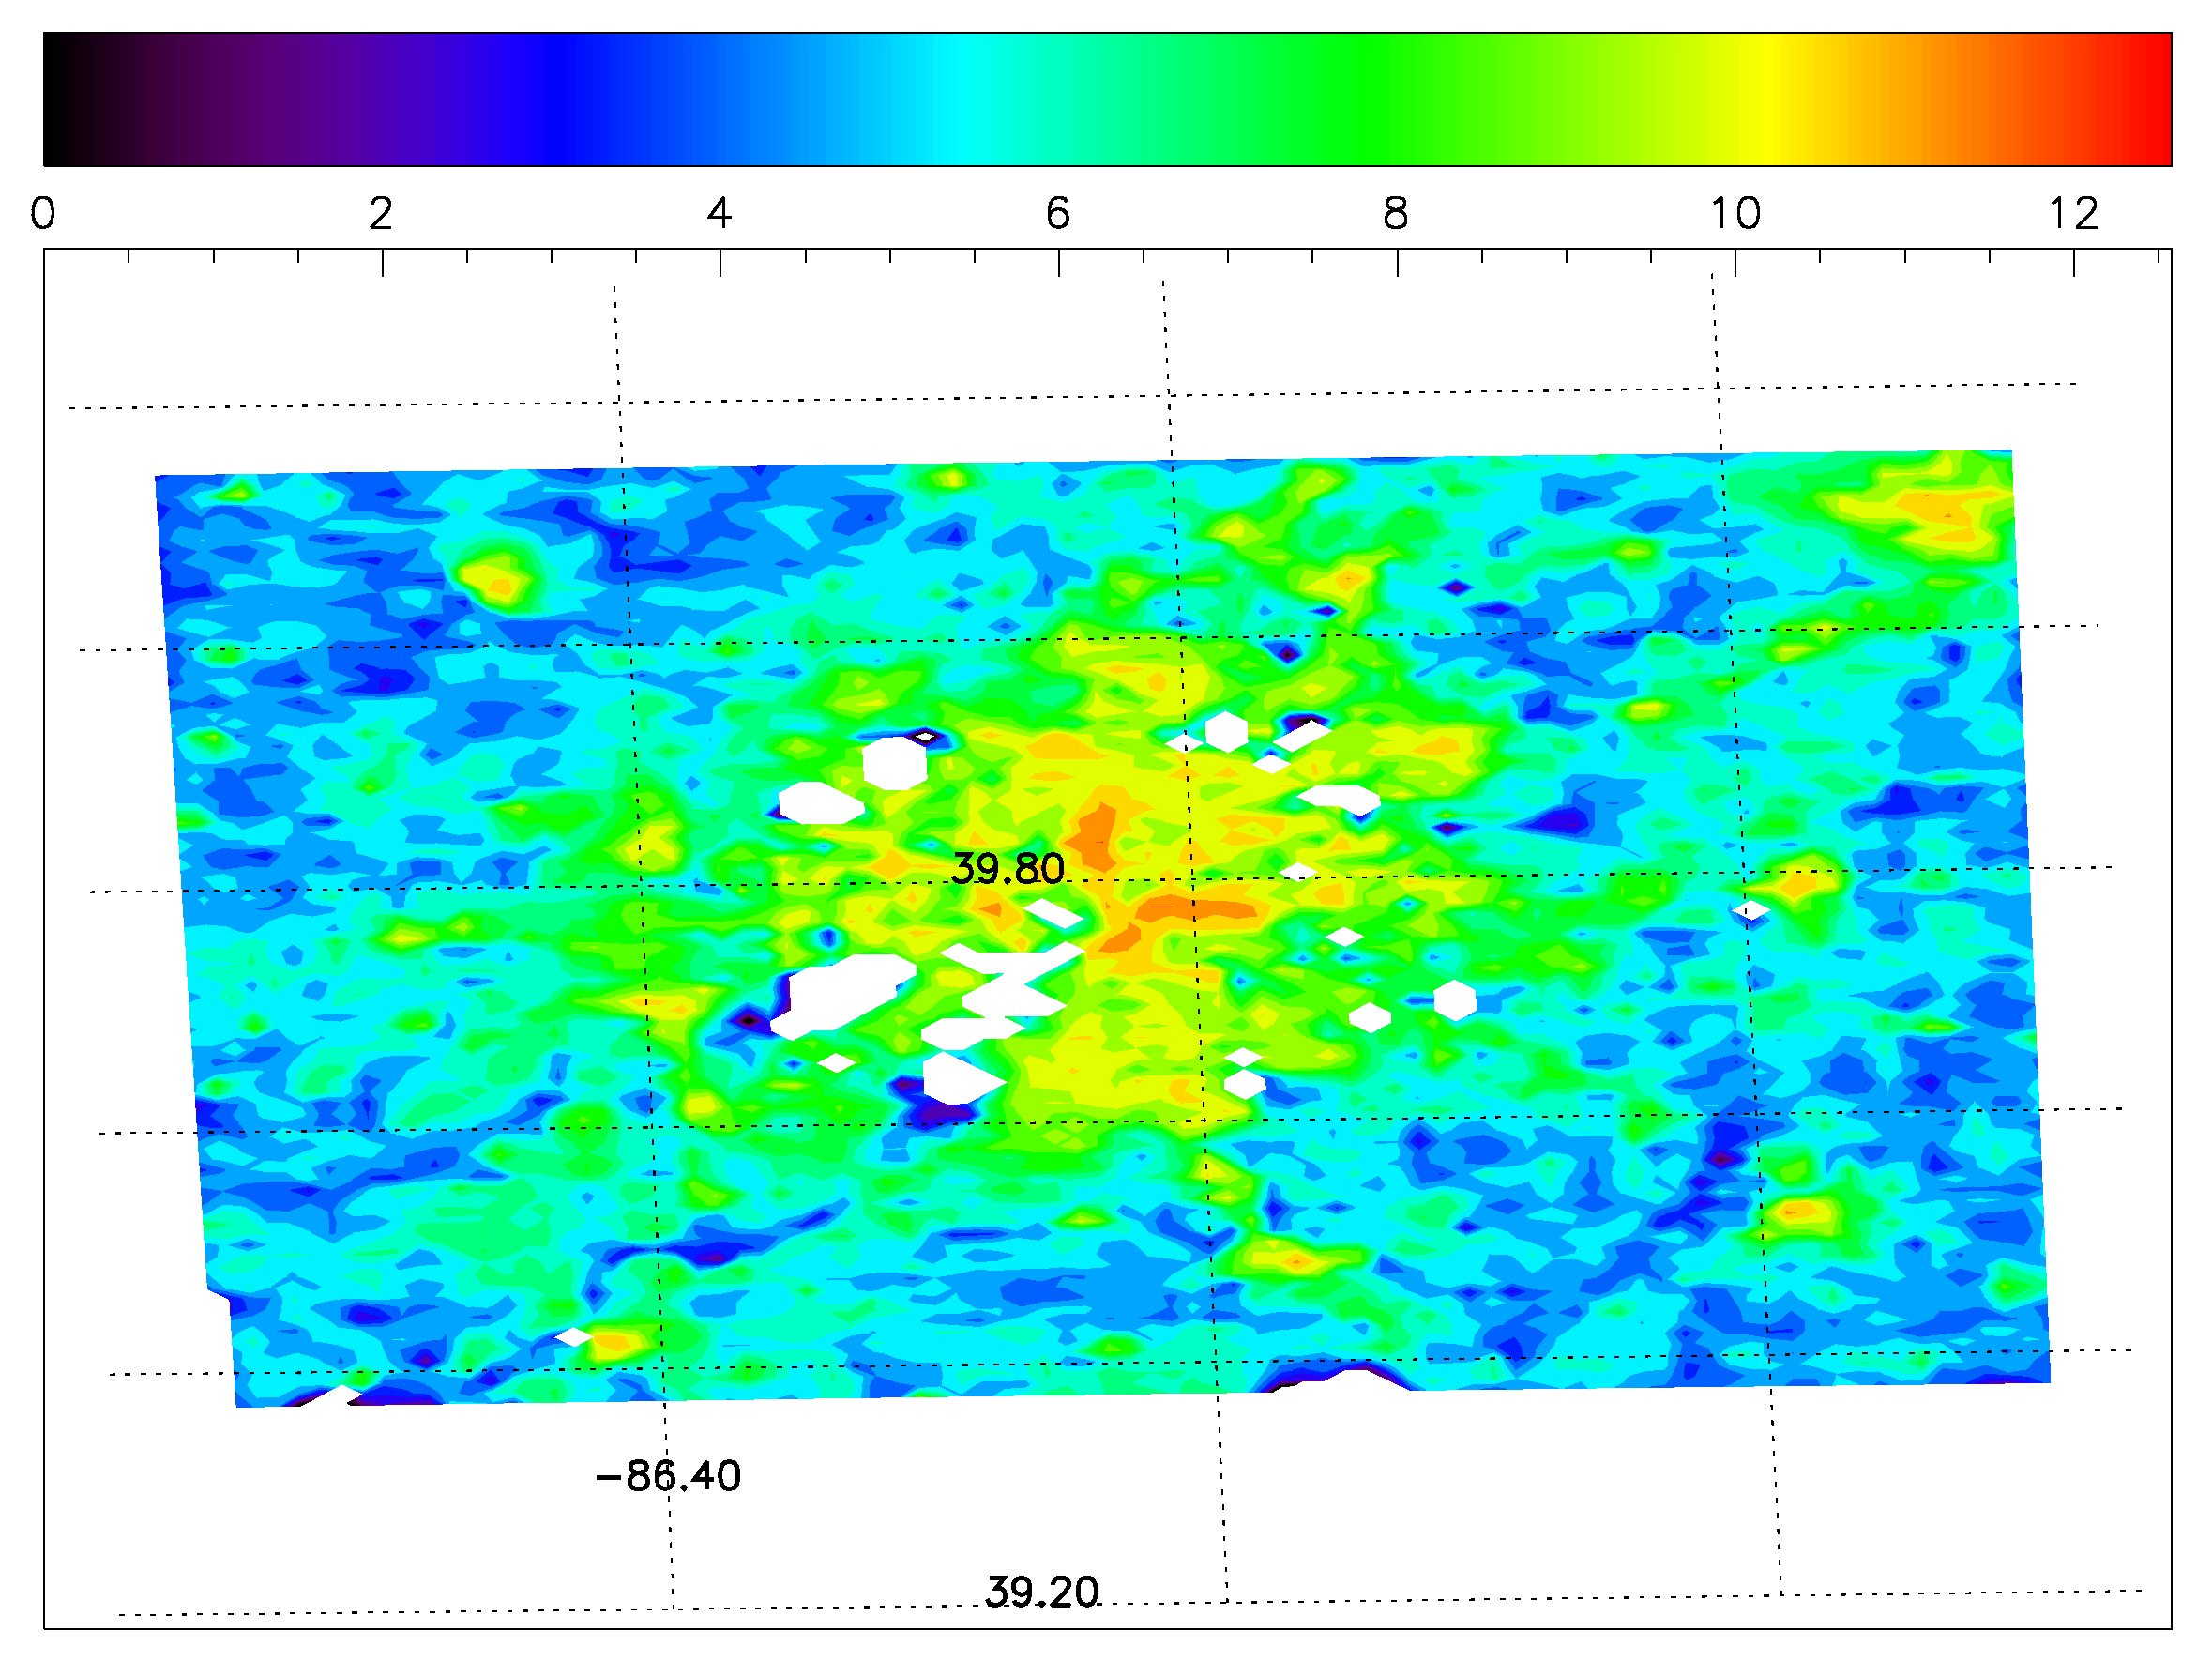
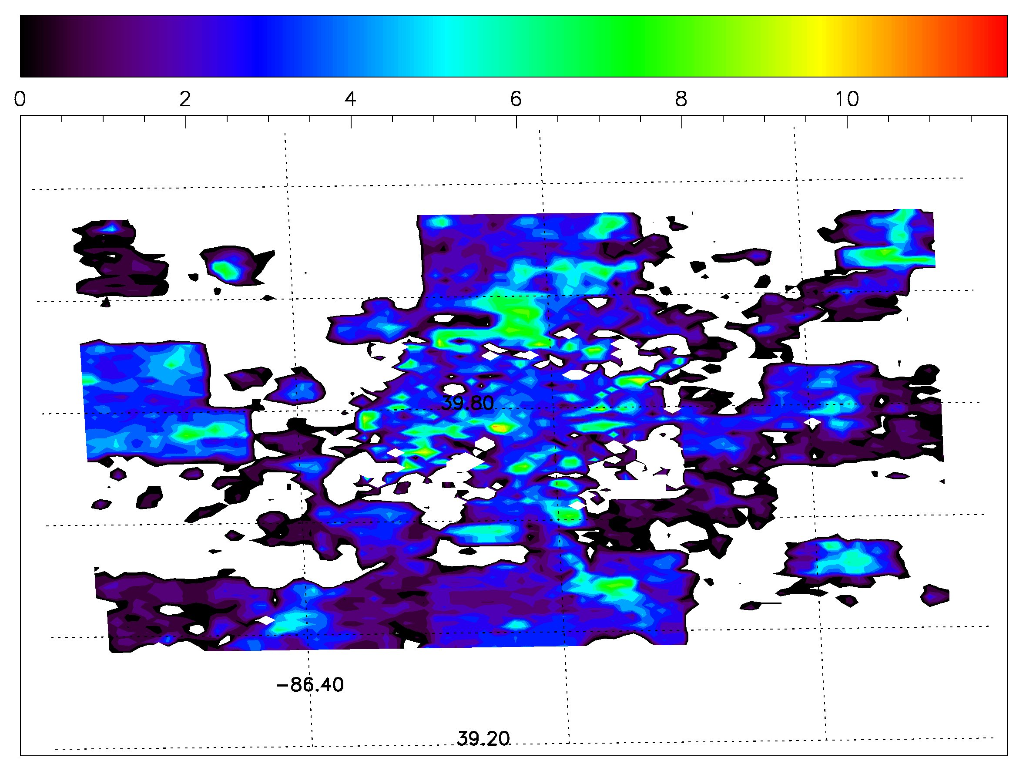
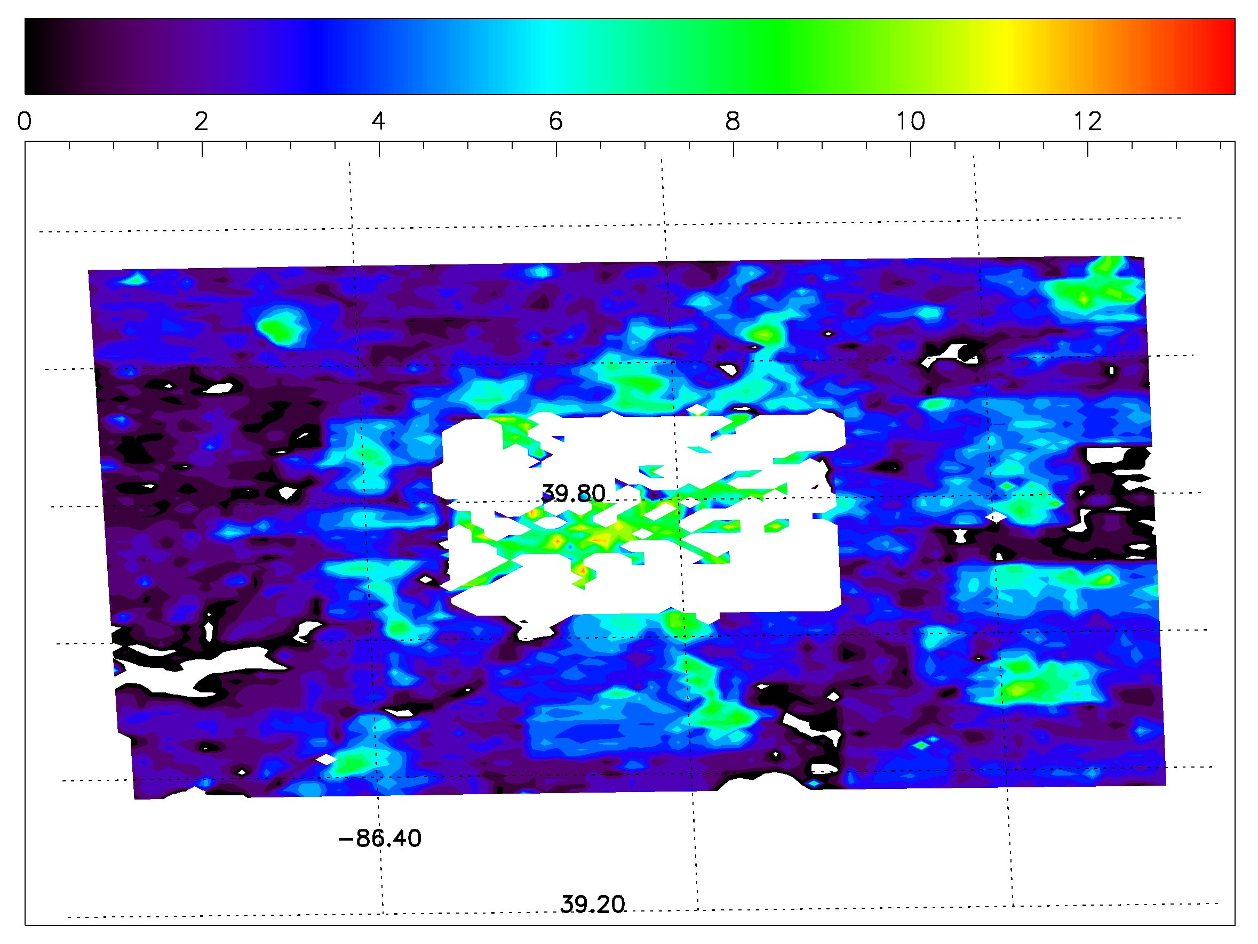
Hestia sectoral emissions within the inner domain
Road sector
Residential sector
Commercial sector
Industrial sector

Slide 45
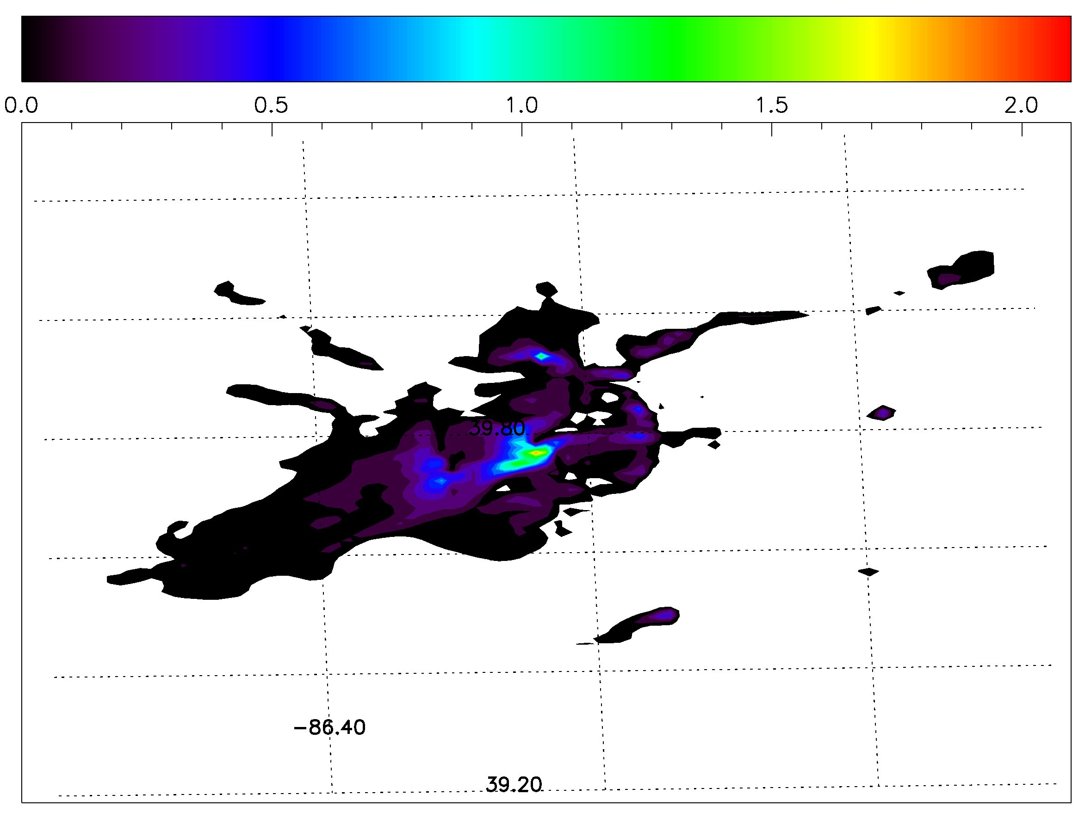
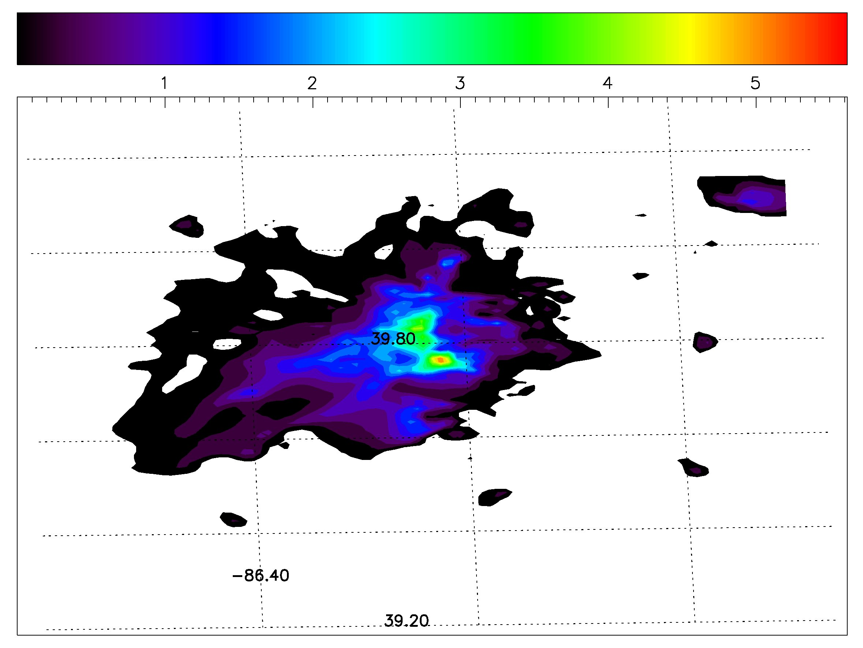
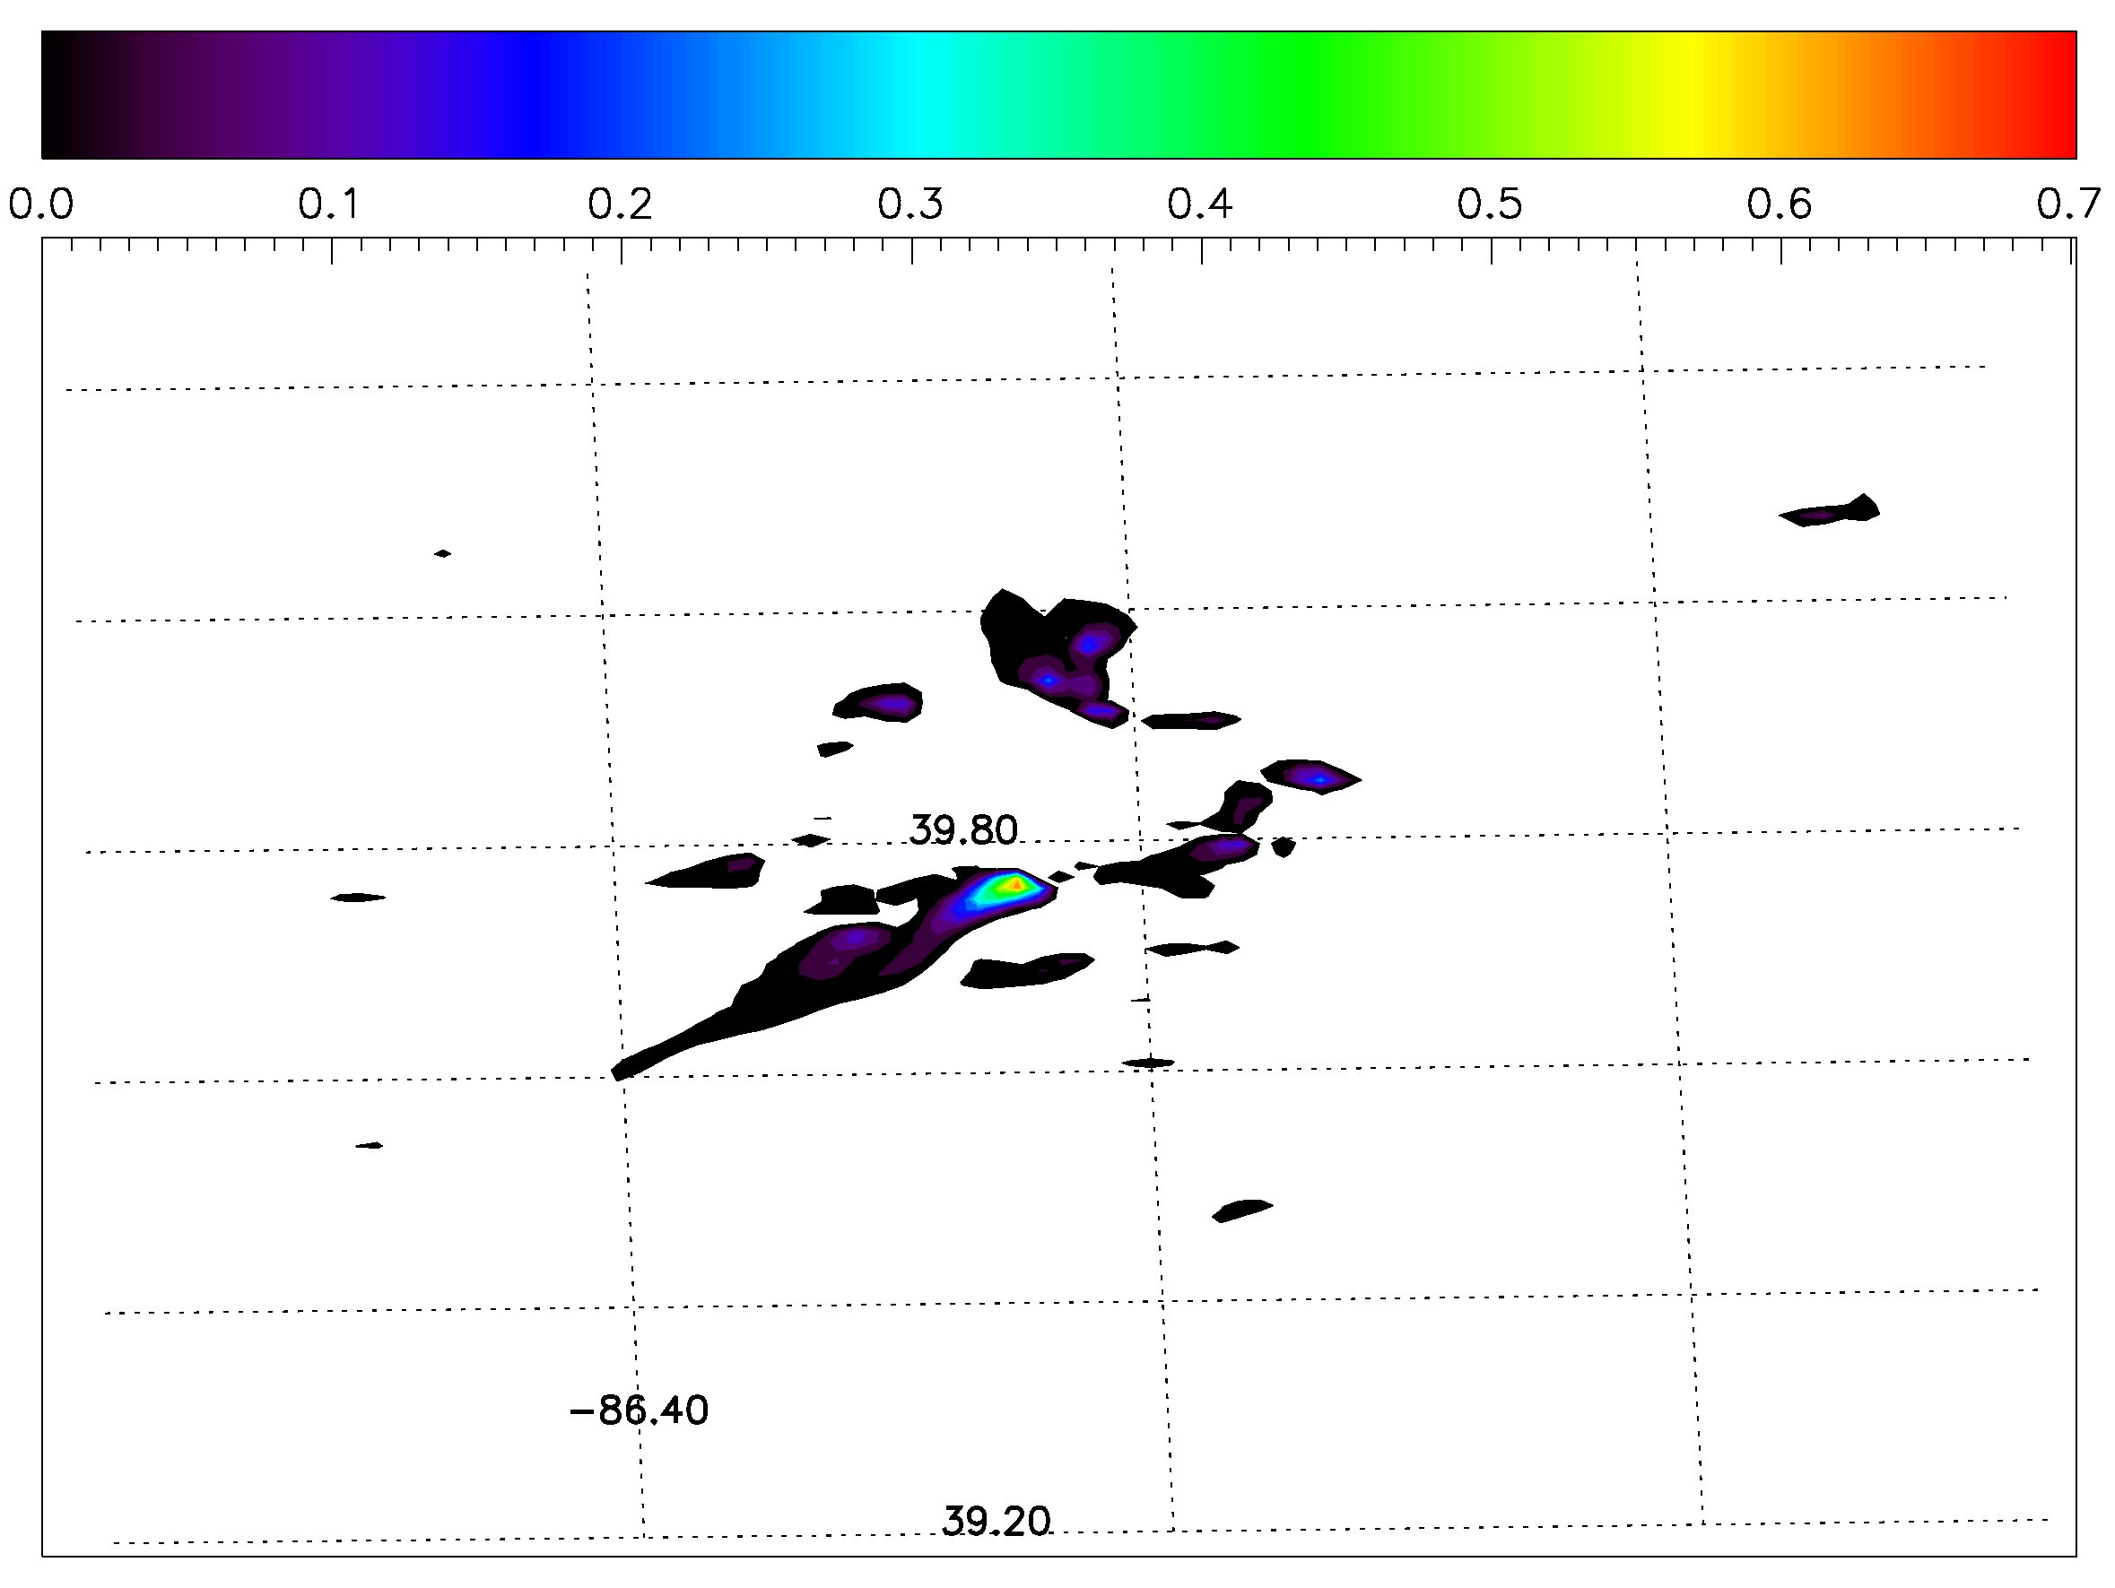
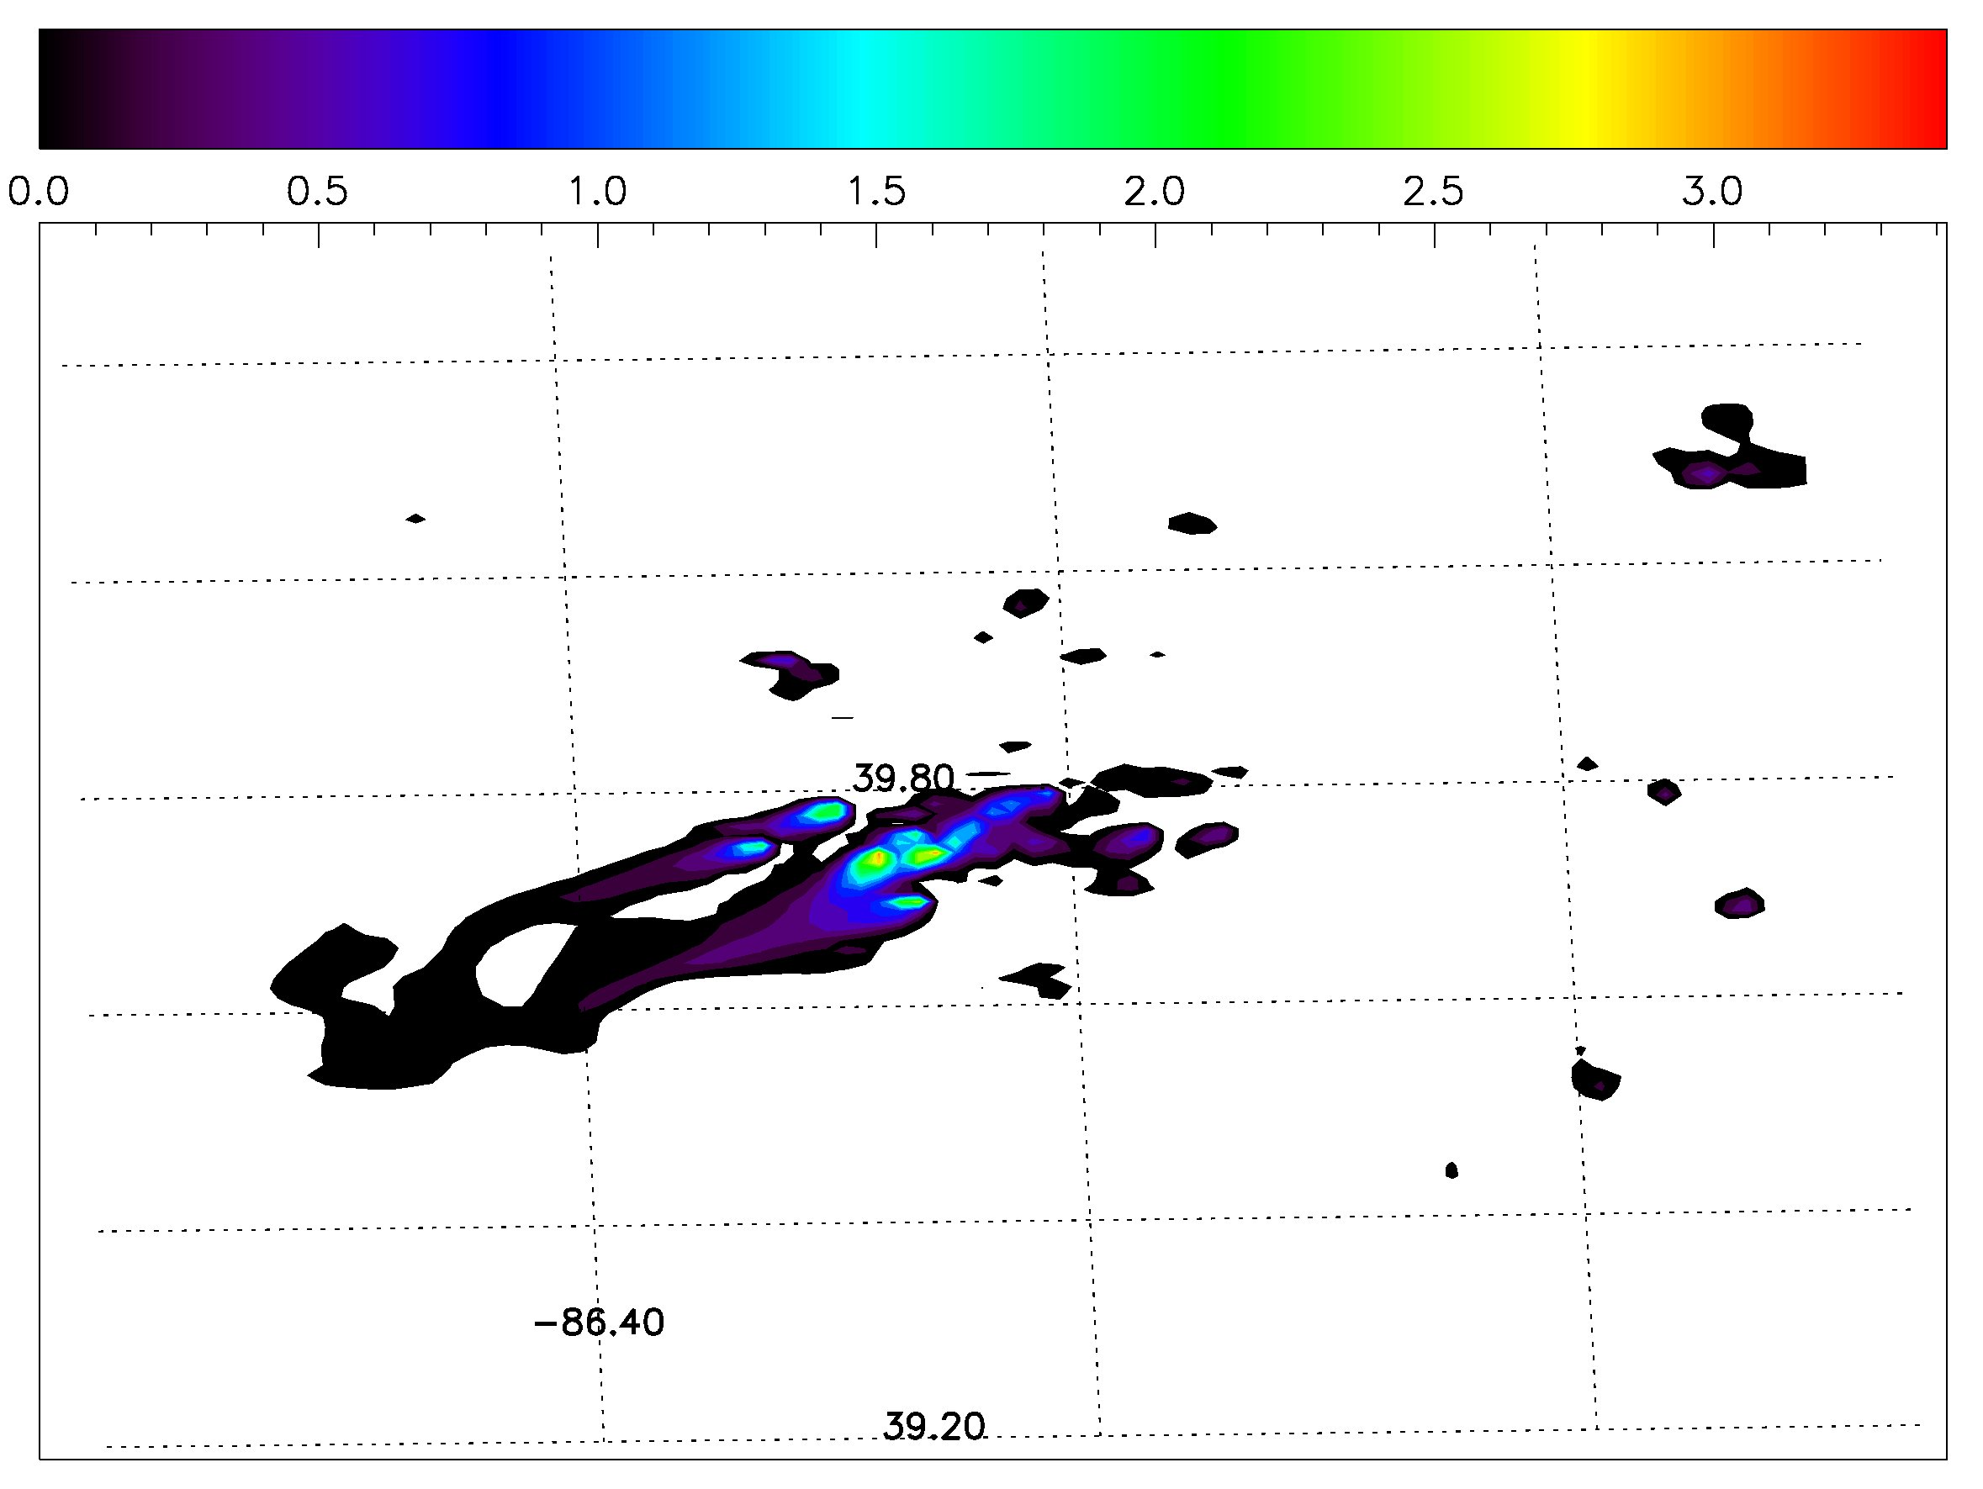
Hestia sectoral emission atmospheric mole fractions
Mixing ratios of tenths to a few ppm
Road sector
[CO₂] Oct 8th 17:00LT
Residential sector
Commercial sector
Industrial sector

Slide 46
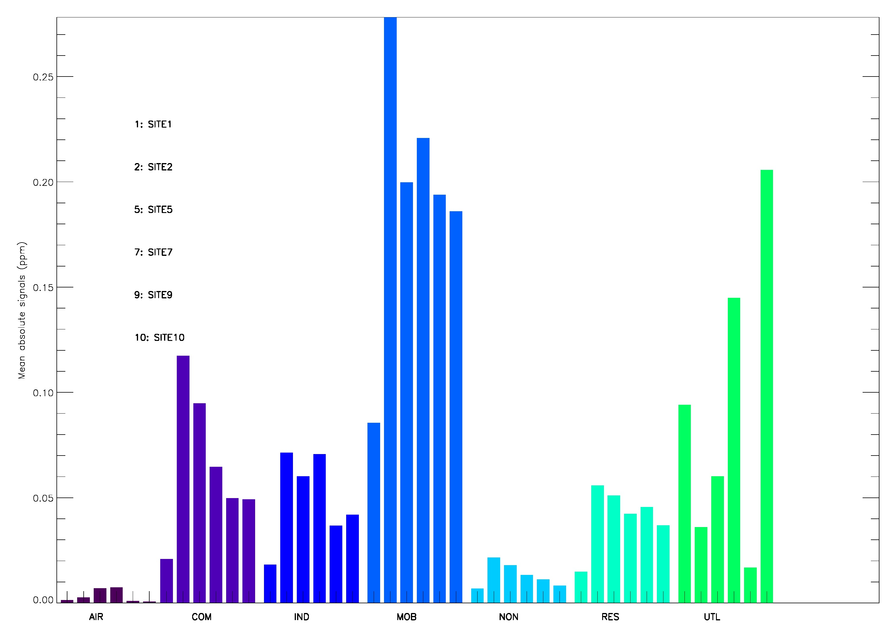
Sectoral atmospheric mole fractions, tower by tower
Winter mean mole fractions
6 of 12 tower sites
Midday ABL mixing ratio (ppm)
Site 1: background
Site 2: downwind
Site 10: powerplant!
Small mixing ratios(?)
Some structure across
towers by sector.
Site 1
Site 10
2
5
9
7
commer
indust
mobile
resid
powerplant

Slide 47
INFLUX ground-based instrumentation
Picarro, CRDS sensors; NOAA automated flask samplers;
Communications towers ~100m AGL
GC53B-1284: Miles

Slide 48
Conclusions
Tower observations detect a clear urban signal in both CO2 and CH4 (buried amid lots of synoptic “noise”).
Simulations suggest thatlateral boundary conditions (and biogenic fluxes?) are of similar magnitude to urban emissions in determining tower-tower differences in CO2.
Inversion system with 6 towers performs very well under idealized conditions.
Sector contributions are likely difficult to identify from tower CO2 alone.

