Slide 1
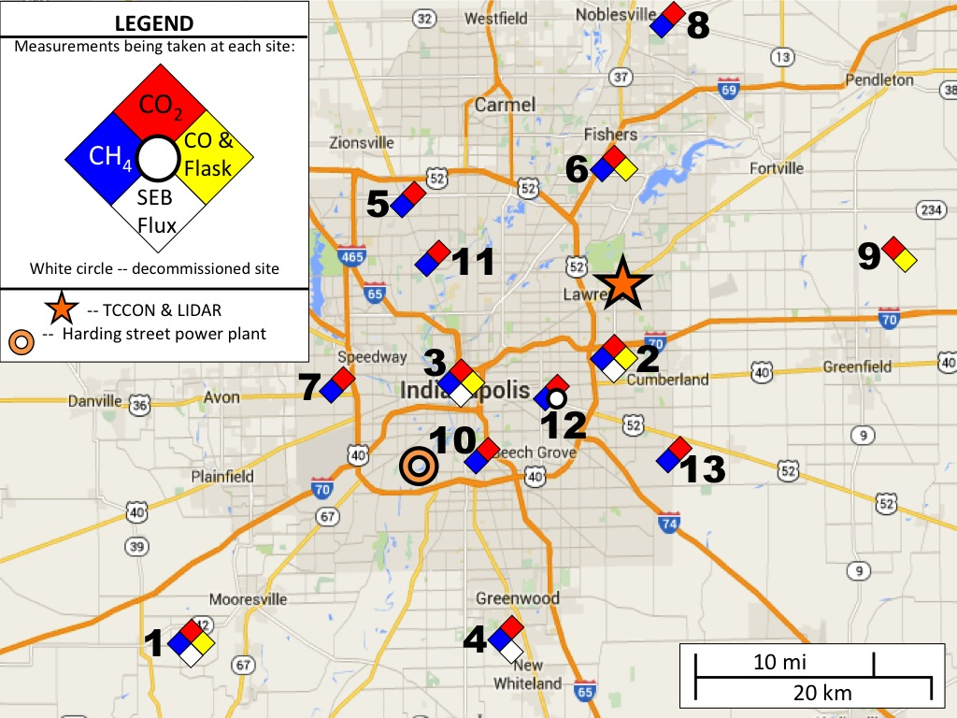
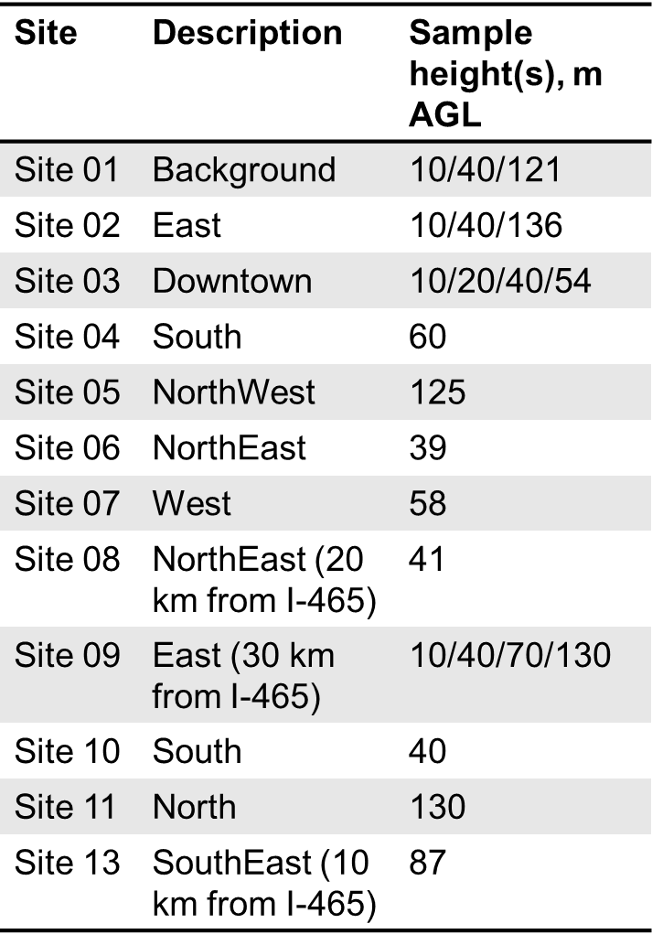
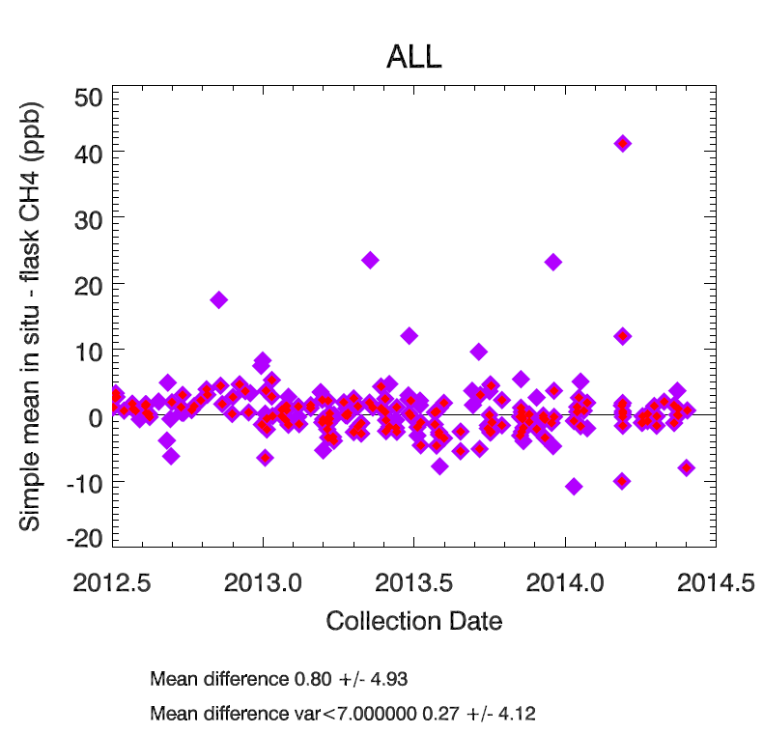
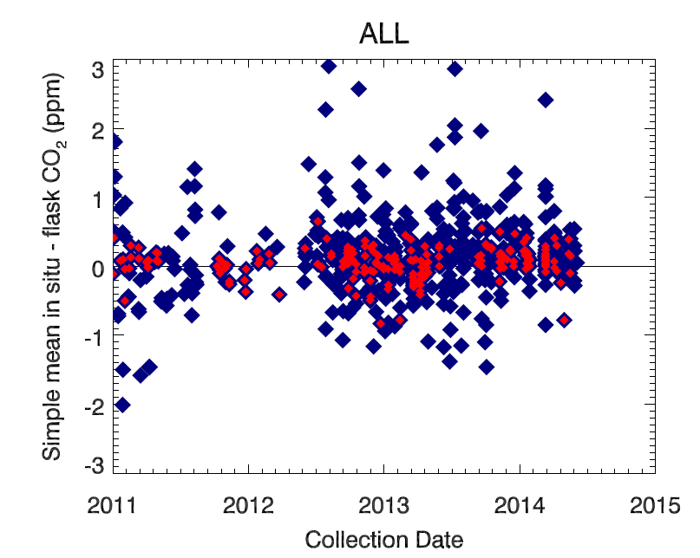
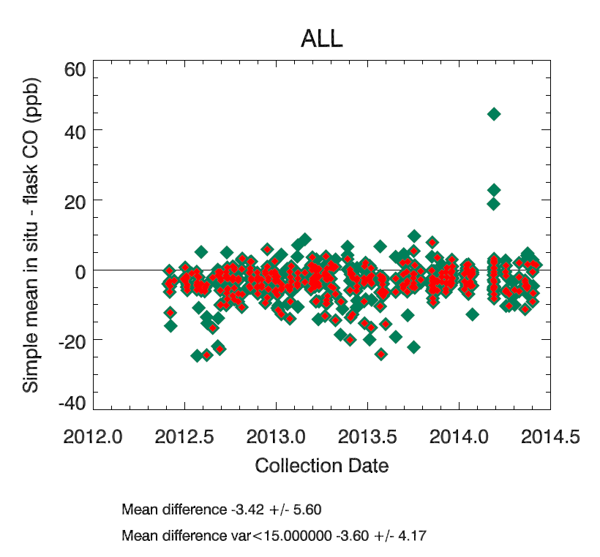
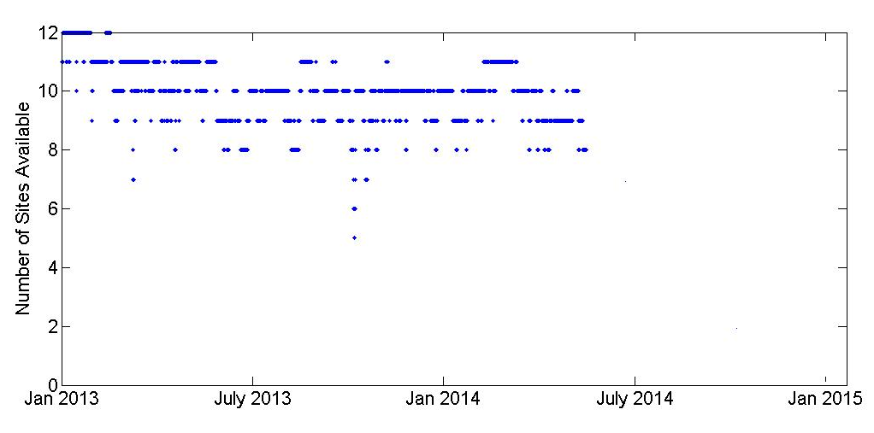
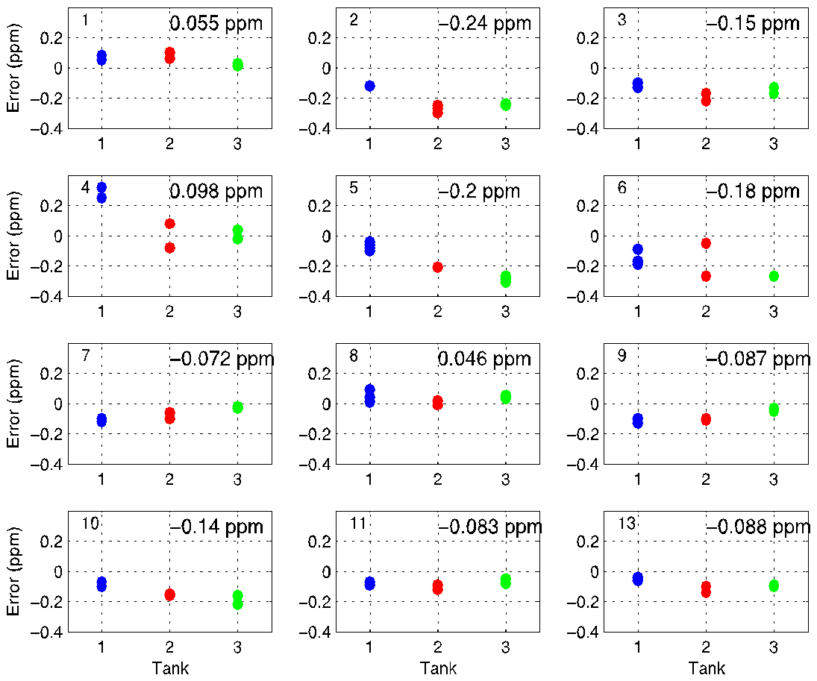
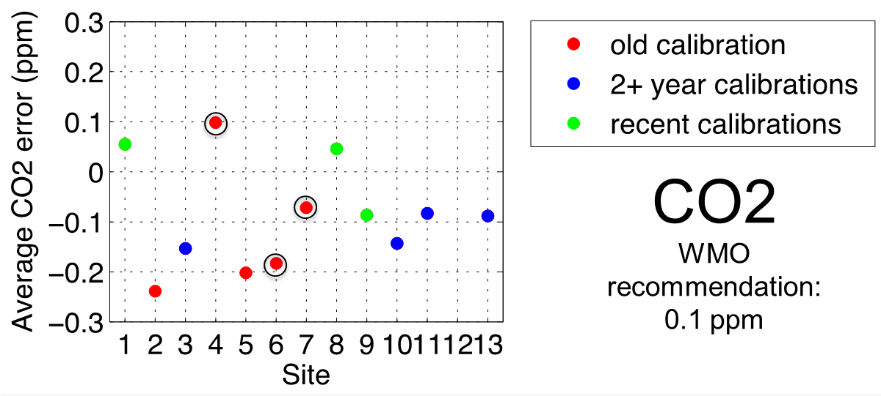
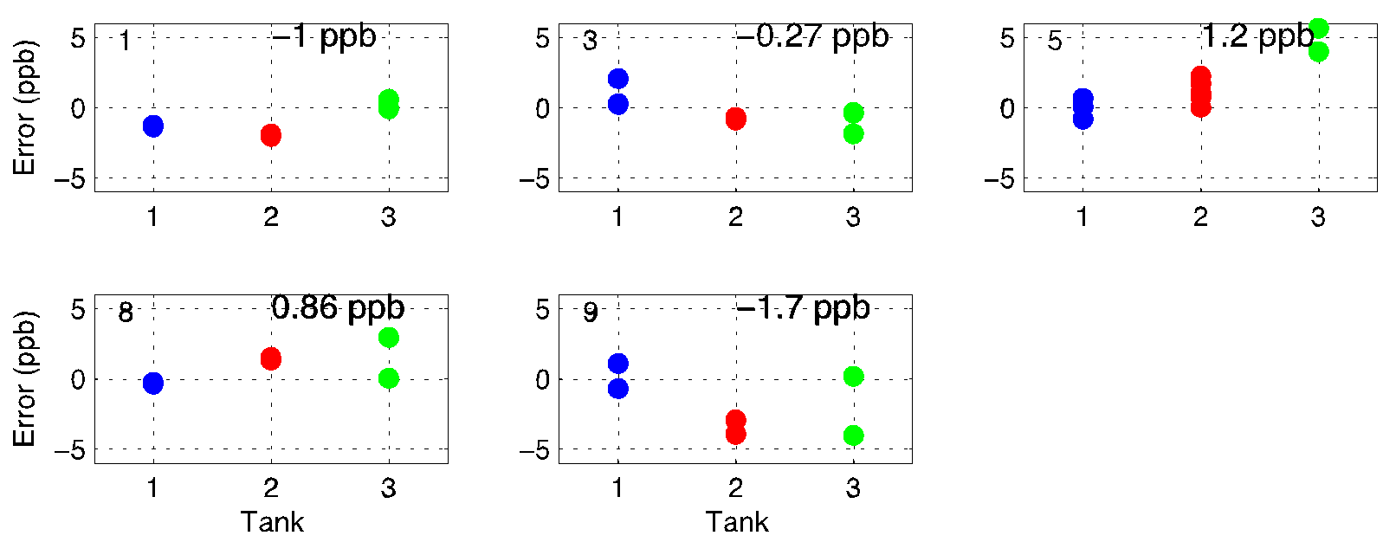
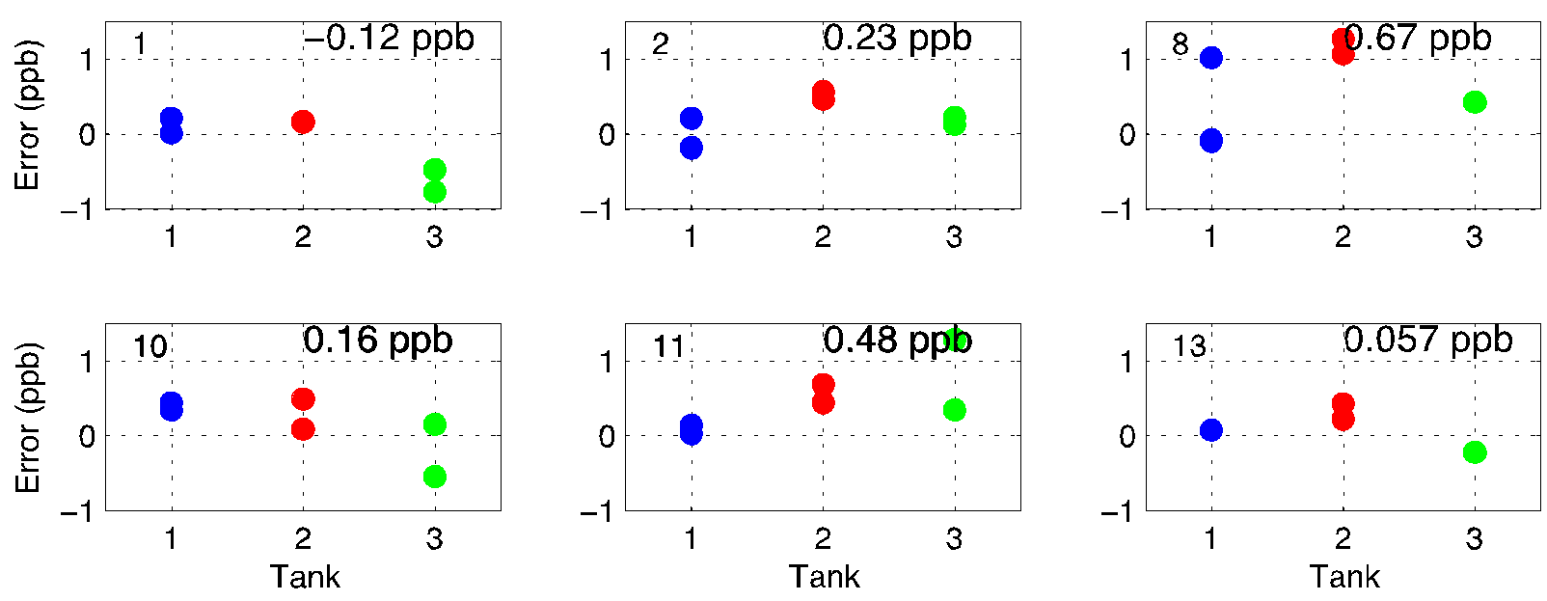
5th NACP Principal Investigators Meeting January 2015, Session: Urban Carbon
CO₂, CO, and CH₄ Surface In-Situ Measurement Network Uncertainty Analysis and Calibration Procedures in Support of the INFLUX Experiment
Scott Richardson¹, Natasha Miles¹, Thomas Lauvaux², Kenneth Davis¹,
Jocelyn Turnbull^{3,4}, Anna Karion³,Colm Sweeney³
¹Penn State University, ²Jet Propulsion Lab, ³NOAA/University of Colorado, ⁴GNS Science
The INFLUX Experiment
A 12 station surface-based measurement network monitoring CO₂, CO, and CH₄ has been deployed in and around the Indianapolis, IN metropolitan area as part of the Indianapolis Flux Experiment (INFLUX). Measurements began in 2010 with network installation completed in 2013. Observations are made at heights ranging from 39 m to 130 m using communication towers.
Current State of Tower Measurements:
Cavity ring-down spectrometers (Picarro, Inc.) used at all 12 sites
Each site has at least one calibrated reference tank sampled daily.
2 sites measure CO₂, CO, and CH₄
3 sites measure CO₂ and CO
7 sites measure CO₂ and CH₄
4 CO₂-only replaced with CO₂ and CH₄ in Fall 2014
Flasks packages at 5 sites provide
One-hour integrated air samples
This poster will discuss:
Instrument calibration procedures
Round-robin test
Flask – In Situ data comparison
Total data availability
Flask Comparison
Flasks filled to provide a one-hour integrated air sample (Turnbull et al., 2012)
Hourly average in situ values compared to flask CO₂, CO and CH₄ values
The mean offset between in situ and flask measurements is determined for all measurements
Then subset of measurements with low variability in the in situ measurements within the hour
CO₂ < 0.5 ppm, CO < 15 ppb, CH₄ < 7 ppb
The low variability subset should provide a better comparison.
CO₂ mean difference of 0.05 ± 0.22 ppm (is consistent across all towers and instruments).
CH₄ Biases within WMO 2 ppb tolerance
CO Biases within WMO 5 ppb (urban) tolerance
All data mean diff: -3.4 +- 5.6 ppb
Low variability mean diff: -3.6 +- 4.2 ppb
All data mean diff: 0.8 +- 4.9ppb
Low variability mean diff: 0.3 +- 4.1 ppb
All data mean diff: 0.13 +- 0.54 ppm
Low variability mean diff: 0.05 +- 0.22 ppm
Round Robin Results
Very recent calibration at sites 01, 08, and 09
Ave site error: -0.08 to +0.05 ppm CO₂
~2 year old calibration at sites 03, 10, 11, and 13
Ave site error: -0.15 to -0.08 ppm CO₂
> 2 year old calibration at site 02, 04, 05, 06, and 07
Ave site error: -0.25 to +0.1 ppm CO₂
Time since last cal more important than age of instrument
CO₂ only first generation systems (circled)
-0.18 to 0.1 ppm average
CO₂ Round Robin
Instrument Calibration Procedure
Prior to deployment each CRDS calibrated using 4 NOAA primary standards
CO₂ : 356 – 435 ppm, X2007 scale
CO: 130 – 303 ppb, WMO CO X2014 scale
CH₄ : 1700 – 2400 ppb, NOAA04 scale
Round Robin Calibration
3 tanks tested 1-5 times at each site, treated as unknowns.
CO₂ : 395.76 ppm / 433.17 ppm / 451.17 ppm
CO: 143.56 ppb / 254.49 ppb / 305.67 ppb
CH₄ : 1865.29 ppb / 2117.14 ppb / 2350.98 ppb
Sites 01 and 09 calibrated immediately prior to round robin
Site 08 calibrated August 2013
Sites 03, 10, 11, and 13 calibrated July 2011 at NIST
Sites 02, 04, 05, 06, and 07 calibrated following round robin (“old” calibrations”)
CO Round Robin
CH₄ Round Robin
Measurement Network Plans
Maintain 12 measurement sites
Conduct round robing testing with full re-calibration using 4 tanks every 1-2 years
Move one site to NW of city to investigate background site effect on inversion results
CONTACT: Scott Richardson, (814) 574-3232
srichardson@psu.edu

