Slide 1
Environments Speak: What is Yours Saying?
Joan V. Miller
The Pennsylvania State University
Division of Undergraduate Studies
Graduate Assistant

Slide 2
Overview
Theoretical Background
Example of Application to an Advising Environment
Opportunity to Apply to Participants’ Environment

Slide 3
Developing a Mindset
Dewey, 1933
“We never educate directly, but indirectly by means of the environment. Whether we permit chance environments to do the work, or whether we design environments for a purpose makes a great difference.”
Winston
Churchill
“We shape our buildings and then they shape us.”
Strange & Banning, 2001
“Students deserve nothing less than an educational environment that is affirming, energizing, challenging and productive.”

Slide 4
Perspectives Informing Student Relationships with Institutions
Unenlightened
Adjustment
Developmental
Ecological
(Strange & Banning, 2001)
Notes:
Unenlightened – some students won’t make it – help ease those students out onto other endeavors/ Adjustment – help students change to fit/adjust to environment/ Developmental – students must reach certain points of readiness; require support/ Ecological - incorporates the influence of environments on persons and persons on environments. IN THIS PERSPECTIVE INSTITUTIONS BEAR THE REPSONSIBILITY FOR DESIGN AND CREATION OF CAMPUS ENVIRONMENTS THAT ARE ARRANGED APPROPRIATELY TO PROVIDE EDUCATIONAL SUPPORTS

Slide 5
Component Features
Physical
Human Aggregate
Constructed Environment

Slide 6
Physical Environment
Functional
Spatial layout, accessibility, proxemics
Ambient Conditions
Symbolic
Signs, symbols, artifacts – reflect the culture and communicate values/expectations
Non-verbal communication
Notes:
POWERFUL FIRST IMPRESSION
THE IMPACT OF PHYSICAL DIMENSIONS ON BEHAVIOR OF PARTICIPANT/GENERAL INFLUENCE ON BEHAVIOR
THE NON VERBAL MESSAGING CONVEYED IN THE PHYSICAL SPACE MUST NOT CONTRADICT THE VERBAL MESSAGING BEING GIVEN.
RESEARCH HAS SHOWN THAT NON VERBAL MESSAGING MOST OFTEN BELIEVED AS TRUE

Slide 7
Goal: Behavior Setting
Messages in physical environment remind participants what behaviors are expected.
Gather, study, discuss, relax
“Campus spaces do not merely create a functional space or atmosphere; they facilitate expected behaviors.”
Wicker, 1984

Slide 8
Human Aggregate
Environments are structured to support the people who reside in them.
Who is in the environment?
“Environments are also transmitted through
people. The dominant features of a particular environment are partly a function of the
collective characteristics of the individuals
who inhabit it.” Holland, 1973

Slide 9
Human Aggregate Category Examples
Major
Race/Ethnicity
Physical Ability
Sexual Orientation
SES
Personality

Slide 10
Considerations
Differentiation
Is there a dominant group?
Consistency
Who comprises the group?
What are their characteristics and needs?
How similar are they?
Are all types represented in the environment?
Are there different types present?
Is it a critical mass of one similar type?

Slide 11
Constructed Environment
What is the environmental press of the current environment?
Does the perceived environment lead to intended outcomes?
Important to understand whether all students are taking in the environment as was intended
The collective perceptions of the students within
Subjective views and experiences of the participants

Slide 12
Framework for Environmental Audit
Social
Ecological
Approach
“Multidisciplinary study of the impacts of physical and social environments on human beings.” Moos, 1986
Goals
Eliminate stressful, inhibiting features
Create features that will challenge students toward learning, growth and development
Components
Physical space
Perceptions/social climate/culture
Build community
Aggregate Characteristics

Slide 13
DUS Advising Student Waiting Area

Slide 14
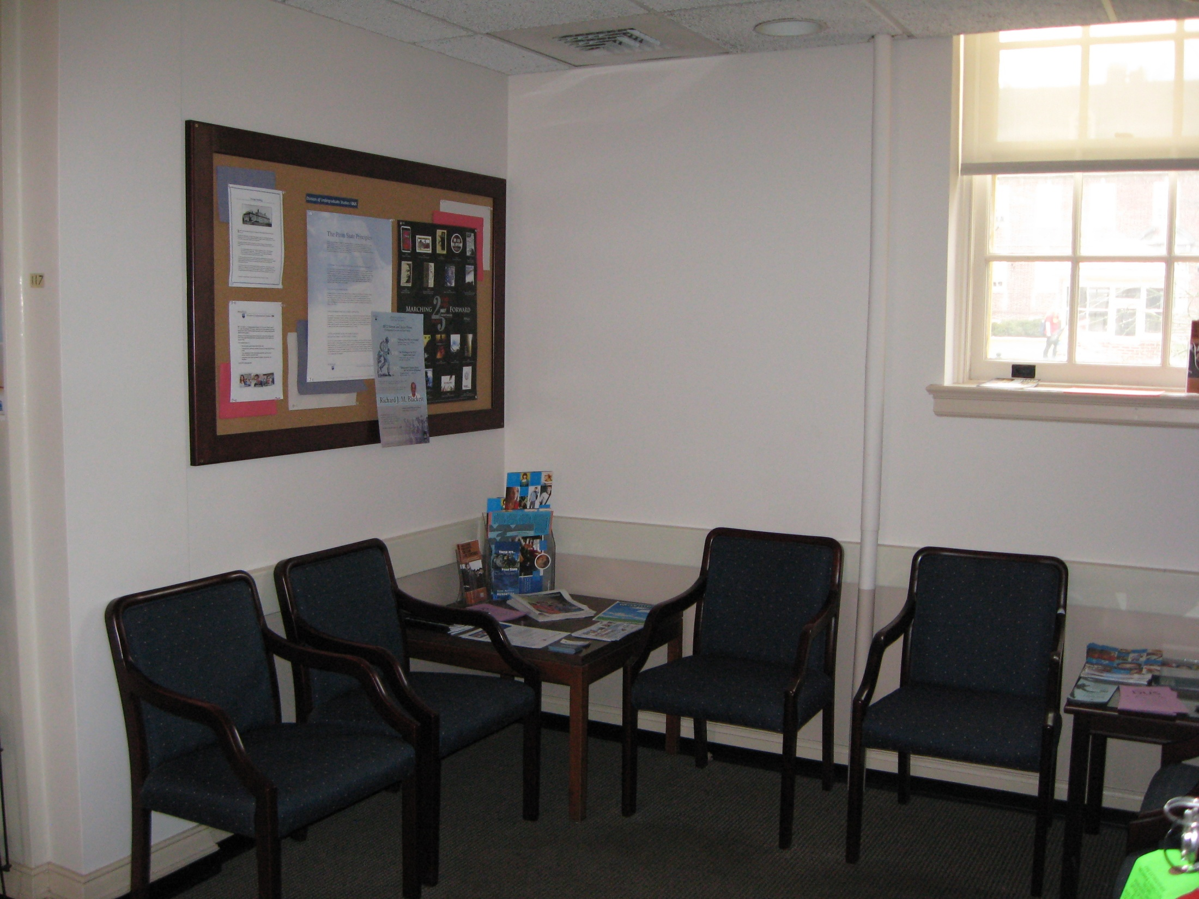

Slide 15
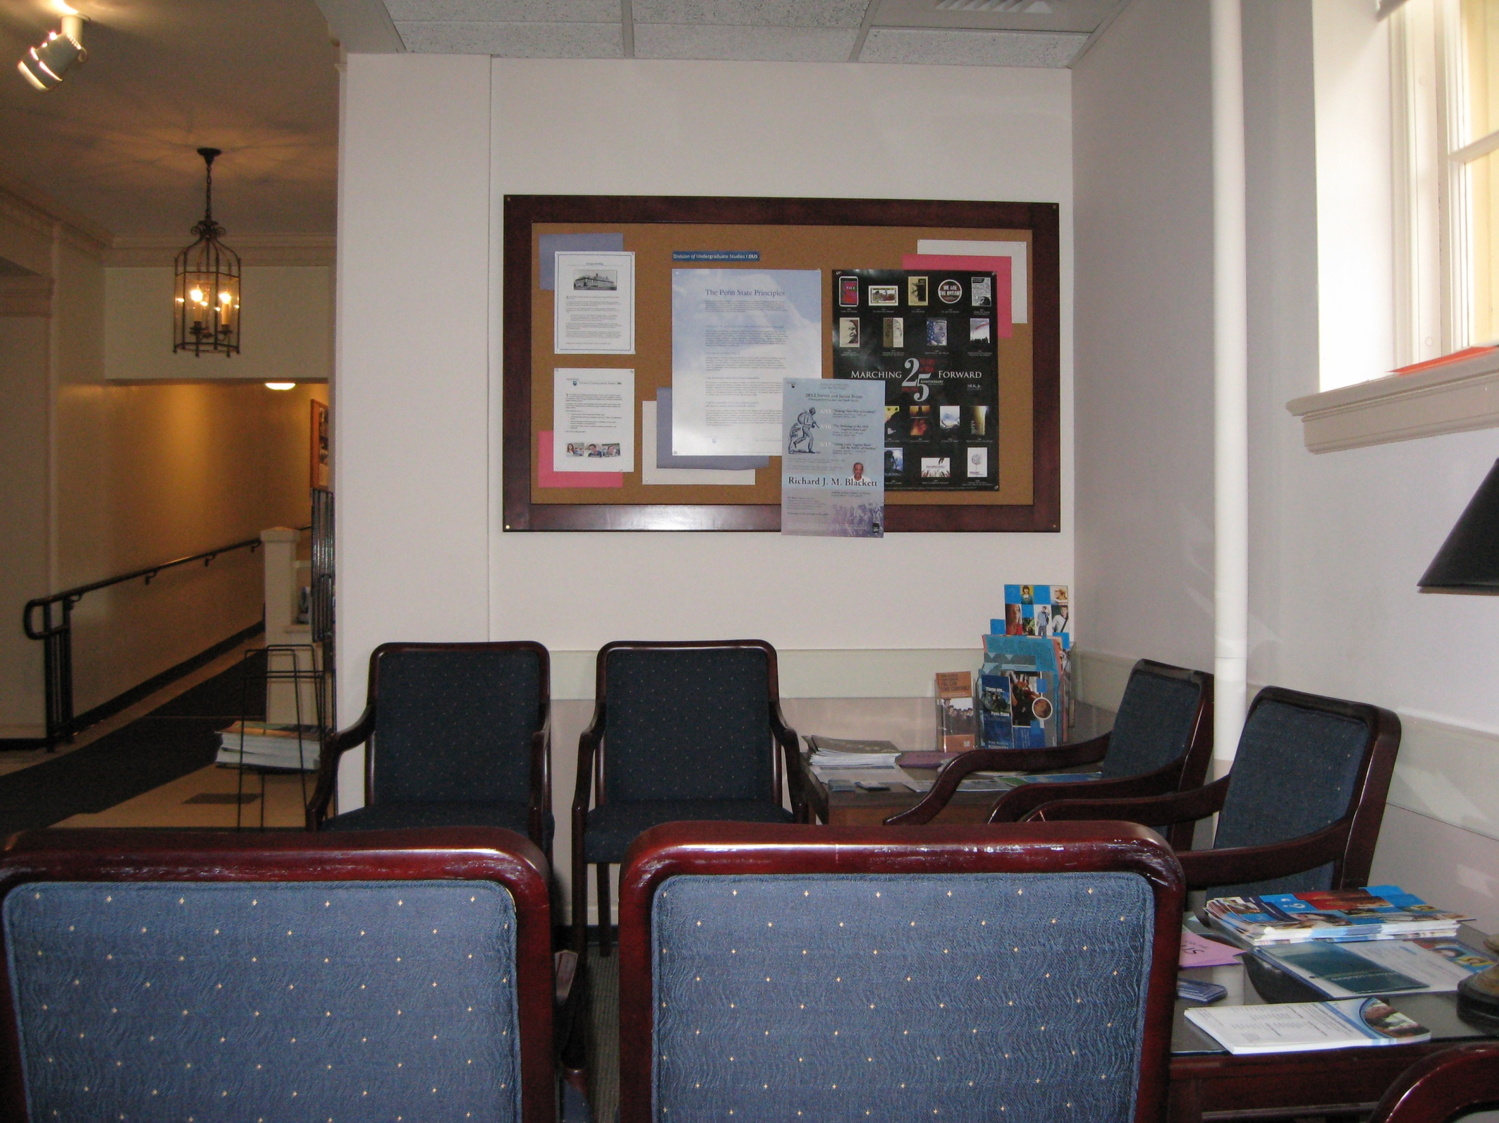

Slide 16
Constructed Environment
What are our expectations for students? What behaviors do we want to promote?
Intentional exploration
Environmental Press
Academic culture of exploration through education about options and decision making. Students explore themselves and the curriculum.
Well-informed educational planning
Intellectual development
Student ownership of education and decision making

Slide 17
Physical Space
Goal
Space that reflects academic culture and aggregate qualities of students.
Comfortable space that that also represents differences among us.

Slide 18
Human Aggregate
Dominant
Sub types
Various races, ethnicities
International students
Provisional, adult students
Exploratory students

Slide 19
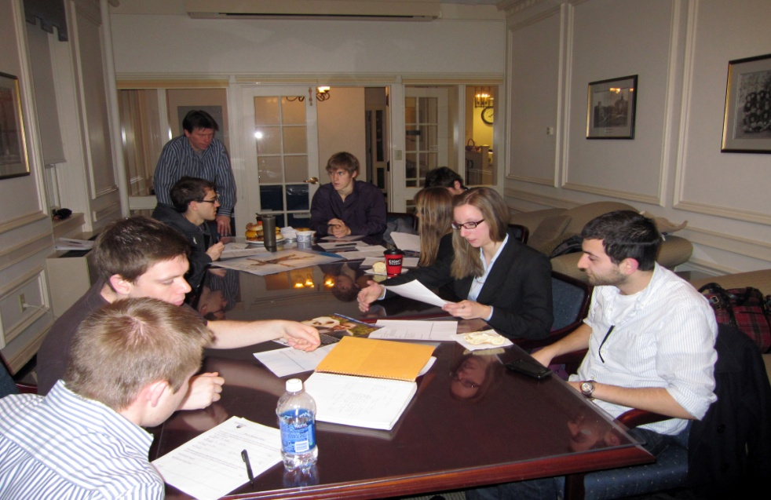
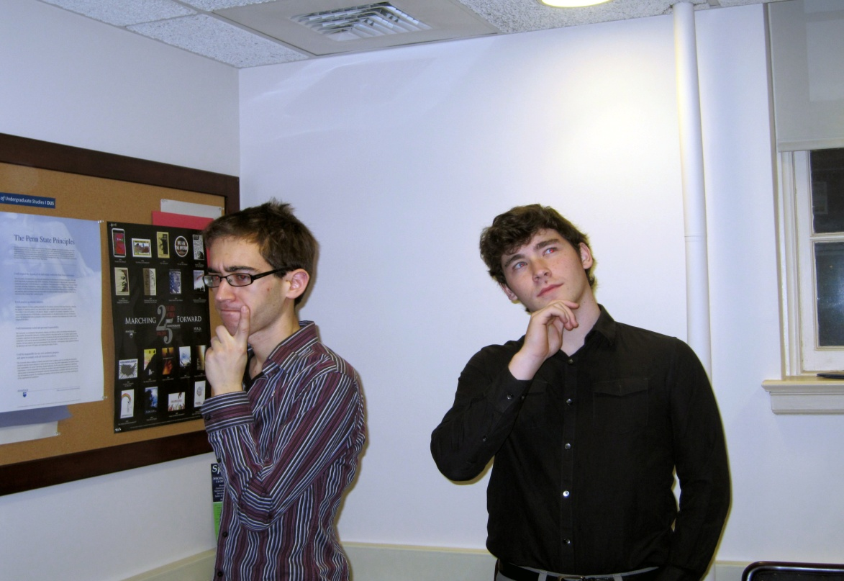
Participant Involvement
Notes:
DUS Leadership Council – provided the student perception of an exploratory environment and contributed great ideas!

Slide 20
Visible Artifact of Exploration
Notes:
Clearly supports all of the behavioral expectations of our academic culture.

Slide 21
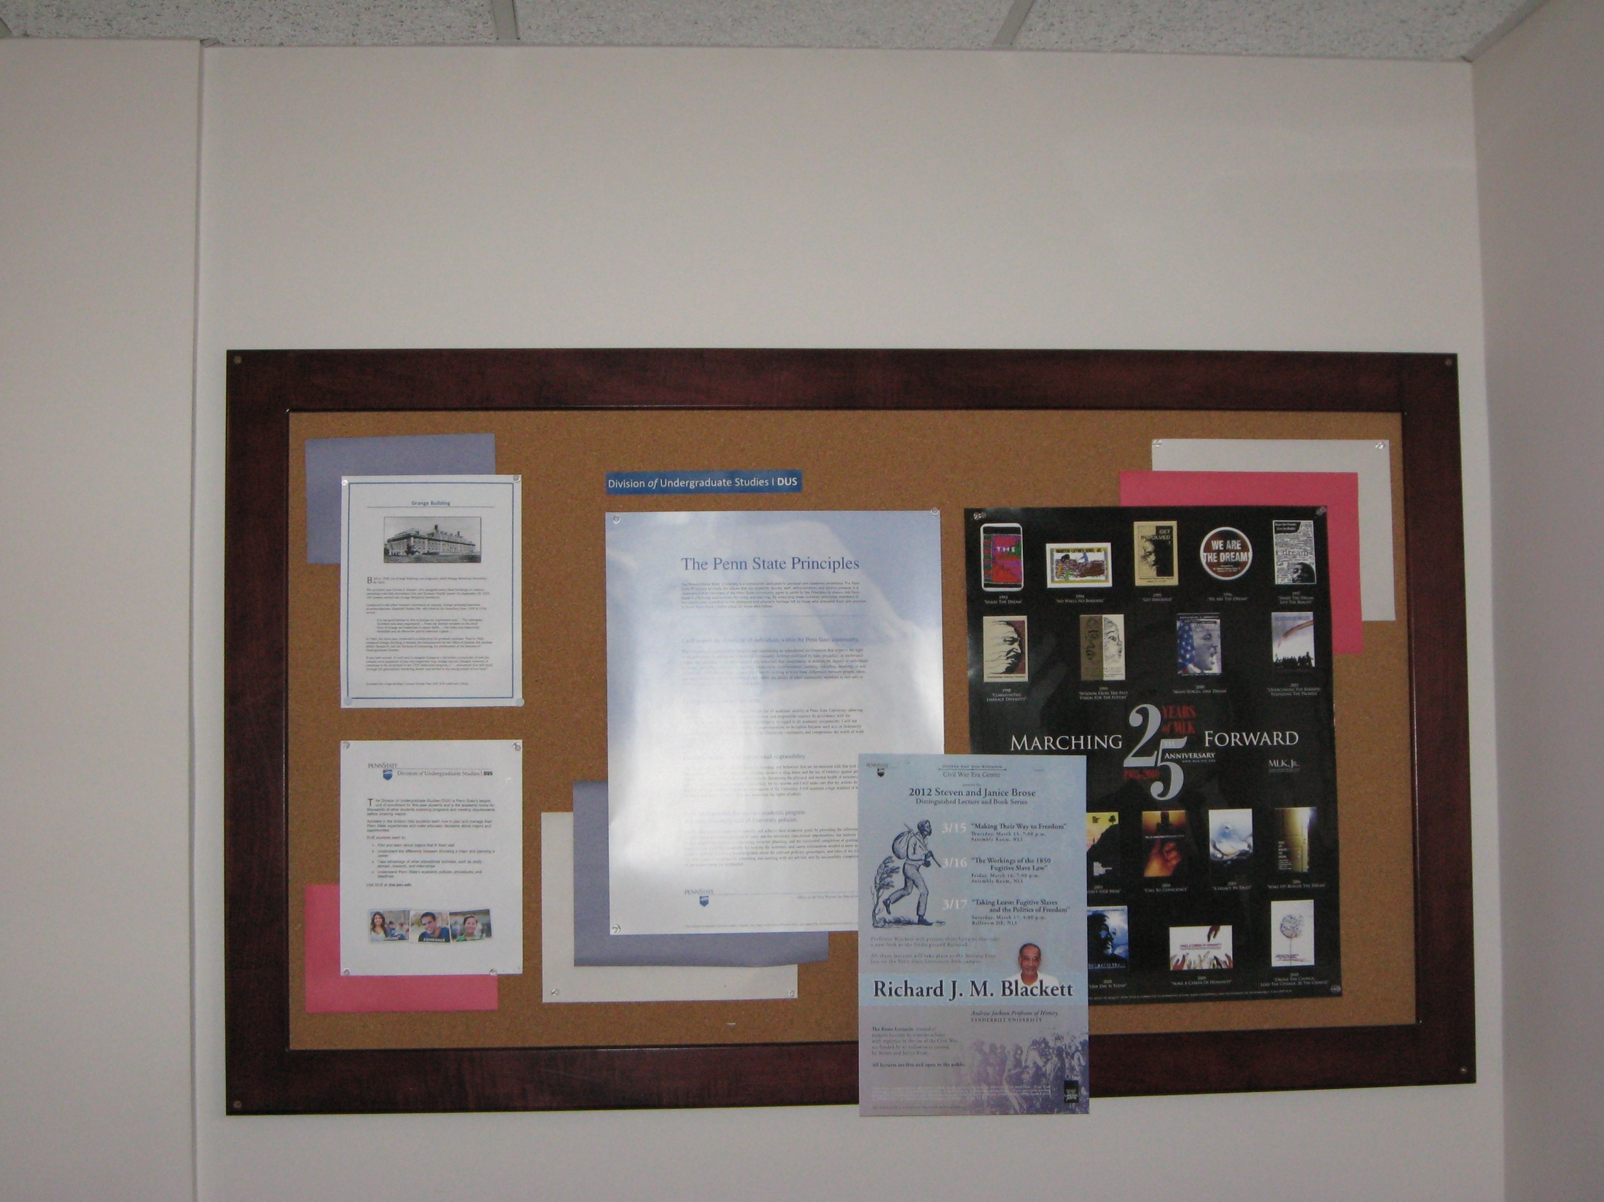

Slide 22
Explore/Experience Bulletin Center
Educated Decisions—Division of Undergraduate Studies
Notes:
Promotes experiences and opportunities to enhance student exploration – graphic represent all sub types –promotes inclusiveness of unit.

Slide 23
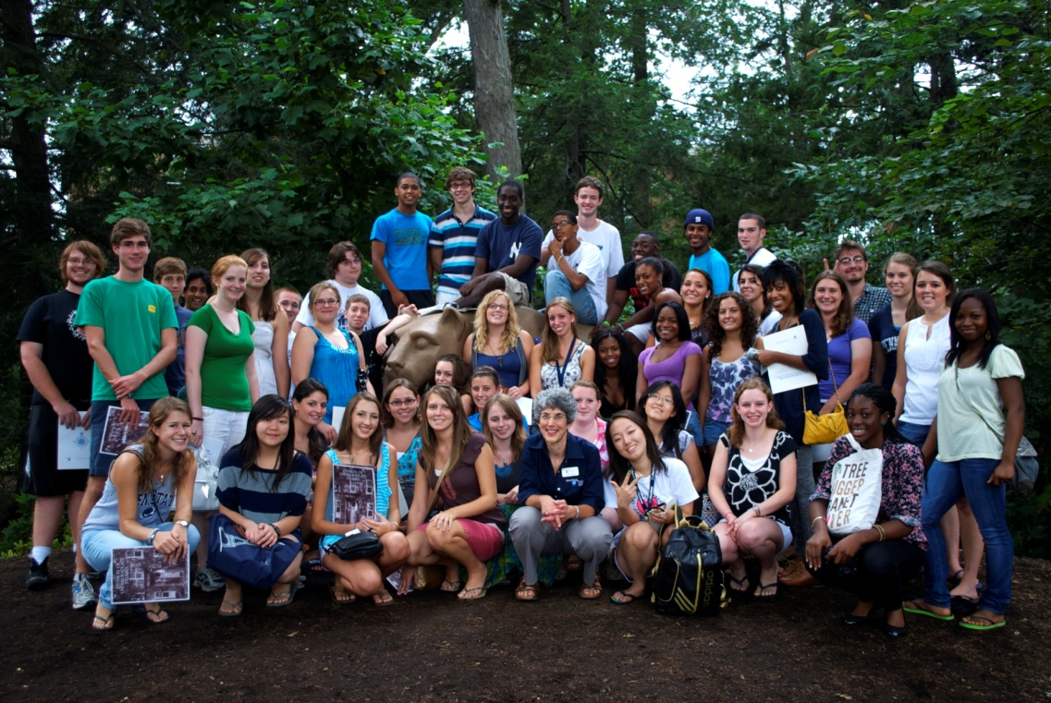
Photo Gallery of our Communities
Discover House Learning Community

Slide 24
What Does Your Environment Say?
Physical
How is furniture arranged? Enhancing or inhibiting expected behaviors? Easily moved?
What unique features are in the space? Are students interacting with them?
Human Aggregate
What kinds of people are typically present in the space?
Are the unique needs of the group being addressed? If not, what changes are needed?
Constructed Environment
Are students using the space as expected?
What behaviors are routine?
What non verbal messages are the artifacts, signs and symbols communicating?
What is the ambience like? Lighting? Temperature? Sound?
Accessibility for all?
What is the nature of interaction between and among individuals ?
How much of the space is devoted to student expression vs. how much is institutional space?
Are all groups represented?

Slide 25
Worksheet

Slide 26
Sharing
What aspects of your environment are working well?
What needs for change were uncovered?

Slide 27
References/Acknowledgements

Slide 28
Questions?
Thank you!
jxm1063@psu.edu

