Slide 1
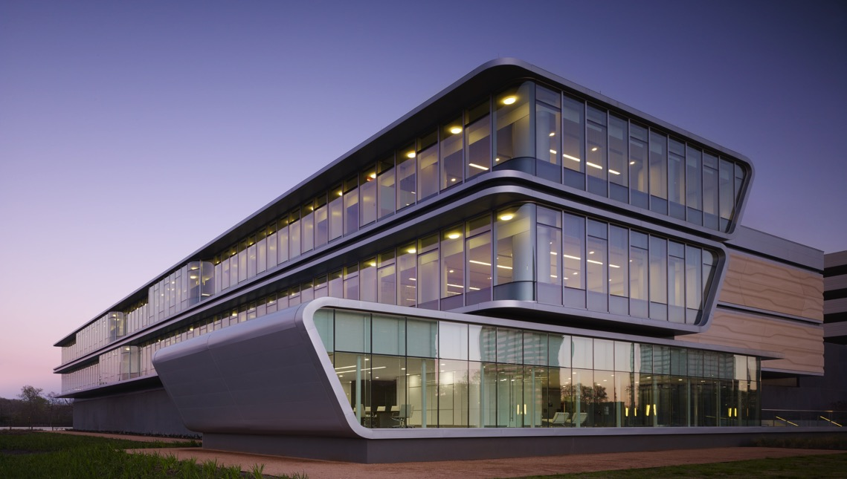
BP Center for High Performance Computing Facility – Year One Review
2015 Rice Oil & Gas HPC Workshop
March 4, 2015

Slide 2
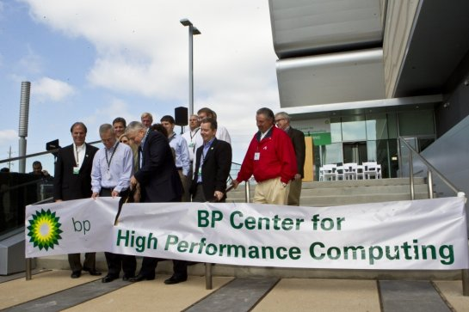
PROJECT TEAM
OWNER: BP
DESIGNER: HOK
CONTRACTOR: ANSLOW BRYANT
COMMISSIONING: ENGINEERED AIR BALANCE (EAB)
PENNINGTON & ASSOCIATES
(Marie D. De Jesús / Houston Chronicle)

Slide 3
SCHEDULE
DESIGN
07/11 - 04/12 (9 MO.)
CONSTRUCTION
05/12 - 09/13 (17 MO.)
OPERATION
09/13 - CURRENT (18 MO.)

Slide 4
SUCCESS IN DESIGN, CONSTRUCTION & OPERATION
DELIVERED ON-TIME
WITHIN BUDGET
OPERATING ACCORDING TO OWNER’S REQUIREMENTS
SAFETY
NO LOST TIME INCIDENTS OR DAYS AWAY FROM WORK
TIRR TOTAL INCIDENT RATE 2-3x BELOW INDUSTRY AVERAGE
TRUTHFUL & ACCURATE - MORE THAN 200 INCIDENTS LOGGED
COLLABORATIVE TEAM JOURNEY – BEGINNING TO END
PEER REVIEW – CONTINUOUS PROCESS
PRE-DESIGN
DESIGN
CONSTRUCTION
COMMISSIONING
POST OCCUPANCY

Slide 5
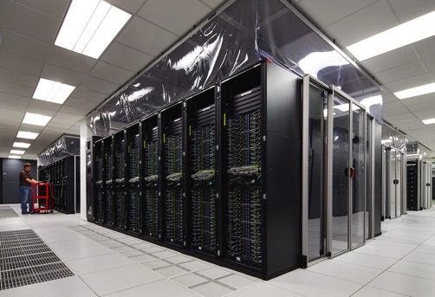
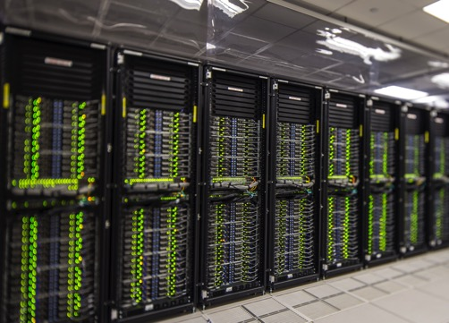
OWNER’S REQUIREMENTS
15 MVA ULTIMATE ELECTRICAL LOAD
TARGET PUE OF 1.35 AVERAGE, 1.5 MAXIMUM
GROWTH CAPABILITY AND FLEXIBILITY (FUTURE-PROOF)
SCALABLE
MAXIMUM 35 KW RACK
REDUNDANCY:
N + 1 COOLING EQUIPMENT
2N, 34.5 KV FEEDS FROM CNP
2N STATIC UPS
PROTECTED WHITE SPACE
HOT AISLE CONTAINMENT

Slide 6
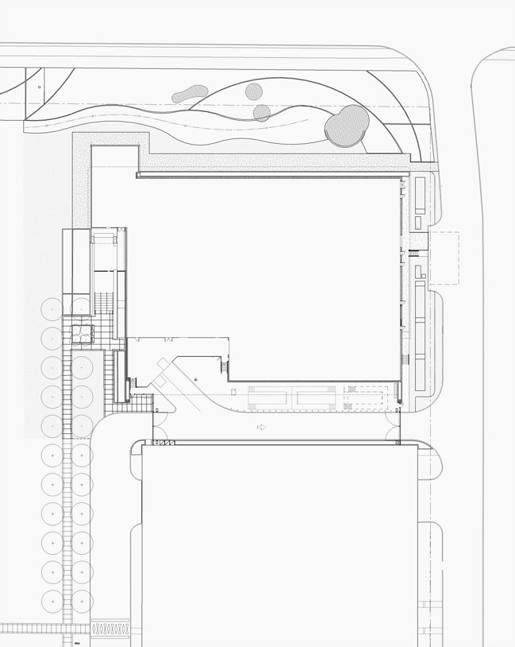
SITE PLAN
I-10 SERVICE ROAD
MAINTENANCE PATH
BUILDING ENTRY
HPC FACILITY
BP WAY
LOADING DOCK
SERVICE DRIVE
NORTH GARAGE
GARAGE DRIVE

Slide 7
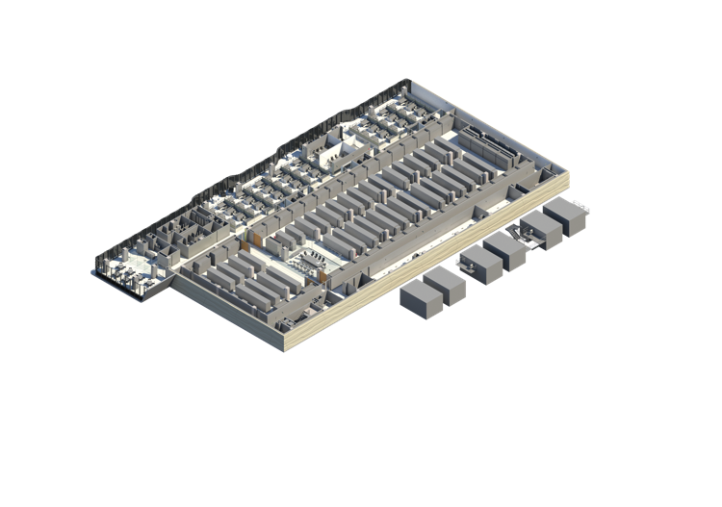
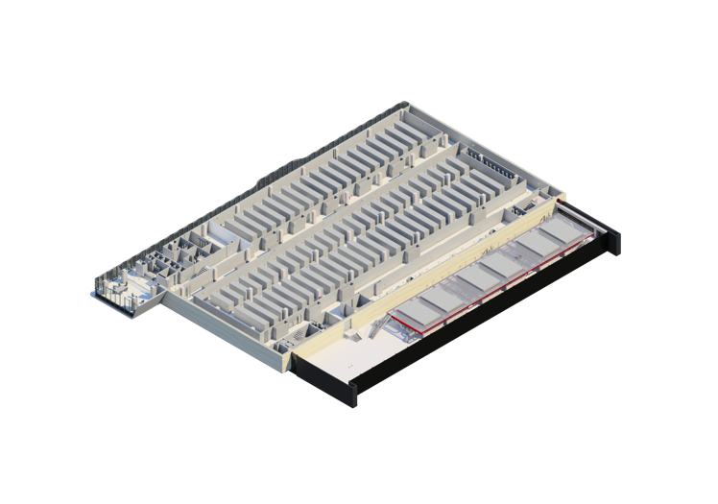
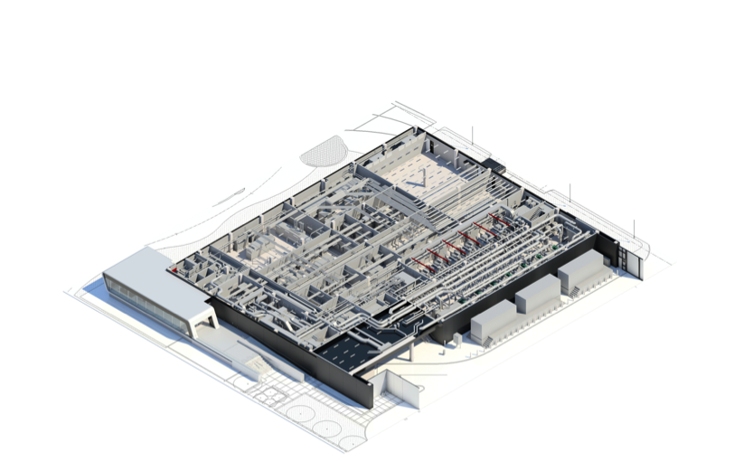
STACK DIAGRAM
LEVEL 3 – TENANT
LEVEL 2 - TENANT
LEVEL 1 - SUPPORT

Slide 8
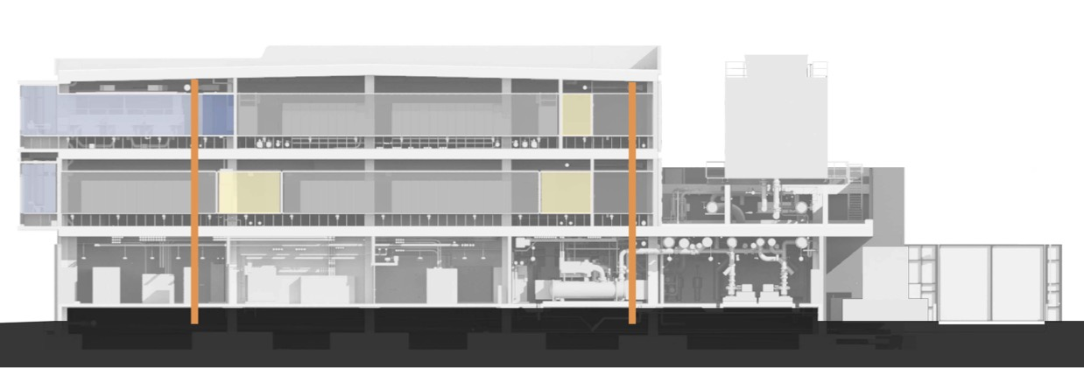
SECTION DIAGRAM
OVERSIZED SERVICE ELEVATOR
OVERSIZED CORRIDORS
ROBUST ENVELOPE SURROUNDING WHITE SPACE AND SUPPORT SPACE
ELEVATED SLAB ON GRADE ABOVE 500 YEAR FLOODPLAIN
COMPUTING CIRCULATION
COMPUTING / RACK SPACE
COMPUTING SUPPORT
OFFICE
OFFICE SUPPORT
VERTICAL CIRCULATION

Slide 9
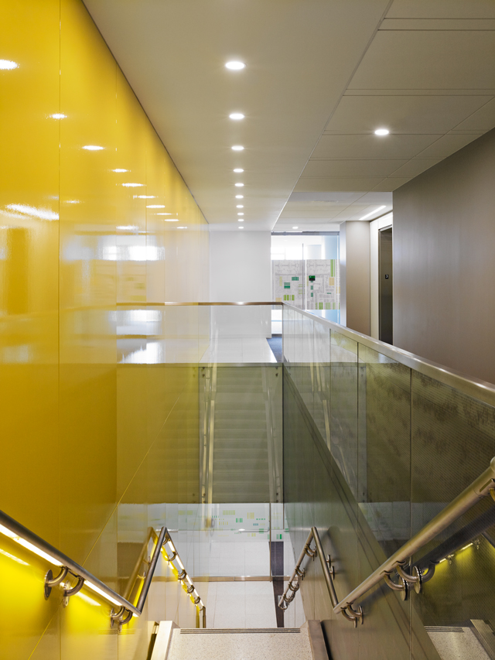
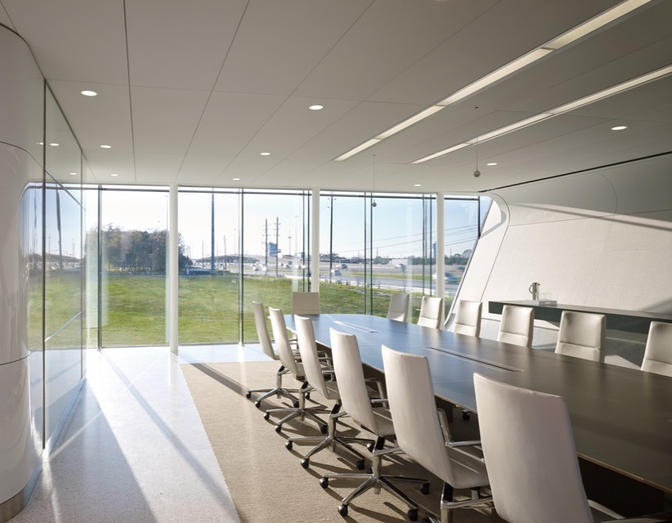
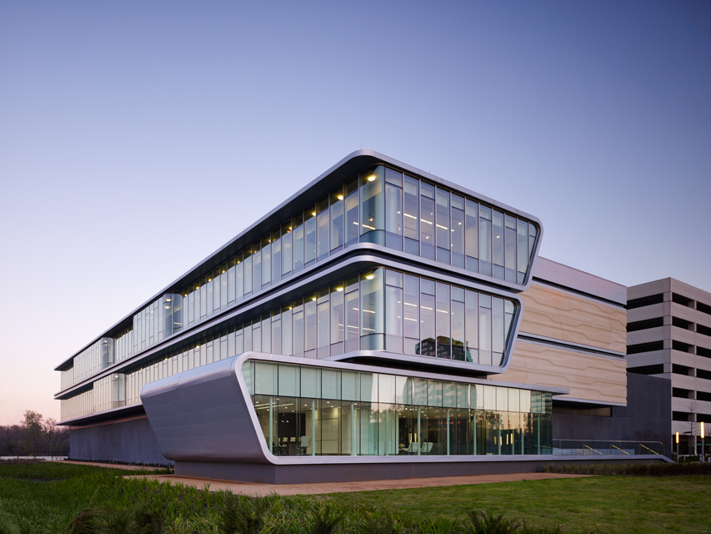
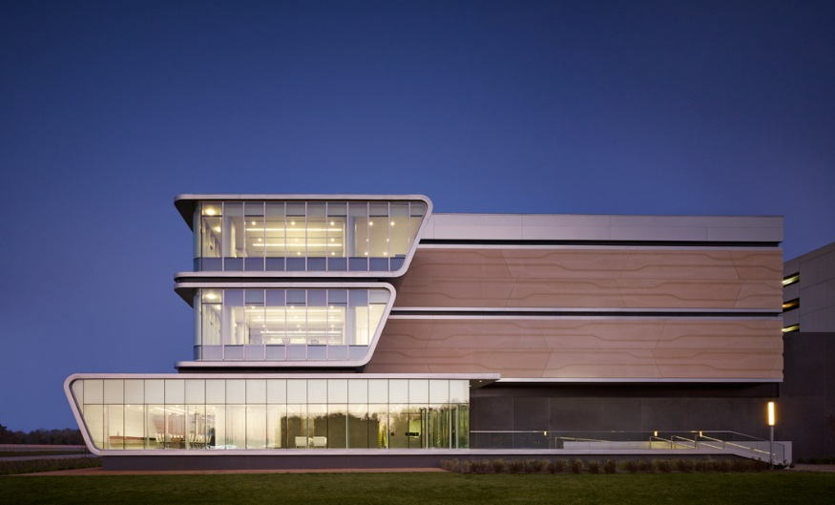
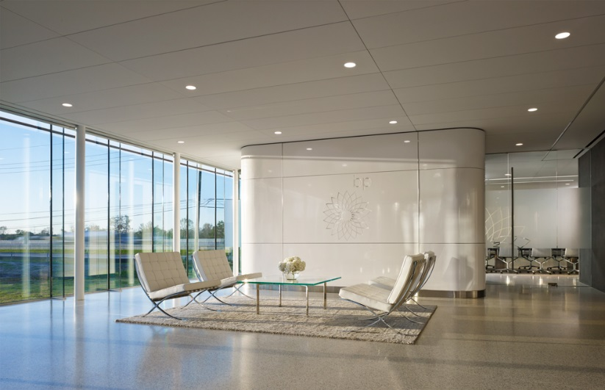
ARCHITECTURE AND INTERIOR
PUBLIC PERCERPTION / FREEWAY IMAGE
INTERACTION BP AND CLIENT
ENTRY APPROACH FROM CAMPUS
ENTRYLOBBY / SECURITY
VERTICAL CONNECTIVITY

Slide 10
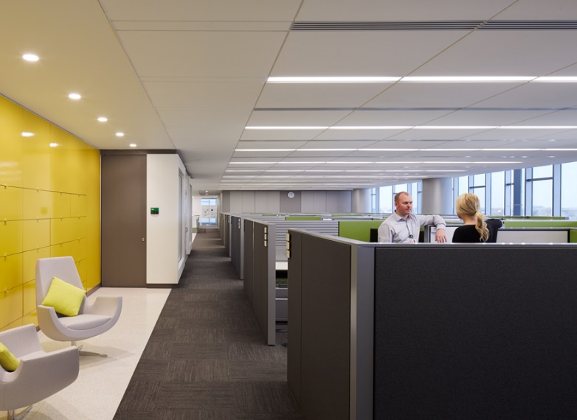
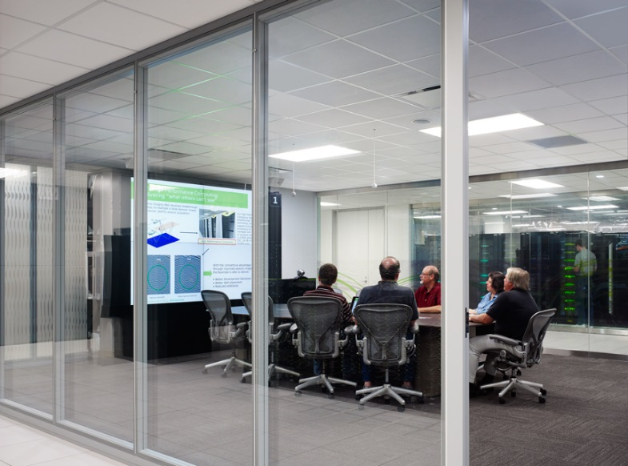
ARCHITECTURE AND INTERIOR
CARBON SPACE / WORK AREAS
VERTICAL CONNECTIVITY
SILICON SPACE

Slide 11
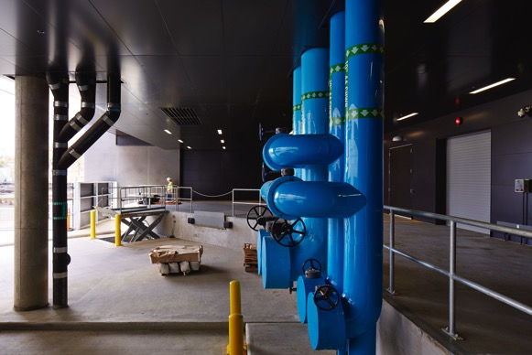
ARCHITECTURE
SECURE, ELEVATED AND COVERED LOADING DOCK
PROTECTED WHITE SPACE WITH PERIMETER PERSONNEL ACCESS
STRUCTURE WITH 300 PSF LOADING
PEOPLE FRIENDLY
PARAPET WALL 5+ FT. ABOVE ROOF
ROOF STRUCTURE SLOPED FOR STRATEGIC DRAINAGE

Slide 12
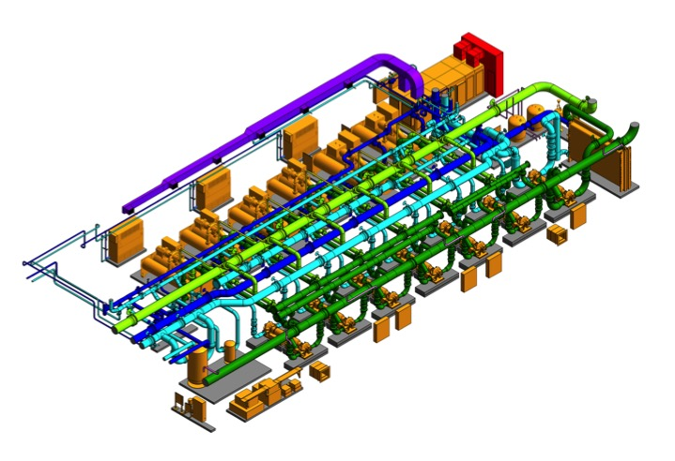
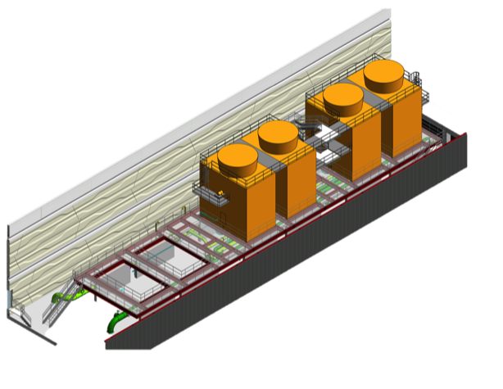
COOLING
DISTRIBUTION NETWORK SIZED FOR ULTIMATE LOAD
EQUIPMENT INCREMENTALLY ADDED TO SUPPORT DEMAND
N + 1 EQUIPMENT
DUAL CHILLED WATER SYSTEMS
WATER-COOLED CHILLERS
WATER ECONOMIZER
RESERVE MAKE-UP WATER STORAGE

Slide 13
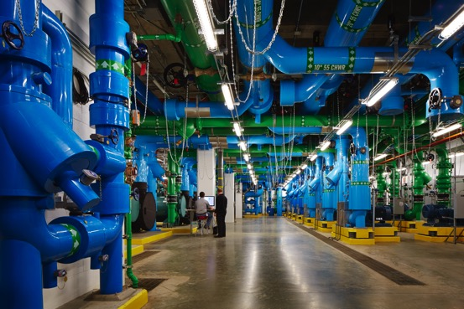
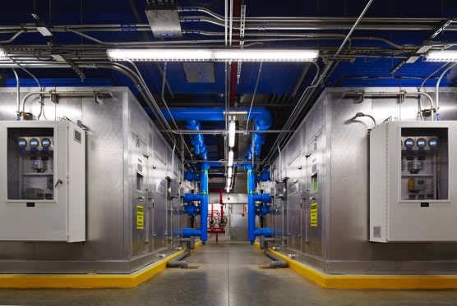
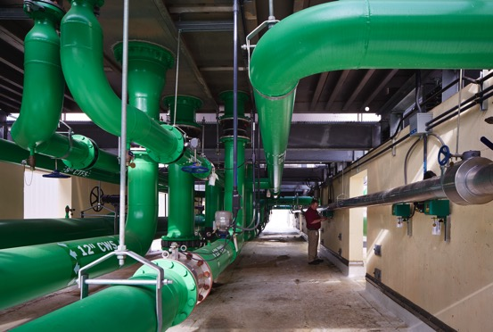
COOLING
LOOP PIPE DISTRIBUTION WITH DUAL FEEDS
PRE-TREATED OUTDOOR AIR SUPPLY
MEASUREMENT AND VERIFICATION (SUBMETERING)

Slide 14
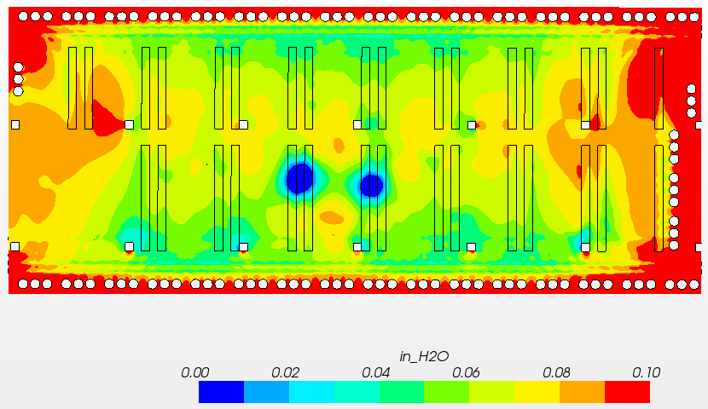
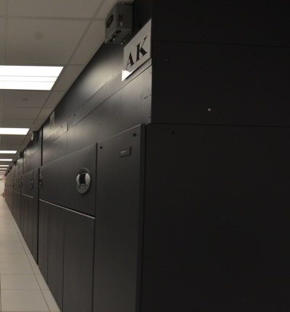
COOLING - WHITE SPACE
CAPABLE OF AIR AND LIQUID COOLING
TREND TOWARDS INCREASED HEAT DENSITY
INITIALLY 35 KW/RACK
LATER CHALLENGED (80+ KW/RACK WATER-COOLED)
DEMAND CONTROLLED VAV AIRFLOW IN WHITE SPACE
LIQUID COOLING FOR HIGH HEAT DENSITY APPLICATIONS

Slide 15
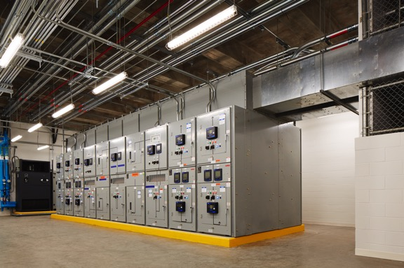
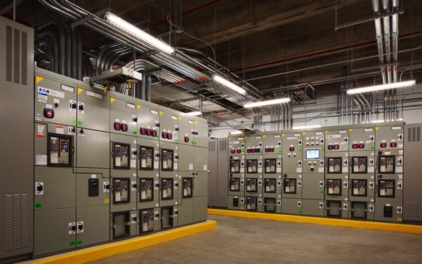
ELECTRICAL
100% REDUNDANCY AT 34.5 KV SERVICE, 5 KV SWITCHGEAR AND SOME 480V / 277V UNIT SUBSTATIONS
BACKUP GENERATORS FOR SOME COMPUTING / RACK SPACE
STATIC UPS ENERGY SAVER MODE
FLYWHEEL TYPE UPS
RACK POWER-BLDG. UTILIZATION VOLTAGE (480V / 3 PHASE)

Slide 16
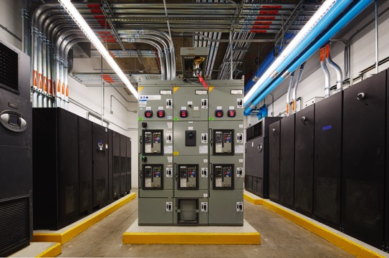
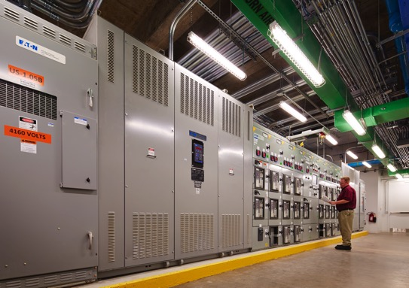
ELECTRICAL
MEASUREMENT AND VERIFICATION (SUBMETERING)
HIGH EFFICIENCY TRANSFORMERS
HIGH EFFICIENCY LIGHT SOURCE (LED, T5 & T5HO FLUORESCENT)
AUTOMATED LIGHTING CONTROLS

Slide 17
OPERATING PERFORMANCE - PUE
Annual Average PUE = 1.32

Slide 18
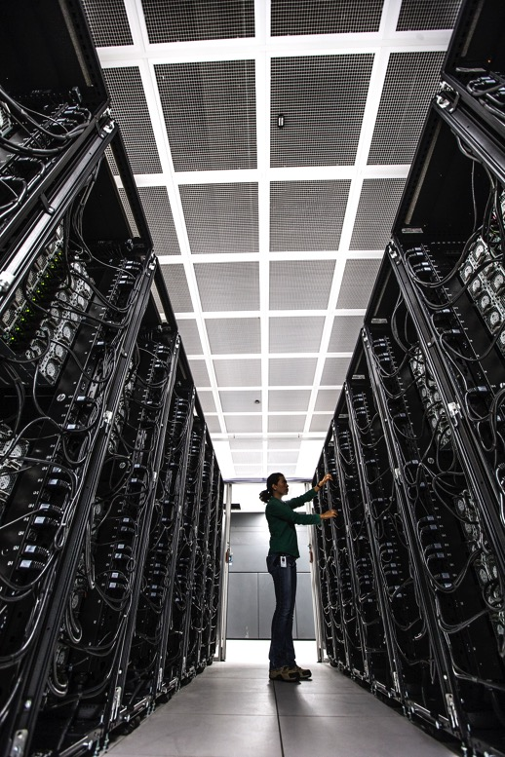
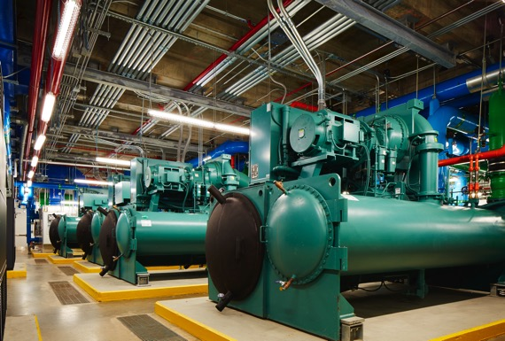
OPERATING PERFORMANCE
SAFE & RELIABLE OPERATIONS
REAL TIME ON-GOING TESTING
PHASED EXPANSION
FLEXIBILITY CHALLENGED
MOVE READY: UP TO 50 RACKS/DAY

Slide 19
THANK YOU
GARY W. KUZMA PE, CEM, LEED AP, GBE
Director of MEP Engineering
+1 713 407 7739 | gary.kuzma@hok.com
SAADEDDINE DIMACHKIEH PE, CLEP, LEED® AP
Firm Wide Director of Electrical Engineering
+1 713 407 7714 | saad.dimachkieh@hok.com
STEFAN GARRARD
Innovation Lab Project Lead
+1 281 366 3245 | stefan.garrard@bp.com

