Slide 1
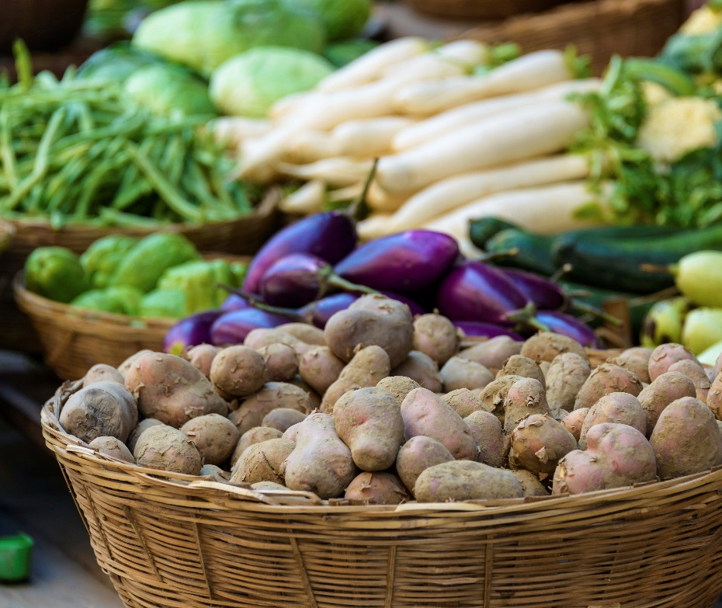
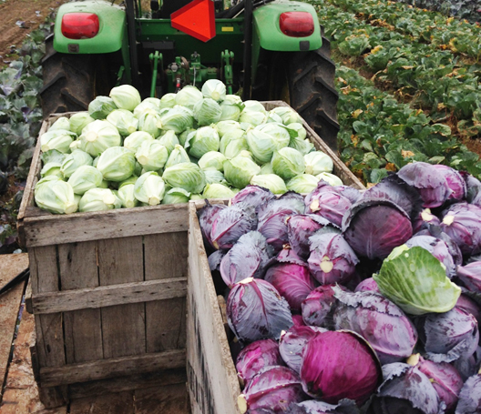
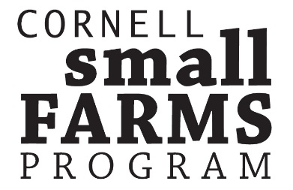
16 Lesson Plans to Prepare Small and Mid-scale
Farmers to Enter Food Hubs, Groceries, Restaurants and Cooperatives

Slide 2
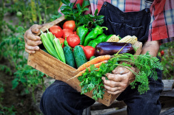
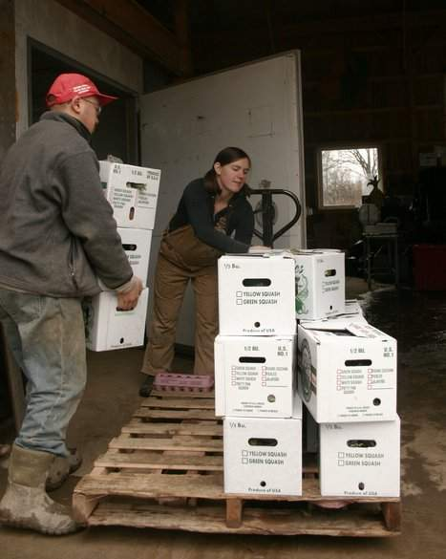
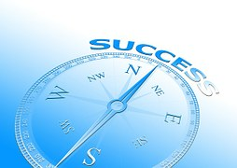
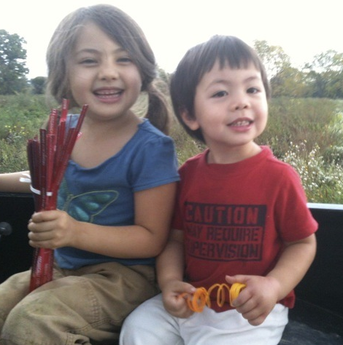
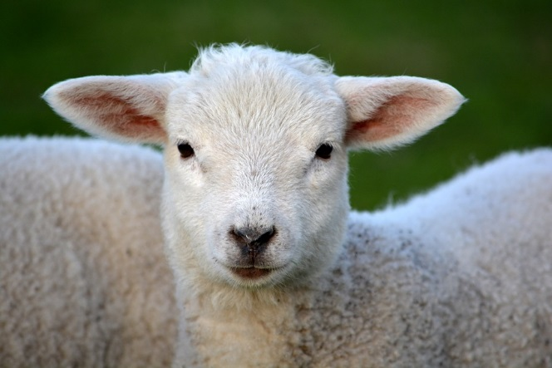
Unit 1.0 Mission and Vision: The Compass Charting Future Success This powerpoint presentation is a companion resource to the ‘Baskets to Pallets Teaching Manual’ available at smallfarms.cornell.edu
Please see ‘Module 1: Soft Skills’ for additional teaching resources.
Notes:
INTRODUCTION
I’m not sure when mission and vision statements came into vogue, they have been around for decades. Mission and vision statements are a dynamic tool.
Numerous business management books suggest mission and vision statements are important when a business begins or when a business contemplates change.
If your business already has a mission and vision statement, then review and if necessary modify the statements to reflect the move from direct marketing to wholesale marketing.
If you don’t have a mission or vision statement, take the time to create them.
This module comes with a workbook/study guide. An additional resource is “Developing Vision and Mission Statements from Purdue University. If offers examples of mission and vision statements and a critique of the statements.
Why do this?
In the process of creating mission and vision statements, the persons involved in the business have the opportunity to honestly think about how the business will impact their personal lives.
It is a means for the principle leadership team to define what the business will do to accomplish its goals to meet the needs of its owners, employees and customers.
Mission and vision goals are useful to brand the business, develop business strategies and hire employees.
We will use two different farms as each farm provides critical elements when gearing up for wholesale markets.

Slide 3
Mission and Vision: Compass Charting the Future What we plan to cover:
Change and risk
Brief review of roles we play, our values, and our goals
Developing a mission statement
Developing a vision statement
Are you ready for wholesale marketing? (Workbook Exercise #1)
Notes:
Moving from direct marketing to wholesaling involves is a change in the business and all change usually includes some risk. This module will provide some thoughts on how to think about change and risk.
Examining the roles that we play…spouse, parent, child, business owner, farmer, community leader, help us to understand our values and what brings us happiness and satisfaction. Our roles can help us define what is most important. They do change through time.
What business owners value and what the goals of the business should be incorporated into the mission and vision statement. We will learn why mission and vision statements are important to a business undergoing change.
Finally there is a brief exercise in the workbook to determine if you are ready for wholesale marketing. Each question answered can mean there is a change needed in how the farmer will produce the product and how farmers will interact with the buyer. Questions answered ‘no’ or ‘unsure’ can be addressed in the following modules. The remainder of the workbook gets to “how does the business intersect with the lifestyle and personal goals of the operator.

Slide 4
Change – moving from the old and familiar
It is constant
Motivation to change
Negative
Positive
A choice not to change
“You must do the thing you think you cannot do.”
- Eleanor Roosevelt
Notes:
Part of the basis for this module is that we can think about change and the move from direct-to-consumer sales to wholesale marketing as a rational decision – it’s about money, markets, production, labor, etc.
In reality it is about the change in a business and how we view change is ‘irrational’ and sometimes very emotional!
Depending on how we are ‘wired,’ we embrace the change as an opportunity - ‘game on.’ Or we fear the change and are concerned over our lack of success.
IT IS CONSTANT
We all change and sometimes we have no choice
We grow up…moving from childhood to adulthood.
We go to work…We own an business…We retire
We cherish old friends and meet new acquaintances.
OUR MOTIVATION TO CHANGE
We change when something becomes uncomfortable or painful.
We change when we can see an opportunity for a better future
WE CAN CHOOSE TO NOT CHANGE
“I’ll think about it tomorrow” is a choice and postpone decisions to be made.
Postponing decisions can have negative consequences as the world around us will continue the change.
I think Eleanor Roosevelt said it best, “You must do the thing you think you cannot do.”
DISCUSSION QUESTION: HOW DO YOU FEEL ABOUT CHANGE AND THE MOVE FROM DIRECT MARKETING TO WHOLESALE?

Slide 5
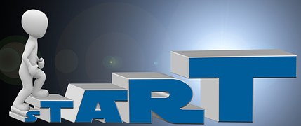
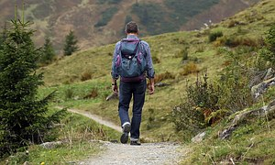
Managing the fear, embracing the change
Makes us feel unsettled
Consider the adventure
Failure
Business transition plan
“We need to accept that we won’t always make the right decisions. That we’ll screw up royally sometimes – understanding that failure is not the opposite of success, it’s part of success.”
-Arianna Huffington
“I have not failed. I’ve just found 10,000 WAYS that it won’t work.”
- Thomas Edison
Notes:
Change makes us feel uncomfortable.
It can be an uncomfortable feeling.
It pushes us out of our comfort zone
To manage change:
Think about change as an adventure
Break a big change into series small steps to be accomplished
Each step accomplished builds self-confidence and increases motivation to move forward
Change can lead to a fear of failure and our perception of risk
Our perception of risk can lead to action or inaction
Failure is part of the learning process. Edison said it best. “I have not failed, I’ve just found 10,000 ways it won’t work.”
When something doesn’t work the way we expect it to, it provides opportunities to reflect, re-group in order to move forward. It is a learning opportunity.
Arianna Huffington of the Huffington Post says, “We need to accept that we won’t always make the right decisions. The we’ll screw up royally sometimes – understanding that failure is not the opposite of success, it’s part of success.”
Gearing up for wholesale marketing has risks.
It is important that the farm operation leadership team understand how each team member views risk.
Key take away: Manage the fear by doing a business plan that creates worse case, best case and most likely scenarios.

Slide 6
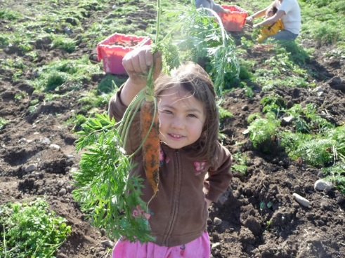
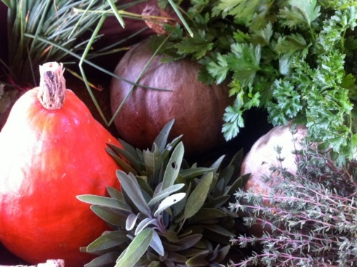
CASE STUDY - Change Stick and Stone Farm
PEOPLE
Lucy and Chaw with Greta, Ezra, Rhoda
FARM BUSINESS
Farming for 20 years
Managing 110 acres tillable land with 35 to 40 acres growing organic vegetables
LLC member of The Full Plate Farm Collective – 3 farms with 600 CSA shares in the growing season, 300 shares in winter
Specialize in cooking greens, root crops and fruit crops that store well
Present markets: 35% Full Plate Collective, 35% wholesale, 15% farm market
“Selling to restaurants and Wegmans transformed the business.”
Notes:
Instructor notes: Brief bio of our first case study.
Stick and Stone Farms is a lesson in change.
In 1996 Lucy joined 2 friends and started growing a few acres of vegetables on rented land with little equipment and selling to farmers markets.
Over 5 years the 2 partners left the business.
The farm sold produce through 4 farm markets, 3 days per week. They spent a lot of time selling the product and not making a lot of money.
In addition to participating in 4 farmers markets, in 1999 Lucy contacted a couple of restaurants she believed would be interested in purchasing the vegetables, and to a local food co-op and to Wegmans.
Wholesaling to restaurants and Wegmans transformed the business.
On the farm, it appeared the landowner from whom they were renting wanted the land, so they started looking for another place to farm. In 2003 they purchased a farm. The wholesaling piece of the business was increasing. Sales at farmers market was stagnant.
They dropped 2 of the 4 markets and focused on selling to restaurants. No one was selling to restaurants – they were early innovators. They chose restaurants that aligned with their values of local, healthy, fresh, high quality vegetables. They were very successful.
Today the business….(read the bullet points in the slide.)

Slide 7
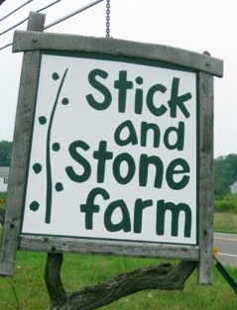
CASE STUDY – On wholesale marketing Stick and Stone Farm
BEST PRACTICES
Carry through
Communication
Honesty
Trust
Personal relationships
“There are definitely times we’ve had to short people. I would immediately call them and tell them what’s going on and why we are short. Everybody is understanding. If you don’t contact them, then forget about it, they’re done with you.”
Notes:
What Stick and Stone Farm has found as they have moved from direct marketing to wholesaling is that:
Read the quote
You have to do what you say you are going to do.
If you are short on product you have to let them know that you cannot make the delivery as promised.
Honest communication maintains the trust in the relationship and preserves your reputation
Being friendly really helps, it’s about relationships
Reputation is critical in this business
KEY TAKE AWAY:
Good communication and building relationships built on trust, honesty, and integrity are the soft skills necessary to be a successful wholesale marketers.

Slide 8
CASE STUDY – Mission and Vision Stick and Stone Farm
The vision of Stick and Stone Vegetable Farms is to provide a meaningful and sufficient livelihood for the owners and employees of the farm, to reduce the environmental impact of human production and consumption, and feed the local community with healthy, tasty, and unique vegetables.
The mission of Stick and Stone Vegetable Farm is to grow and market fresh, local and organic produce for the Ithaca community and throughout NYS year-round.
Notes:
Moving from direct-to-consumer sales to wholesale marketing involves change in the business that can impact one’s personal life.
It is important to examine these changes.
Mission and vision statements are one way to start the conversations about change and its impact.
Existing mission and vision statements should be reviewed to determine if they reflect the change from direct marketing to wholesale marketing. The mission and vision statements of Stick and Stone Farm are applicable for both the direct marketing business and the wholesale marketing business.
As we move through the presentation we will learn more about why mission and vision statements are important and how to write them.
KEY TAKE AWAY:
Mission statements are what the farm strives to do in the present.
Vision statements are what the farm and it’s owners plan to accomplish into the future. Vision statements merge the personal values of the owners and the goals of the business.

Slide 9
CASE STUDY – Lifestyle Stick and Stone Farm
“When we dropped from 4 markets to 2 markets per week, it let us spend a lot more time actually farming.”
“Overtime we’ve struggled with lifestyle choice. If your doing deliveries after you harvest, it’s a long day. I remember in 2007 we were going around town and our one-year old daughter was in the car with us, and it was like 10:00 at night.”
“We are re-evaluating our long-term goals in terms of scale and desired outcomes, especially important as we get older.”
Notes:
Stick and Stone Farms shared insights into how the business impacted their lifestyle.
Read the quotes….quotes reflect the transition through time.
It is important to align your personal goals and your desired lifestyle with your business.
Business goals and lifestyle goals will change through time.

Slide 10
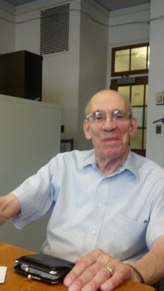
Performance + Values = Strong Sense of Accomplishment
MISSION
“Farming will always be a way of life for those who treat it like a business.” – George Conneman, Professor Emeritus, Cornell University
SUCCESS
VALUES
GOALS
Values influence outward behavior and how we view the world in which we live.
VISION
What are some of the hats you wear or the roles you play?
What are some of the values connected to those hats or roles?
Notes:
What we value helps to shape the goals we choose to accomplish. Values influence outward behavior and how we view and interact in the world in which we live.
If there is a disagreement or conflict, many times it is rooted in what people value.
When we link our values to what we do, we have a strong sense of accomplishment that brings happiness.
“Do what you love to do and you’ll never work a day in your life.” - Anonymous
It is important to identify values and goals as a foundation to create mission and vision statements that will lead to business success.
IN ORDER TO CREATE MISSION AND VISION STATEMENTS IT IS IMPORTANT TO IDENTIFY WHAT WE VALUE.
MOST IMPORTANT:
WHY DEFINE VALUES?
Influence business decisions, strategies, choices
Expose personal bias
Influence how people interact with one another
Values held by one person may not be the same held by others
Awareness of values of each farm operator makes goal setting easier`
Understanding core values will minimize uncertainty and competing priorities
Business based on shared values will have less conflict and more likelihood of success
Personal values can be reflected in the values statement of the business
There are two types of values – personal values and governing values.
WHAT ARE PERSONAL VALUES?
Standards or beliefs
Conscious and unconscious
Used when making decisions, judgement, choices
Define what is important
Transcend the generations
Derived from cultural experiences of family, community, society
WHAT ARE GOVERNING VALUES?
Fundamental values of greatest importance and highest priority
Define relationships
Closely related to the roles that one plays
Understanding ‘why’ one values something hones in on what a person is willing to invest time, money, and energy
Many people talk about a farm as a great place to raise the kids, that they like to grow things, that they like to be in the outdoors. These are important values to farmers and their families. Whether direct marketing or wholesaling, the farm needs to have sufficient financial resources to meet the needs of its operators and employees.

Slide 11
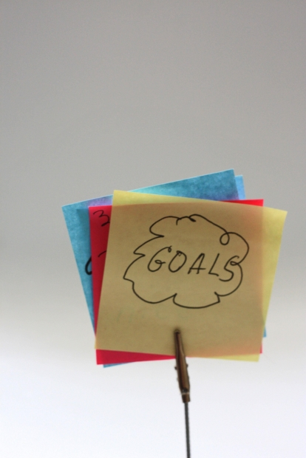
Goals = What one wants to accomplish (Goals need to be ‘SMART’)
S pecific
M easurable
A ttainable
R ealistic
T imely
CLEARLY DEFINED GOALS
Motivate and inspire
Mitigate conflict
Direct resources when necessary
Values inform goals and management strategies.
Notes:
As you consider moving from direct marketing to wholesaling, what do you hope this change will accomplish?
How does this change contribute to the goals of the business?
How does this change contribute to your personal goals?
KEY TAKE AWAY: - What are goals?
Goals describe what one wants to accomplish or achieve. A goal defines what one wants to do and values illuminate why one chooses to invest resources needed for achievement. Goals describe the ‘what’ and the ‘who.’ Values describe the ‘why.’ Goals can be economic, environmental, and social or community oriented. Goals do not describe the ‘how.’ The ‘how’ is identified through the business plan.
Whether personal or business goals, they should be
S – Specific
Who is involved?
What is to be accomplished?
Where will it be accomplished (location)?
When will it be accomplished (start/end dates)
What are the requirements needed for and constraints that limit likelihood of achievement?
What is the reason, the purpose, or the benefit of accomplishing the goals?
M – Measurable – develop criteria to measure progress to attain the goal
How much?
How many?
How will I know when it has been accomplished?
A – Attainable –
What are the skills I need to be successful?
What are the skills other people need for me to be successful?
What are the small steps I need to accomplish to achieve the bigger goal?
R – Realistic – must be an objective one is both willing and able to work towards and Rewarding – supporting feelings of success
T – Timely (How long, deadlines to complete smaller objectives that will lead to goal accomplishment and Tangible – tactile, one can experience through one’s sense of taste, touch, smell, sight or hearing.
Clearly defined goals not only motivate what one or ones family or business partners want to accomplish, they can also motivate and inspire

Slide 12
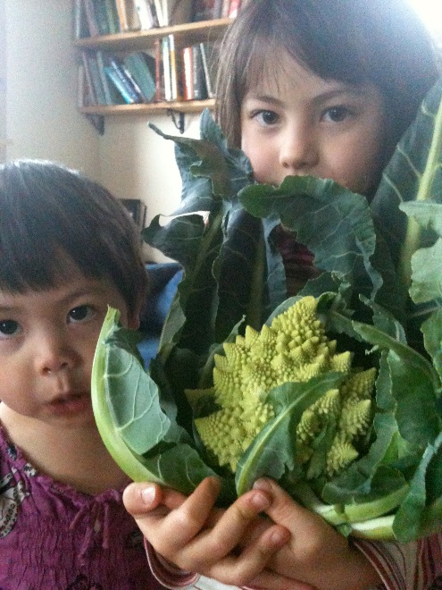
Stick and Stone Farm
LESSONS LEARNED
Self-satisfaction of growing fruits and vegetables versus marketing fruits and vegetables
Balancing the farm business with the other life responsibilities
FRUITS AND VEGETABLES GROWN TO:
Provide meaningful and sufficient livelihood for owners and employees
Reduce environmental impacts
Feed the local community and region with healthy, tasty and unique vegetables.
Personal values help to identify goals that influence the decisions made in the business.
Notes:
REVIEW SLIDE:
Stick and Stone Farm has provided insights into change and the intersection of their personal lives as they moved from direct marketing to wholesale marketing.
We learned that serving 4 farm markets did not provide them with the time to enjoy growing the crops – the production side of the business.
While they were very innovative, being one of the first farms to sell to local restaurants, they realized that it did not allow them the time to be the parents and caregivers of their children that they envisioned themselves to be.
They value producing healthy, tasty and unique vegetables and they found customers who shared similar values.
And regardless of who you are selling to, it’s really about the relationships with the buyer…being a reliable supplier of high quality product, being honest and following through on promises made to build trust.
TRANSITION STATEMENT:
As we move forward, mission and vision statements are tools to think about how the business and the desired lifestyle of business owners intersect.
KEY TAKE AWAY: Personal values help to identify the goals that influence the decisions made in the business.

Slide 13
The Mission statement is focused on the PRESENT. It is a concise summary.
Who are we?
What do we do?
For whom do we do it?
Why does this business exist? or
What is its purpose?
Notes:
Stick and Stone Farm provided insights into what they value.
They shared their mission and vision statements.
Those statements reflect their personal values and what the business does and strives to accomplish in the future.
We will use the second case study to show how to construct the mission and vision statements for your farm.
KEY TAKE AWAY – The mission statement describes the present state of the business
The mission statement is created by answering the following questions.
Who we are?
What we do?
For whom do we do it?
And why does the business exist or what is its purpose?

Slide 14
The Vision Statement answers, “What does the business aspire to be in the FUTURE?
Reflects the values of its owners and the reason for its existence
Articulates the description of the farm business when it achieves success
Describes the business stakeholders, products and services
Notes:
KEY TAKE AWAY - The vision statement relates to the view of the business owners of what perfection would look like in the future?
READ THE BULLET POINTS

Slide 15
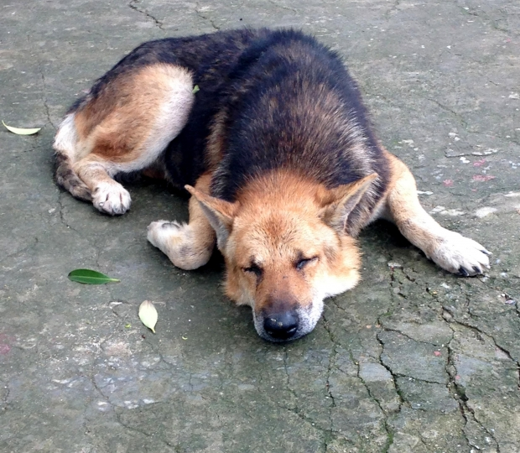
DOES ANYONE REALLY DO THIS STUFF?
Notes:
Numerous business management books suggest mission and vision statements are important when a business begins or when a business contemplates change.
But does anyone really do this stuff?

Slide 16
DOES ANYONE REALLY DO THIS STUFF? YES!!!!
Mission drives loyalty across generations
Fosters customer engagement
Improves strategic alignment
Brings clarity
Creates, quantifies, articulates the culture of the business
Groscurth, Chris. 2014 “Why Your Company Must be Mission Driven.” Business Journal. Gallup. March 6.
Notes:
The Gallup scientists conducted an analysis of 49,928 business units in 192 organizations representing 49 different industries in 34 countries.
They found:
Mission drives loyalty and helps employees answer the question – “Do I belong here? Do I have an opportunity to do what I do best?”
Fosters customer engagement – promotes brand differentiation, consumer passion and brand engagement.
Improves strategic alignment – alignment begins with a clear “what” and “why”. Strategic alignment brings in the “how,” “who,” “when,” and “where.” It is also a means to hire people with similar values and personal goals that align with the business.
It helps the business operators establish and balance priorities, set performance goals, and align rewards and compensation at all levels.
Mission statement brings clarity – it guides decision making and judgement. A clear sense of what matters most, helps leaders decide the best path forward and inspires conviction and dedication
Cornell’s ProDairy Program introduced these concepts to the dairy sector in the early 1980s.

Slide 17
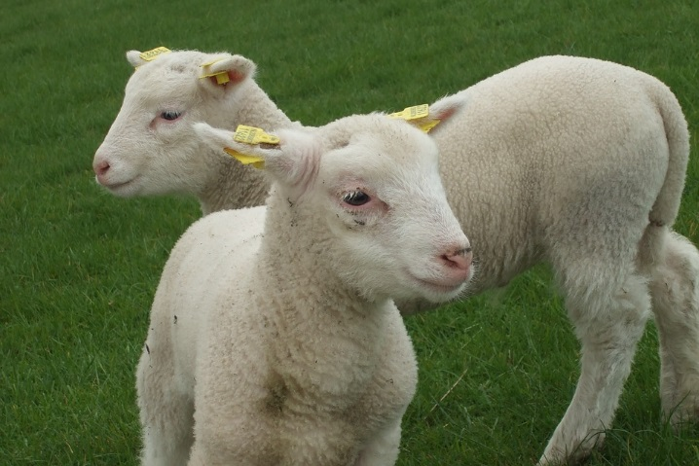
CASE STUDY – Great Northern Farm
PEOPLE
Rich and Wendy
FARM BUSINESS
165 ac. with 30 ac. tillable, 35 ac. Grass or hay
Poorly drained loamy soils good for grass
Provide most to all of the labor
Able to market most of what they produce on the weekends at the Syracuse Regional Market and via the website that leads to sales appointments at the farm
Notes:
We’ll use the next case study as a means to develop mission and vision statements.
Rich grew up on a farm in Connecticut.
He moved to NYS and in 1980 when he was a high school ag teacher purchased a farm. The farm consisted of 165 acres – 100 ac. Woods, 35 tillable ac. And 30 ac. of grazing land. Soils tend to be poorly drained loams, not very good for row crops but good for hay and grazing. He has been around one type of livestock or another all of his life. He mentioned, “Once animals get in your blood, you can’t get them out.”
He was a Vocational Agriculture teacher and also works for Cooperative Extension with experience in natural resources, production agriculture and ag. economic development.
He wholesaled beef cattle for quite a few years but didn’t do much of the marketing. He was mostly by himself doing the chores and crops until he met his future wife Wendy, three years ago.
Wendy had her own 65-acre farm and occasionally hired employees. She raised beef, swine, chickens (eggs), heritage turkeys and lots of sheep.
She sold her land and moved her operation down to his. Each had certain assets and skill sets that blended together nicely, so her business has been incorporated into Rich’s farm.
Each have their own set of chores. Rich does most of the machinery work. He hays about 30-40 acres on the road they live in the summertime. Most days he does a good portion of the animal chores and they both do some of the machinery work.
Wendy does most of the book work. She markets her meat products through Meadow Raised Meats. She sells at the Syracuse Regional Market on the weekends. She has a website. People make appointments to come to the farm to pick up products. It’s by appointment so that they don’t have people strolling in 24/7. She also mails products via FedEx and UPS to customers throughout the Northeast. Eighty percent of their market is retail. They would like to do more wholesale marketing.
Their animals are mostly grass fed. They buy small amounts of GMO-free grain and are de facto organic, other than occasional grain or fertilizer. They use no chemicals, herbicides or pesticides. They use cover crops and crop rotations along with the concepts of sustainable agriculture.
They wrestle with the idea of hiring labor and are able to market most of what they produce. Rich says, “At some point you want to stop and smell the roses without killing yourself.”

Slide 18
CASE STUDY– The hats we wear Great Northern Farm
Workbook Exercise #2.
ROLES in the business?
1.
2.
3.
PEOPLE
Rich and Wendy
ROLES outside of the business?
1.
2.
3.
Notes:
KEY TAKEAWAY - The hats we wear or the roles we play are one means to decide what the people in the business value?
Note to instructors, recognize that most people will not do the pre-assignments. Class discussion is important for the case study as well as for their own farm.
(SEE WORKBOOK Exercise #2, THE HATS WE WEAR)
DISCUSSION QUESTIONS:
WHAT ARE SOME OF THE HATS THAT RICH AND WENDY WEAR OR THE ROLES THEY PLAY?
WHAT ARE THE HATS THAT YOU WEAR?
DEPENDING ON TIME ALLOCATION: WRITE DOWN/SHARE WITH THE GROUP, THE ROLES THAT YOU/PARTICIPANTS PLAY.

Slide 19
CASE STUDY– The hats we wear Great Northern Farm
Workbook Exercise #2.
PEOPLE
Rich and Wendy
ROLES outside of the business???
1. Spouse
2. Community leader
3. Educator
4. Volunteer
ROLES in the business???
1. Farmer
2. Marketer/Salesperson
3. Mechanic
4. Bookkeeper
Notes:
These are some of the roles. There are more.
Our roles provide insight into our values.

Slide 20
CASE STUDY – Values? Great Meadow Farm
Workbook Exercise #3.
PEOPLE
Rich and Wendy
VALUES outside of the business?
1.
2.
3.
VALUES in the business?
1.
2.
3.
Notes:
KEY TAKEAWAY - Roles are one means to decide what the people in the business value
What would you imagine Rich and Wendy value?
Instructor notes: See Workbook Exercise #3.
CLASS DISCUSSION – IDENTIFY THE VALUES OF RICH AND WENDY
WRITE DOWN/SHARE WITH THE GROUP, THE ROLES THAT YOU/PARTICIPANTS PLAY.

Slide 21
CASE STUDY – Values Great Northern Farm
Workbook Exercise #3.
VALUES IN LIFE
Respect each other’s skill sets.
“Once animals get in your blood, you can’t get them out.”
“We enjoy living in a rural area.”
VALUES IN THE BUSINESS
“Focused on providing a natural environment for livestock to develop at their own pace and foods that their bodies are built to utilize.”
“We do the things that go along with sustainable agriculture, cover crops, crop rotations, that sort of thing.”
Notes:
Rich said:
Respect each others’ skill sets. – Appreciate each other’s expertise
“Once animals get in your blood, you can’t get them out.” – Enjoy working with animals
“Focused on providing a natural environment for livestock to develop at their own pace and foods that their bodies are built to utilize.”
“We do the things that go along with sustainable agriculture, cover crops, crop rotations, that sort of thing.” – Stewards of the environment.

Slide 22
CASE STUDY– Goals? Great Northern Farm
Workbook Exercise #4.
BUSINESS GOALS:
(S.M.A.R.T.)
?
?
?
LIFE GOAL(S):
?
?
?
Notes:
Now that you have a sense of Rich and Wendy, the roles they play, the values they have, what might you see as their goals?
Instructor notes:
See Workbook, Exercise. #4.
Review SMART Goals.
S. specific, who involved, what accomplished, where, when
M. measurable, how much, how many, by when
attainable, small steps to achievement, skills needed for success
R. Realistic and rewarding must be an objective that everyone works to accomplish, supports feelings of success
T. Timely, Tangible, Tactile – how long (use deadlines to complete smaller objectives), can you feel it, see it to know you have accomplished it
Take a few minutes for program participants to think about Rich and Wendy’s goals and the goals for themselves and their business
CLASS DISCUSSION
What would you imagine Rich and Wendy’s goals to be?
Based on the your (participants/students) what are your business goals?
What are your life/personal goals?
How does the business goals support the achievement of the life/personal goals?

Slide 23
CASE STUDY– Goals Great Northern Farm
Workbook Exercise #4.
LIFE GOAL
“Slow down and smell the roses of rural living.”
BUSINESS GOALS
Less direct marketing
More wholesale marketing
Notes:
These are Rich and Wendy’s goals.

Slide 24
CASE STUDY– Goals Great Northern Farm
Workbook Exercise #4.
LIFE GOAL
“Slow down and smell the roses of rural living.”
BUSINESS GOALS
Less direct marketing
More wholesale marketing
The merger of
life goals and
business goals.
“A farm business that provides a good return and allows us to enjoy a rural lifestyle.” - Rich
Notes:
Goals for the business now mesh with lifestyle goals.

Slide 25
THE MISSION STATEMENT IS CREATED BY ANSWERING THE FOLLOWING QUESTIONS:
Workbook Exercise #5.
What is the present business purpose?
What is the objective to serve customer needs?
How do you get to where you want to go?
What is the primary lifestyle objective for the owners?
?
?
?
?
Notes:
Instructor notes –
Instructors should encourage participants to answer these questions as if they were Rich or Wendy.
Instructors should encourage participants to answer these questions for their own business.
PARTICIPANTS SHOULD TAKE A FEW MINUTES TO REVIEW THEIR ROLES, VALUES, GOALS AND ANSWER THE QUESTSIONS
DISCUSSION QUESTION:
DOES ANYONE CARE TO SHARE, RICH AND WENDY’S?
DOES ANYONE CARE TO SHARE THE ANSWERS TO THE QUESTIONS ABOUT THEIR OWN FARMING OPERATION?

Slide 26
THE MISSION STATEMENT IS CREATED BY ANSWERING THE FOLLOWING QUESTIONS:
What is the present purpose?
What is the objective to serve customer needs?
How do you get to where you want to go?
What is the primary lifestyle objectives for the owners?
Produce humanely raised birds and animals
Produce high quality grass and pasture
Provide top quality foods
Live on the land and enjoy a rural lifestyle.
Notes:
Instructor notes:
For the purposes of this presentation, these are the answers to the questions of Great Northern Farm.
How would you construct Rich and Wendy’s mission statement?
What about your farm mission statement?
Anyone care to share?

Slide 27
THE MISSION STATEMENT IS CREATED BY ANSWERING THE FOLLOWING QUESTIONS:
What is the present purpose?
What is the primary objectives for the owners?
What is the objective to serve customer needs?
How do you get to where you want to go?
Produce humanely raised birds and animals
Live on the land and enjoy a rural lifestyle.
Provide top quality foods
Produce high quality grass and pasture
“The mission of Great Northern Farm is to produce grass and pasture-based, humanely raised birds and animals to provide top quality foods for our customers and for us to live on the land and enjoy a rural lifestyle.” – Rich and Wendy
Notes:
This is the actual mission statement created by Rich and Wendy

Slide 28
Mission and vision statements are different.
The mission statement describes the present.
The vision statement describes what success will be in the future.
Who are we?
What do we do?
For whom do we do it?
Why does this business exist? or
What is its purpose?
Reflects the values of its owners and the reason for its existence
Articulates the description of the farm business when it achieves success
Describes the business stakeholders, products and services
Notes:
Remember, mission and vision statements are different:
KEY TAKE AWAYS:
The mission statement describes the present state of the business
The mission statement is created by answering the following questions.
Who we are?
What we do?
For whom do we do it?
And why does the business exist or what is its purpose?
The vision statement relates to the view of the business owners of what perfection would look like in the future?

Slide 29
THE VISION STATEMENT IS CREATED BY ANSWERING THE FOLLOWING QUESTIONS:
Workbook Exercise #6.
What are the values of the owners?
What is the reason for its existence?
What will the business look like when it achieves success in the future?
Who will be involved?
?
?
?
?
Notes:
We can now answer the questions relative to a vision statement and create a vision statement.
Instructors should encourage participants to answer these questions as if they were Rich or Wendy, complete Exercise 6 in the Workbook.
CLASS DISCUSSION
TAKE A COUPLE OF MINUTES TO ANSWER THESE QUESTIONS FOR YOUR BUSINESS
DOES ANYONE CARE TO SHARE?

Slide 30
THE VISION STATEMENT IS CREATED BY ANSWERING THE FOLLOWING QUESTIONS:
What are the values of the owners?
What is the reason for the existence of the business?
What will the business look like when it achieves success?
Who will be involved?
Live a rural lifestyle
Farm utilizing sustainable agriculture principles to harvest excellent quality products.
Provides a good return for our efforts
Rich and Wendy, retail customers
Notes:
For the purposes of our discussion we can now answer the questions relative to a vision statement and create a vision statement.

Slide 31
THE VISION STATEMENT IS CREATED BY ANSWERING THE FOLLOWING QUESTIONS:
What are the values of the owners?
What is the reason for its existence?
What will the business look like when it achieves success?
Who will be involved?
Live a rural lifestyle
Farm utilizing sustainable agriculture principles.
Continue to strive for excellent quality products that provides a good return
Rich and Wendy, retail customers
“The vision of Great Northern Farm is that for the years to come we will live and farm in an ecologically-based manner using commonly accepted principles of Sustainable Agriculture, providing us with a good return and allow us to live a rural lifestyle while providing excellent quality products for our retail customers.” – Rich and Wendy
Notes:
This is the actual vision statement of Great Northern Farm

Slide 32
Values + Goals + Mission + Vision + Planning = Success
MISSION
Mission and Vision: The Compass Charting Future Success
Business
Plan
VALUES
GOALS
VISION
Notes:
KEY TAKE AWAYS:
Do not be distracted by the technicalities of each statement. Focus on the fact that in doing this you build better understanding about the business and the people who operate that business. Any way that clearly expresses this newfound or rediscovered understanding will produce a useful statement.
The vision statement expresses the operators’ vision for the future in words that provide direction motivation to everyone involved in the business. A vision statement is more than a dream, it is a commitment to the future. The mission statement identifies the essential elements of the current business. These statements need to be created by the management team together. They reflect the values and goals of the owners. Shared values and goals reduce conflict, provide direction for the business and a framework to make decisions when resources are short.
A gap usually exists between the present operations defined in the mission and the goals targeted in the vision statement. A business plan is the compass by which farmers develop a strategy and implementation plan to move towards the vision.
While we might think that gearing up for wholesale is about operating capital, increasing production, finding more land, identifying new markets, food safety certification, etc. It is really about the human capital, the people involved in the business…the operators and employees and their families and the soft skills they possess. It is the relationships built on trust with buyers and suppliers. The mission and vision statements are a good place to start the change.
Good examples of mission and vision statements can be found in “Developing Vision and Mission Statements from Purdue University.

