Slide 1
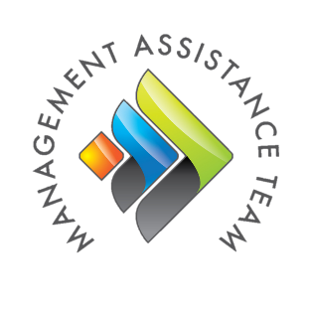
Introduction to
Wildlife Governance Principles:
Tools for Better Conservation
presented by Ann B. Forstchen
Florida Fish and Wildlife Conservation Commission
The Association of Fish and Wildlife Agencies’
Management Assistance Team
www.matteam.org | info@matteam.org | 304.876.7988
All photos FWC unless noted
Notes:
DON’T PUT YOUR PHONE ON HOLD
Hello, I’m Ann Forstchen, the Human Dimensions Coordinator for the Florida Fish and Wildlife Conservation Commission.
I’d like to acknowledge my partners in this work:
Dr. Dan Decker, Professor and Director of the Human Dimensions Research Unit at Cornell University
Chris Smith, Western Representative of the Wildlife Management Institute
Dr. Pat Lederle, Michigan Department of Natural Resources
Mike Schiavone, New York Department of Environmental Conservation
Meghan Baumer, Cornell University
I’d also like to acknowledge that partial funding for this work was provided by an AFWA Multi-State Conservation Grant and in large part from in-kind services provided by our home institutions.
I’d like to thank the entire AFWA’s Management Assistance Team and especially Mary Hughes for their assistance in hosting this webinar.

Slide 2
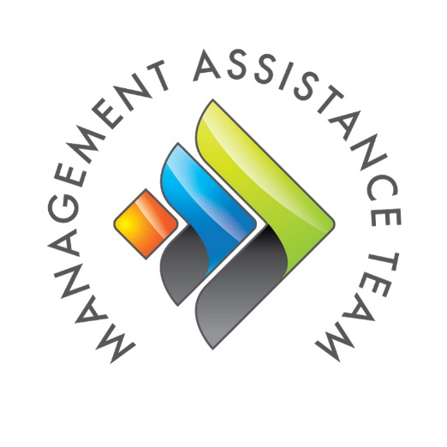
Who is MAT?
The Management Assistance Team (MAT) is a six-person, high-performing team that is part of the Association of Fish and Wildlife Agencies. Funded by a Multistate Conservation Grant, MAT’s offices are located at the National Conservation Training Center in Shepherdstown, West Virginia. Think of MAT as an internal training resource on retainer for all fifty state fish and wildlife agencies across the country.

Slide 3
Webinar Participation
Stay engaged!
Participated in polls and chats.
Enter questions and comments in the chat pod.
Use emoticons
Mute your phone.
Notes:
Reminder: don’t put your phone on hold- if you have to take a call, pleas hang up and dial back into the webinar.

Slide 4
Webinar Objectives
By the end of this webinar, you will be able to:
ID drivers of ecological and social changes affecting conservation
Describe Public Trust Thinking (PTT) and Good Governance (GG)
Define the ten Wildlife Governance Principles (WGPs) derived from PTT and GG
Describe how the WPGs can benefit your conservation organization

Slide 5
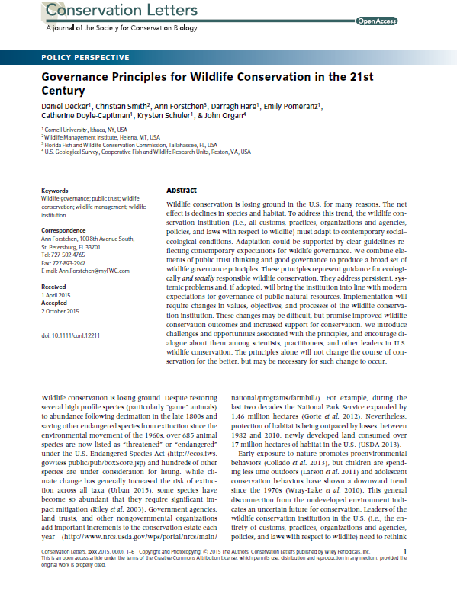
Wildlife Governance Principles
Proposed by Decker et al. (2016)
High-level guidance
Fulfill public trust obligations
Meet modern expectations of good governance
Result in conservation being:
Valued
Supported
Relevant
Notes:
This webinar focuses on the need for, and the development of a set of governance principles and implications for fish and wildlife agencies that apply them. The 10 principles, proposed in a Conservation Letters journal article published in January 2016, provide high level guidance for all organizations in the conservation institution, and in particular for state fish and wildlife management agencies to better fulfill their public trust obligations and meet modern expectation of good governance. We believe that adoption and consistent application of these principles will result in state fish and wildlife agencies being valued, supported and relevant. I’ll be providing some background on how these principles evolved over the past decade and the development of an assessment tool to explore agency alignment with the principles. While the focus of my remarks are on state fish and wildlife conservation agencies, these principles are applicable to federal agencies and other conservation organizations.

Slide 6
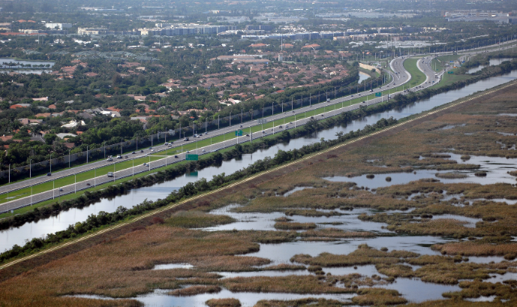
Drivers of fish and wildlife management change
Changing human demographics
Changing landscapes
Diversification of interests in natural resources
Socio-political pressures
Photo credit: SFWMD
Notes:
State agencies have a long and successful history of managing fish and wildlife and the habitats they depend on and for providing experiences that stakeholders desired. The agency structure, culture, and decision-making processes were well suited to understanding the needs and concerns of these stakeholders. However over the past 40 or 50 years the human population has grown, diversified and are distributed across and impacting the landscape in new and different ways.
Conservation agencies are realizing that people, in addition to their traditional user groups, are interested in a broader set of fish and wildlife species and management contexts. The national surveys sponsored by the US Fish and Wildlife Service since 1980 have repeatedly confirmed the magnitude of these nonconsumptive wildlife interests.
Peoples interactions with wildlife are changing and agencies need to better understand and manage these interactions. Many human-wildlife interactions are a positive and rewarding experience, but agencies are increasingly called upon to mitigate or reduce human wildlife conflicts and must develop strategies to help people put negative interactions in context so they don’t begin to perceive all wildlife as a nuisance, pests or dangerous.
As public agencies we also face a wide variety of dynamic social and political pressures.

Slide 7
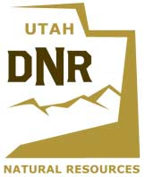
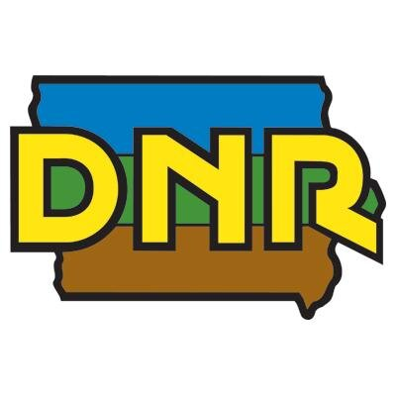
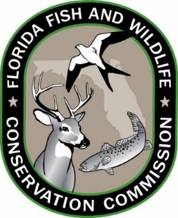
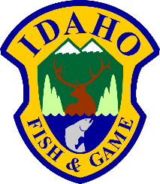
Drivers of fish and wildlife management change
Agency trust and credibility
Adequate resources to fulfill mission
Responsible public trust stewards
Public service delivery
Conflicting values and demands
Notes:
Additionally state conservation agencies must continually work to maintain their credibility and the trust of citizens. They must seek the needed resources to provide the programs and activities to manage and conserve fish, wildlife and their habitats and provide opportunities and access for people to use and enjoy fish and wildlife. They need to understand the range of values that people have for wildlife and manage the demands or conflicts that people have relative to fish and wildlife.

Slide 8
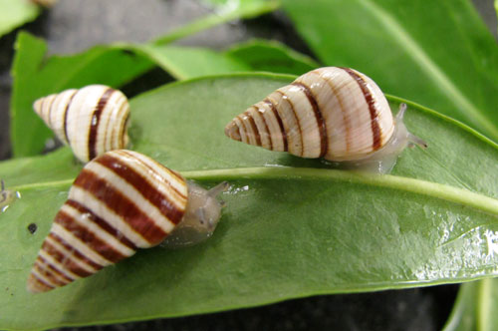
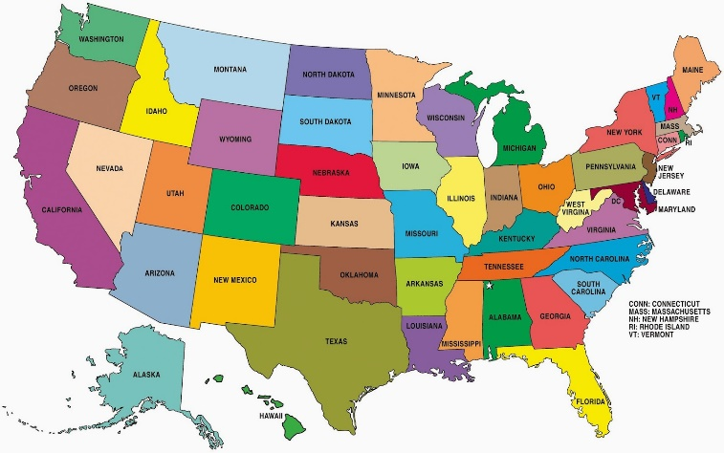
Agencies reaction to change?
Incremental and slow
Inconsistent across the country
Embraced in some states, resisted in others
Emergence of human dimensions of wildlife
Photo credit: Univ. Hawaii
Photo credit: toam.tk
Photo credit: Seton.com
Notes:
So how have state agencies reacted to these changes? In most cases, in a slow incremental manner. Change efforts may have been addressed at the work unit level but rarely at the agency level and are inconsistent or uncoordinated across the country. While we each work in unique social and political climates there are opportunities to collectively adapt to contemporary societal conditions and needs.
But there is some progress! One way that agencies are already using, albeit inconsistently, is gathering social science information from stakeholders and citizens about their attitudes, opinions and behaviors regarding fish and wildlife and our management of them. This insight informs agency decision and policy making that serves the needs of people and wildlife.

Slide 9
Response to Drivers
Resist and Retrench
Revise and Reform
Notes:
Agencies can respond to these drivers by resisting change and relying on known traditional practices and procedures that address only a subset of conservation needs or they can broaden their thinking and approaches to transform their programs and products to conserve all wildlife for all people.

Slide 10
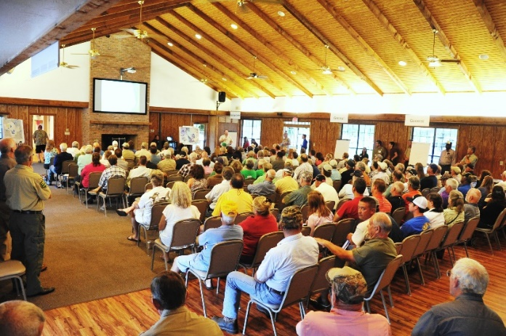
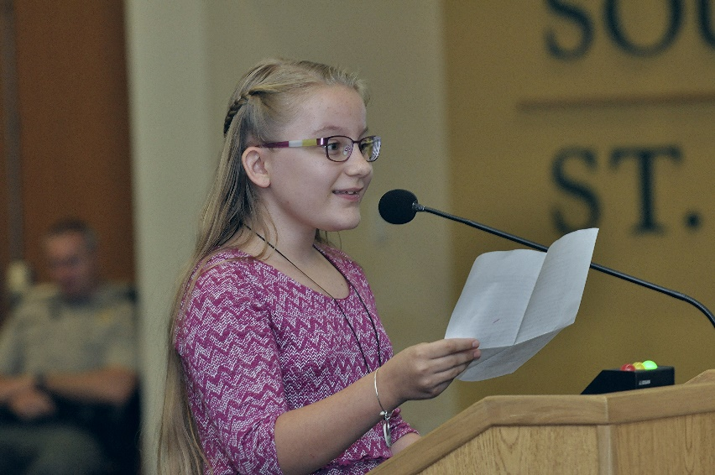
Change to what?
Narrow focus → All wildlife for all people
Static agencies priorities → adaptable agencies that meet modern challenges
Declining relevance → relevant, valued and supported
Notes:
There has been general agreement of the need for change, but perhaps the unasked question is Change to what? We believe the change needs to be from a narrow focus on traditional stakeholders and their interests to an approach that addresses needs for all species and all citizens. Agencies need to change from a culture of static priorities and legacy programs to adaptable organizations that can meet modern challenges. And we need to reverse our declining relevance and become recognized, valued and supported by society in general, not just by our current stakeholder groups.

Slide 11
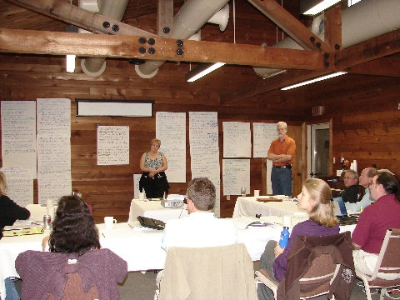
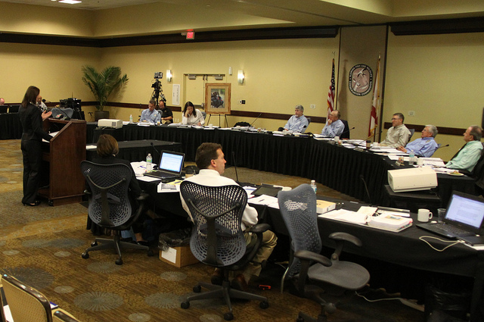
Capacity to Change
Willingness to consider new ideas and adapt
Readiness to improve and expand skills
Commitment of time and resources to implement and support improved practices
Notes:
A state agency needs to carefully consider its capacity to enact change. This includes a culture that is willing to consider new ideas or approaches and adapt to the changing needs of society. It also includes considering the agencies readiness to review, improve and expand staff skill sets, such as negotiation, conflict management, or social science inquiry and analysis. And perhaps most importantly, the agency needs to have the capacity to commit time and other resources to implement and support the new or improved practices and procedures.

Slide 12
Need for guidance
Public Trust mandate
Society’s expectations of agencies
Good governance norms
Stakeholders
Conservation Agency
From Decker et al. 1997, 2017
Increasing stakeholder participation
Notes:
Once the need for change is recognized and accepted, and the capacity and commitment for change has been determined, there may be a need for specific guidance on how to move forward. This guidance is provided by the public trust mandate – managing all fish and wildlife for all people, now and for future generations. And also from the need to understand and be responsive to the expectations of modern society – or in other words, the norms of good governance. Over the past half-century there has been a trend of increasing interest and public participation in public policy and decision-making. Transactional or collaborative decision-making, towards the right side of this graphic, tends to be better accepted by the public and more durable because they had a role in the process.

Slide 13
Public Trust Thinking & The Public Trust Doctrine
“By the law of nature these things are common to all mankind: the air, running water, the sea, and consequently the shores of the sea”
Public Trust Thinking
Philosophy
Public Trust Doctrine
Codified and Case Law
From The Justinian Institutes, AD 529
Notes:
For the last several years a group of public trust legal scholars, academics, and wildlife professionals have been exploring the ideas around public trust in the context of modern wildlife management in the US. What we term “public trust thinking” is a broader and older philosophical orientation towards natural resources rather than trying to apply the few strict legal public trust rulings to the breadth of fish and wildlife conservation.
So conceptually, public trust thinking is much broader and more applicable approach in fish and wildlife conservation than the more narrow public trust doctrine.

Slide 14
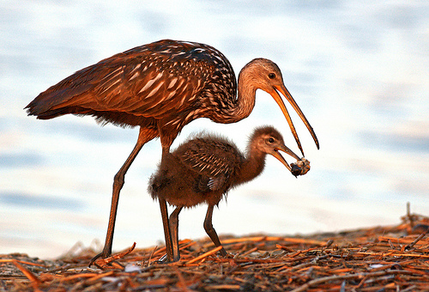
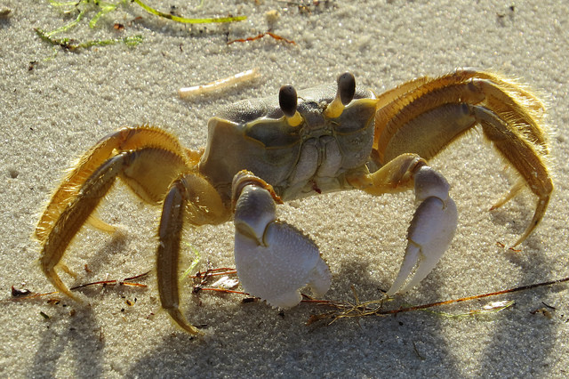
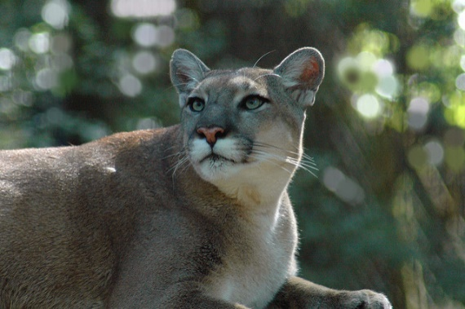
Public Trust Thinking
Fish and wildlife are …
Public resources, intergenerational inheritance
Certain resources are not suited for exclusive private ownership
Managed for the common good – all have rights to benefits
Notes:
14
Public trust thinking is a philosophy about the use and management of natural resources that applies concepts of trusteeship to frame human responsibilities to conserve natural resources. We believe they are common across time, space, and cultures.
Fish and wildlife are considered to be public resources and are an intergenerational inheritance. They are not suited for exclusive private ownership and are managed for the common good. All citizens have rights to the benefits provided by fish and wildlife and our management of them, which includes non-consumptive benefits such as wildlife viewing or just appreciating or valuing that fish and wildlife exist.

Slide 15
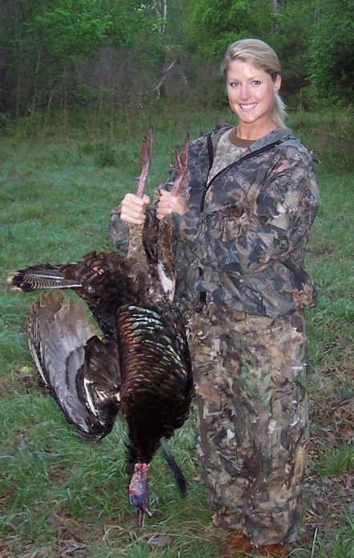
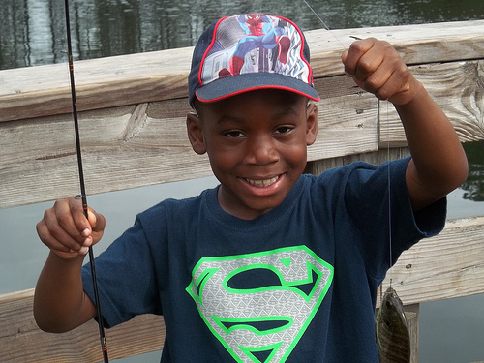
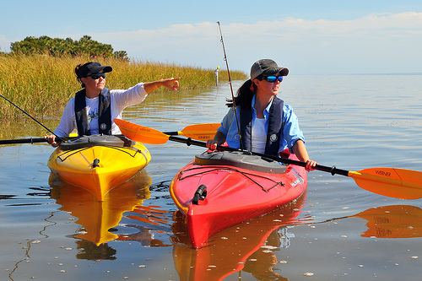
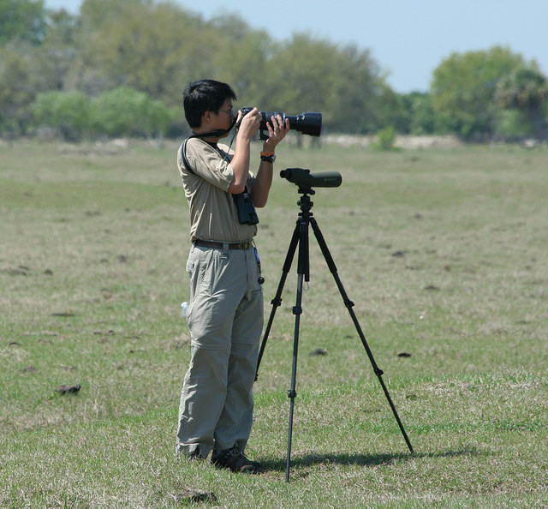
Public Trust Thinking
Fish and wildlife are …
Managed so no group is favored over another
Managed by gov’t on behalf of citizens
Citizens are entitled to hold leaders accountable to safeguard the public resources (fish and wildlife)
Notes:
15
Additionally, fish and wildlife are managed so that the interests of one stakeholder group are not favored over another.
Fish and wildlife are managed by government on behalf of all citizens now and in the future.
And citizens are entitled to hold fish and wildlife trustees and managers accountable to safeguard the trust assets

Slide 16
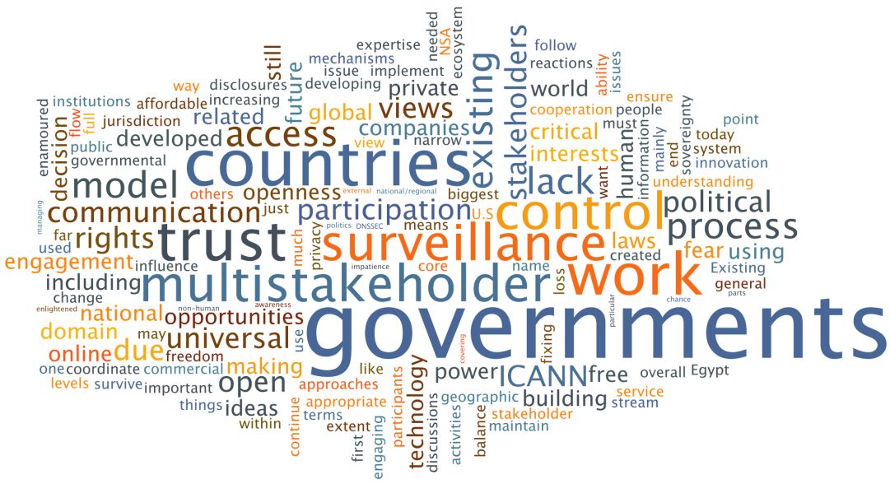
What is Governance?
From Weiss 2000
Notes:
We’re going to shift our focus from public trust thinking to governance . Please take 1-2 minutes to add your thoughts in the chat box about What does governance mean to you? You may need to minimize your screen to reveal the chat box by clicking on the small box with arrows in the upper right part of your screen.

Slide 17
What is Governance?
the processes and conventions through which decisions
are made and implemented by individuals and institutions
From Weiss 2000
Notes:
Governance is a term used to describe how government is conducted and the relationship between government and the governed.
To make sure we’re all on the same page, we use governance to describe the processes and practices that are used to make decisions, and how those decisions are implemented.

Slide 18
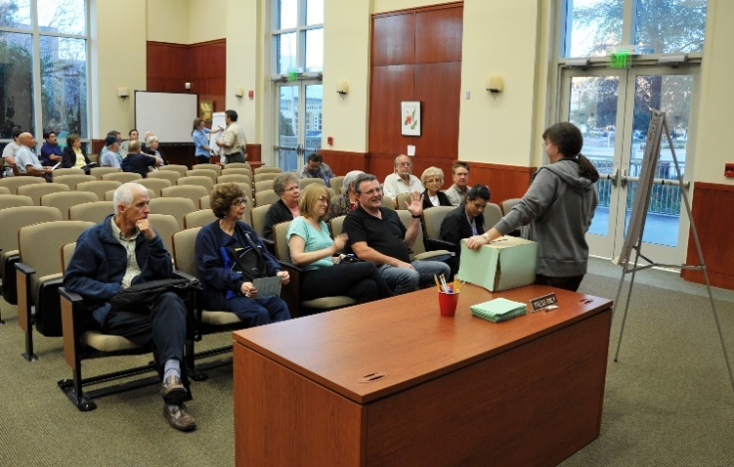
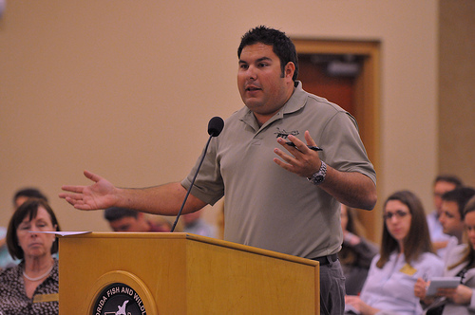
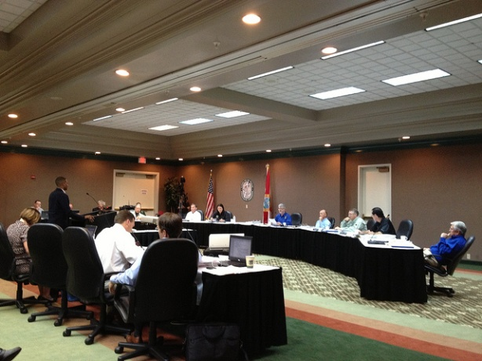
Good Governance
Transparency and accountability
Equity and inclusiveness
Efficiency and effectiveness
Responsiveness
Participation
Notes:
“Good” governance is a more modern development than public trust and reflects the expectations of citizens in Western democracies.
It includes practices that provide for transparency and accountability and result in equitable allocation of trust benefits and inclusion of diverse voices in the decision making process.
Good governance practices also help organizations be more efficient and effective and be more responsive to citizens as well as increasing the participation of citizens in the decision process.
Good governance is future-looking, strategic, and considers cultural and social conditions.
Good governance means that we reach out to citizens, engage them individually and in small discussions on a frequent and regular basis, in addition to our traditional practices of inviting public comment at our board or commission meetings. These all to inform decision-making by the trustees.

Slide 19
Public Trust Thinking
Good Governance
Wildlife Governance Principles
Notes:
The development of the wildlife governance principles has been in the making for quite a while. There has been a large group of folks that have contributed to our thinking on these topics over the past decade or so - from academics, legal scholars and wildlife professionals in the public and private sectors. We broadened our thinking about the Public Trust Doctrine into Public Trust Thinking and explored the concepts of good governance and how they are practiced in fish and wildlife management. We drafted a set of principles, tested them with a multi-disciplinary group of fish, wildlife and habitat professionals and then refined them into a set of 10 principles.

Slide 20
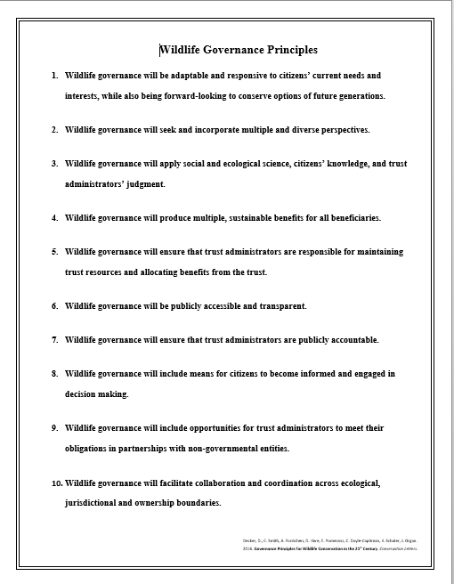
10 Principles
Notes:
The principles are high-level but provide specific guidance to help conservation organizations fulfill their public trust mandate and meet the expectations of modern society. I’ll go through each principle briefly.

Slide 21
Principle 1
Governance will be adaptable and responsive to citizens’ current needs and interests, while also being forward-looking to conserve options of future generations.
Notes:
This first principle is about considering and being responsive to all beneficiaries and not just our traditional stakeholders or the most vocal stakeholders. But it also includes that we need to make sure future generations have the same opportunity to use and enjoy fish and wildlife as we do.

Slide 22
Principle 2
Governance will seek and incorporate multiple and diverse perspectives.
Notes:
This is about us actively seeking out, listening, and responding to different perspectives and incorporating those voices in our policy and decision-making processes.
This is one principle that doesn’t require broad scale investment to accomplish. This can be done at a small scale and at any level – just by you making a decision to reach out and engage with more people than you normally talk to about a conservation issue.

Slide 23
Principle 3
Governance will apply social and ecological science, citizens’ knowledge, and trust administrators’ judgment.
Notes:
This principle is about using science to inform decisions. Remember ecological science alone doesn’t give us the answer to a conservation issue – it informs the decision-makers- the trustees and contributes to the decision-making process.
Note the emphasis on using more than just ecological science information but also taking advantage of citizen’s first-hand insight and knowledge, and using agency staff and trustees expertise, wisdom and judgement in decision-making.
And our reference to social science is that is includes qualitative and quantitative inquiry and research from many disciplines with the same rigor and credibility as information we expect from the ecological sciences.

Slide 24
Principle 4
Governance will produce multiple, sustainable benefits for all beneficiaries.
Notes:
This is about providing many benefits – both tangible and intangible – for current and future generations. By benefits we mean those opportunities or experiences that fish and wildlife and their habitats provide and the values surrounding those.

Slide 25
Principle 5
Governance will ensure that trust administrators are responsible for maintaining trust resources and allocating benefits from the trust.
Notes:
This is about the trust administrators (who are the agency staff and the trustees) being held responsible by citizens for balancing the need to provide benefits from fish and wildlife to current citizens while ensuring that fish and wildlife persist into the future for future generations to enjoy.
Allocation of these benefits means that all citizens are given fair consideration to their needs but they may not be allocated equally- and they may not, in some cases, be allocated at all – such as for no harvest of imperiled species.

Slide 26
Principle 6
Governance will be publicly accessible and transparent.
Notes:
This principle is about being open and transparent – especially when it comes to policy setting and decision making.

Slide 27
Principle 7
Governance will ensure that trust administrators are publicly accountable.
Notes:
Trust administrators are both the agency staff and the trustees. This principle is about making sure there are appropriate and accessible mechanisms in place for citizens to hold agency staff and the trustees accountable.

Slide 28
Principle 8
Governance will include means for citizens to become informed and engaged in decision making.
Notes:
This principle is about providing opportunities for all citizens to learn about fish and wildlife and the benefits they provide to people and providing inviting accessible ways for citizens to get engaged in our decision-making processes- letting us know about their concerns and needs relative to fish and wildlife.

Slide 29
Principle 9
Governance will include opportunities for trust administrators to meet their obligations in partnerships with non-governmental entities.
Notes:
This principle recognizes that we can’t do it all by ourselves - This is about making sure that we partner with others in the conservation community- especially with non-governmental organizations.

Slide 30
Principle 10
Governance will facilitate collaboration and coordination across ecological, jurisdictional and ownership boundaries.
Notes:
Wildlife don’t care about who owns the land or about crossing social boundaries – so we should follow their lead and work collaboratively across ecological, jurisdictional and ownership boundaries.

Slide 31
Benefits of applying WGPs?
Notes:
How you envision these principals might benefit your SFWA? What value might your SFWA gain from adopting the WGPs?
THIS IS AN INTERACTIVE PIECE WHERE PARTICIPANTS CAN “WRITE” ON THE SLIDE.

Slide 32
Benefits of Applying WGPs
Expanded quality and quantity of fish and wildlife maintained
Increased engagement with diverse stakeholders
Diversity of sources of information are used in decision-making
Improved partnerships in conservation
Notes:
We believe application of the wildlife governance principles will improve conservation outcomes, and increase our interactions with more and a more diverse set of stakeholders. It will become routine to use a wide variety of types of information and insight in our decision-making processes and will increase and improve our partnerships in support of conservation.

Slide 33
Benefits of Applying WGPs
Increased collaboration across jurisdictions
Increased agency transparency, accountability, trust and credibility
Benefits provided to all beneficiaries, both current and future
Improved practices, procedures and programs
Notes:
Additionally, we believe that application of the wildlife governance principles will increase collaboration across jurisdictions and increase agency transparency, accountability and credibility- leading to increased trust in the agency.
Application of the principles will ensure that benefits from the wildlife trust are provided to all beneficiaries- now and in the future
And we believe that the application of the principles will result in improved practices, procedures and programs which will ultimately result in improved conservation outcomes.

Slide 34
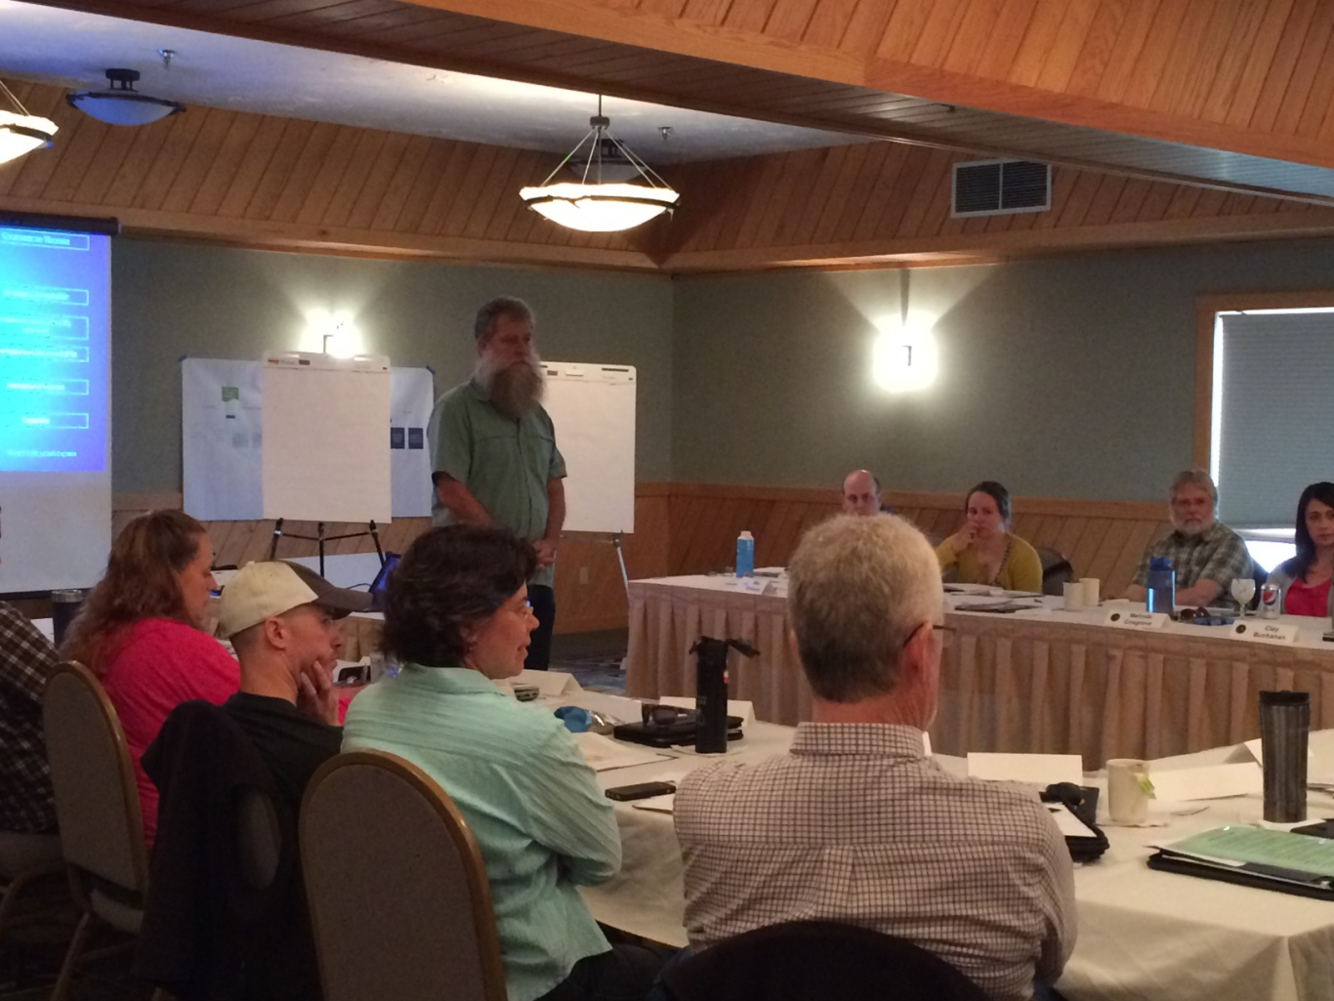
Applying WGPs
One size does not fit all
Agency structure
Agency capacity for change
Socio-political pressure
Diversity of f/w interests
Diversity of citizens
Changing landscapes
Notes:
There is no one recipe for how an agency can or should apply the principles. Every organization works in it’s own socio-political environment. Each organization has it’s unique structure, culture and capacity for change. There is a wide range of fish and wildlife interests and all of these impact how the principles might be applied. There may be some principles that may need more attention than others, but there is always room for improvement for each of them.

Slide 35
Notes:
So in conclusion, we think the wildlife management institution urgently needs to adopt a more effective, strategic approach to address contemporary social values relative to wildlife and changes in land use and ecological conditions. Such an approach must be grounded on principles that encompass roles and responsibilities of all players in the wildlife conservation institution: elected and appointed officials, conservation professionals in government, and non-government entities, and all citizens.
The set of 10 wildlife governance principles are specific enough to give general guidance, and general enough to accommodate the wide variability of specific state level conditions and capacity. They are not prescriptive but provide broad guidance for conservation of all species for all citizens. We believe this approach will help state fish and wildlife agencies specifically and the institution in general be more adaptable and relevant.

Slide 36
Translating WGPs into Action
Research articles about public trust, good governance and wildlife governance principles
Conduct an agency WGP assessment and workshop
Join the WGP Community of Practice
https://blogs.cornell.edu/publictrustpractice/
Notes:
How are the wildlife governance principles actually put into action? What have states already done? As we developed the principles, we also thought about how might a state agency operationalize these principles. We crafted a set of characteristics that would need to exist if the principle was being applied and developed an assessment tool, a survey instrument, that staff in an agency take to assess how well their agency characteristics aligned with the principles. We also designed a workshop for agencies to evaluate and discuss the results of the assessment and help them prioritize what actions to address to improve their practices and procedures.

Slide 37
WGP Assessment Tool
PURPOSE
Assess alignment with WGPs
Inform discussion among workshop group
Identify potential areas for improvement
THEMES
Strategic thinking and organizational adaptability
Evidence-based and broadly informed decision making
Transparency and accountability for decisions and actions
Inclusiveness and diversity
Capacity for conservation
https://blogs.cornell.edu/publictrustpractice/
Notes:
The assessment tool, a survey, is taken by selected agency staff prior to an agency assessment workshop. You really can’t do one without the other. The tool is administered by Cornell University on a Qualtrics platform. It takes about 30 minutes to complete the assessment which is framed around the agencies traits and practices that are categorized into 5 major themes.
A report on the assessment results is prepared by Cornell University staff and is the basis for a in-person workshop designed to discuss the results, understand the reasons behind the results and identify potential areas for improvement.

Slide 38
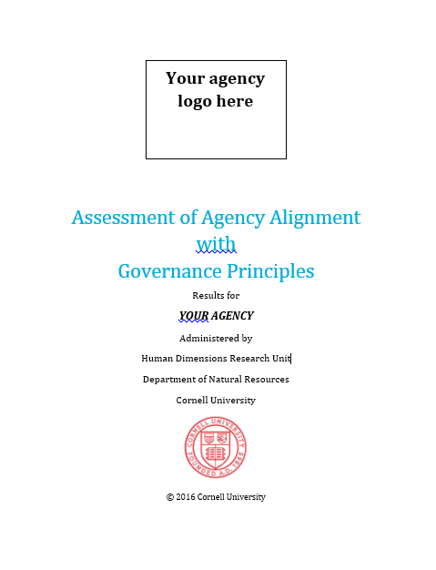
Interested in learning how to apply WGPs?
Alignment to Wildlife
Governance Principles
The pre-recorded webinar will be available after 3:00 pm ET March 28th
WGP Agency Assessment
Training (4)
May and August 2017
https://blogs.cornell.edu/publictrustpractice/
Notes:
4 states have used the wildlife governance principles assessment tool to assess how their agency traits and practices were aligned with the principles. We facilitated workshops in Florida, Michigan, Montana and New York in 2016 and helped them work through and understand the results of the assessment. We also worked with them to prioritize which practices needed the most attention and create a list of actions that would move improve those practices. Our small group doesn’t have the resources to visit every state, so we are providing a 2nd free webinar that will be available on demand after 3:00pm on March 28 to help folks who are interested in applying WGPs in their state, understand how the assessment tool works, how to interpret the results and how to use the results in a workshop setting. From there we are offering 4 regional workshops to train interested staff on how to conduct the assessment tool and how to design and implement their own state based workshop.

Slide 39
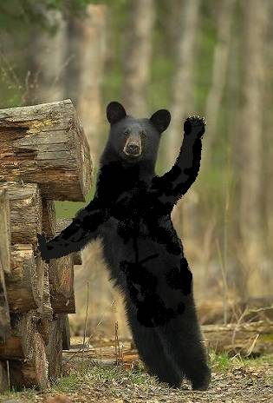
Wrap-Up
Questions?
Comments?
Thank you!
Photo credit: FWC
https://blogs.cornell.edu/publictrustpractice/
Notes:
This webinar has been recorded and will be available for free, on-demand, from the Management Assistance Team website as well as on the website listed on this slide.

Slide 40
More Resources and Contact Info @
https://blogs.cornell.edu/publictrustpractice/
Ann Forstchen Ann.Forstchen@myFWC.com
Chris Smith csmithwmi@msn.com
Notes:
If you would like to learn more about public trust thinking, good governance and the wildlife governance principles, please check out this website for more resources
Remember to view the 2nd free webinar after 3:00pm ET March 28th . We will send you a link to that webinar.
And to learn how to conduct Wildlife Governance Principles assessment workshop for your agency, please plan to attend one of the 4 regional training workshops. Visit the website or contact myself or Chris Smith.
Thank you!

